Slide 1
An Introduction To Pharmacoepidemiology
Dr. Furqan K. Hashmi
Assistant Professor
Punjab University College of Pharmacy

Slide 2
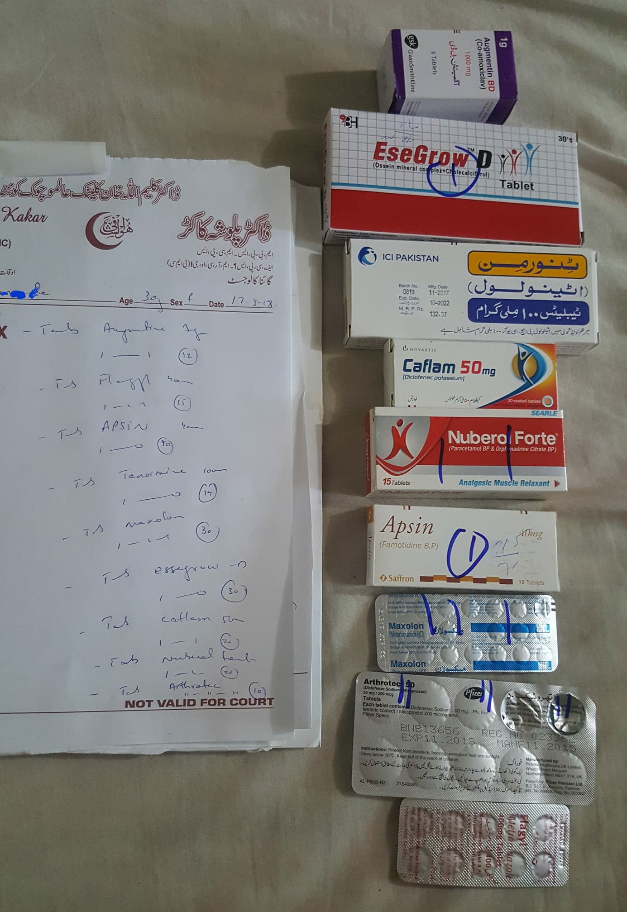

Slide 3
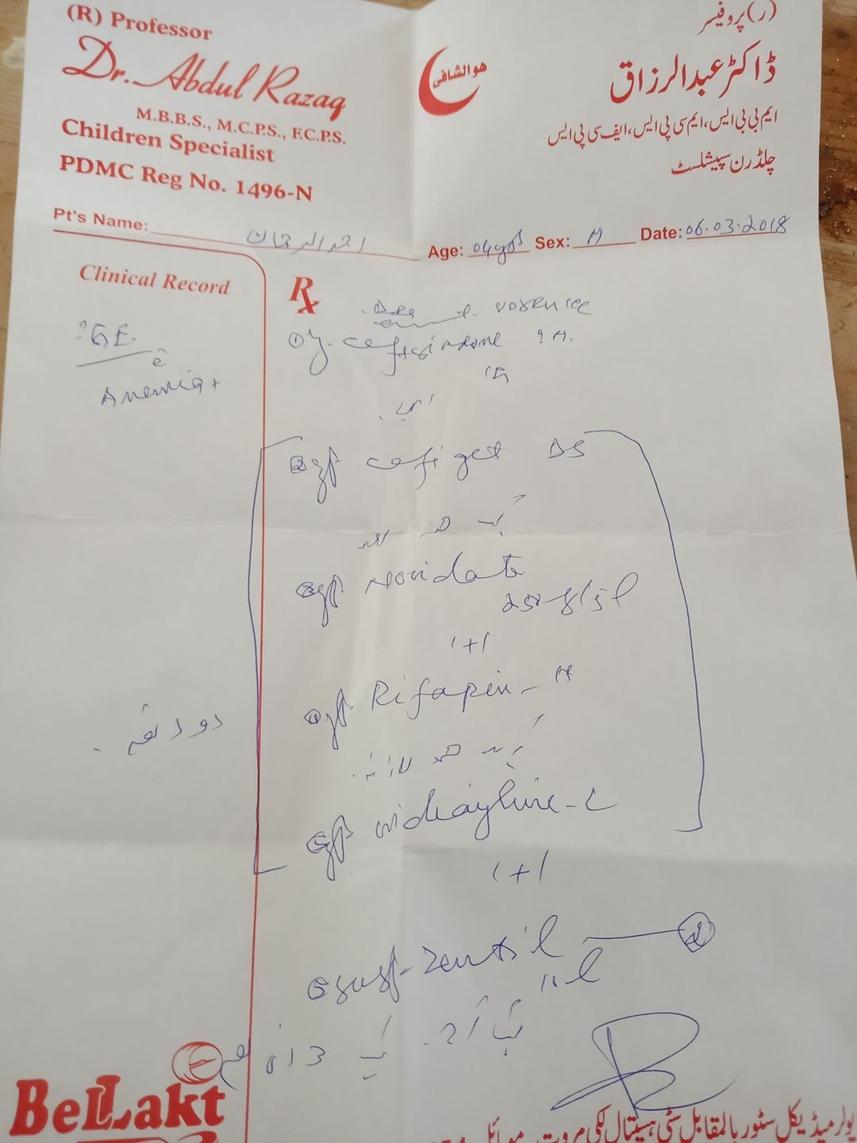

Slide 4
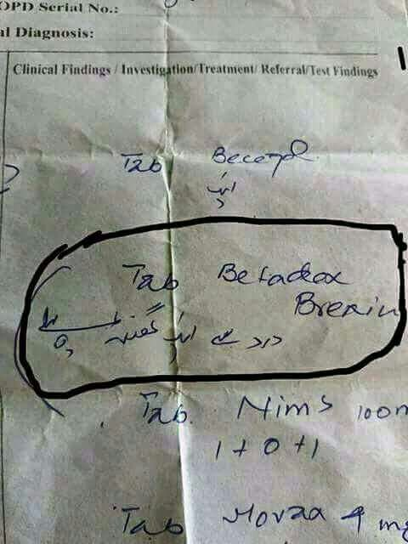

Slide 5
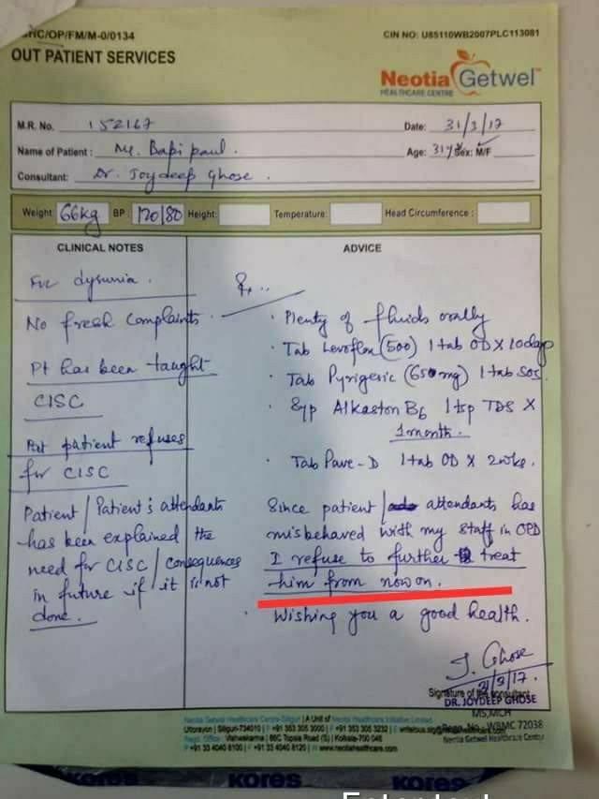

Slide 6
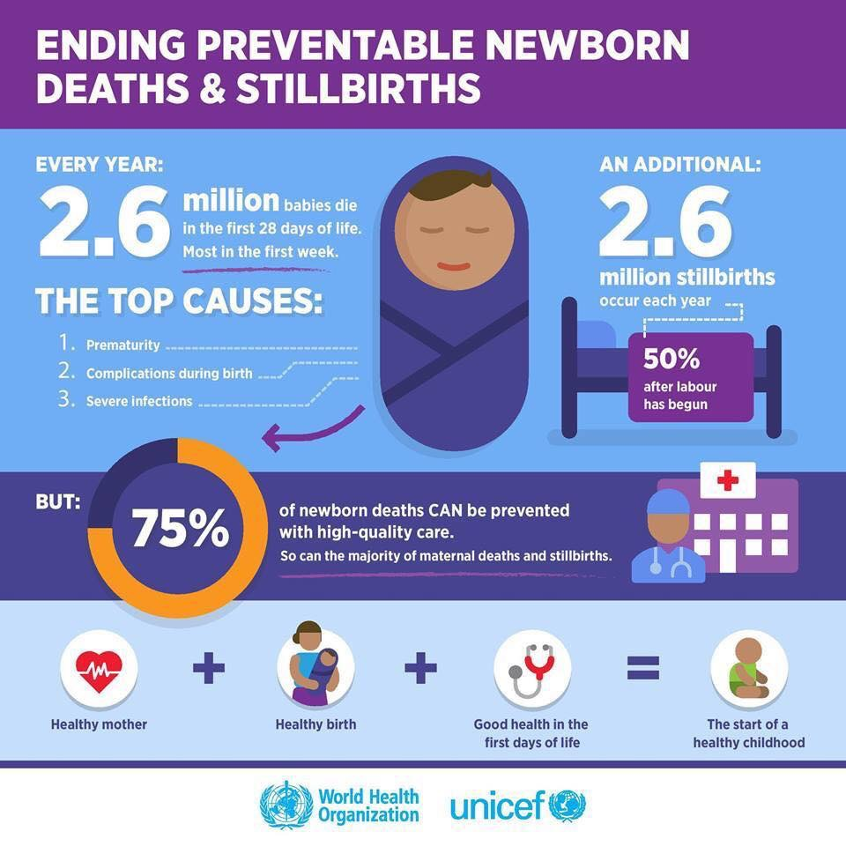

Slide 7
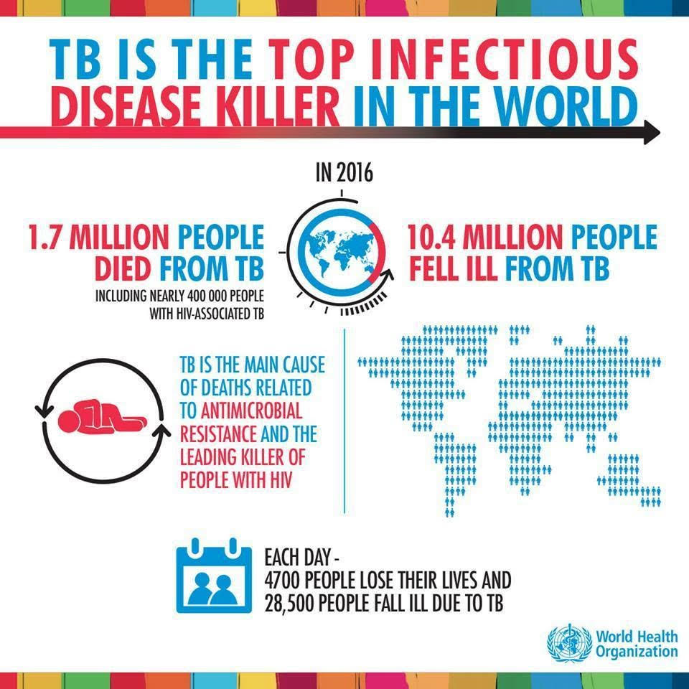

Slide 8
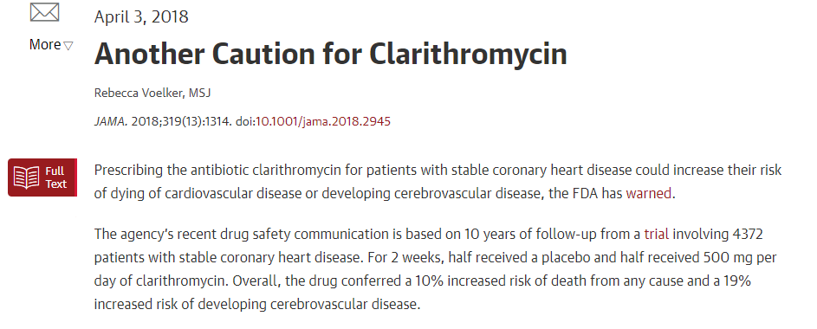

Slide 9
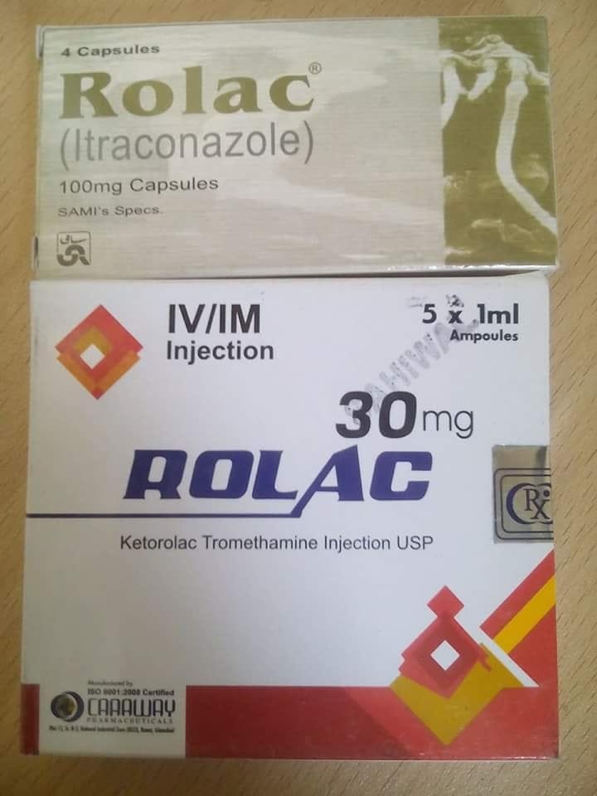

Slide 10
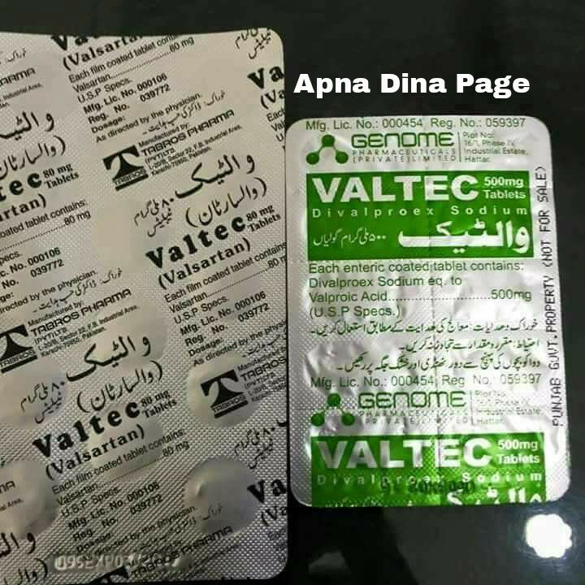

Slide 11
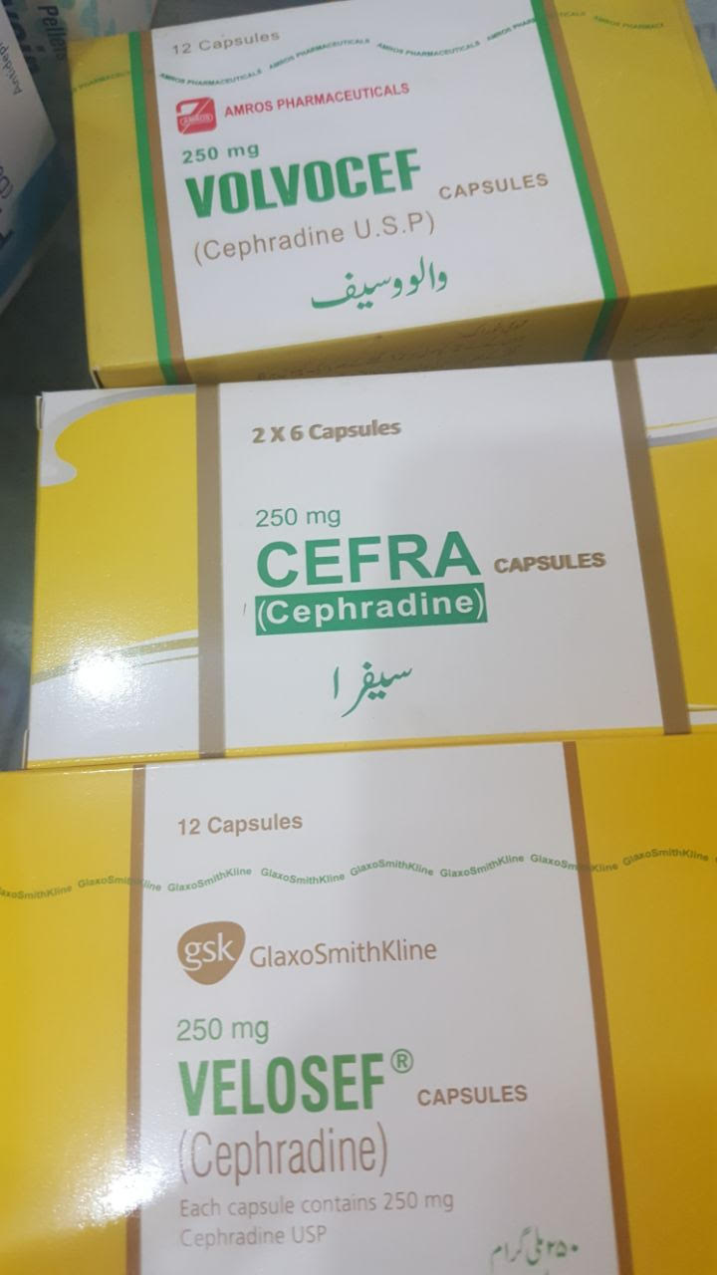

Slide 12

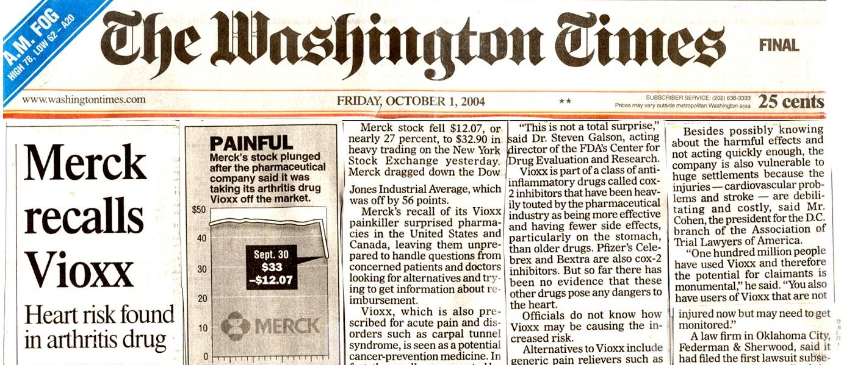

Slide 13
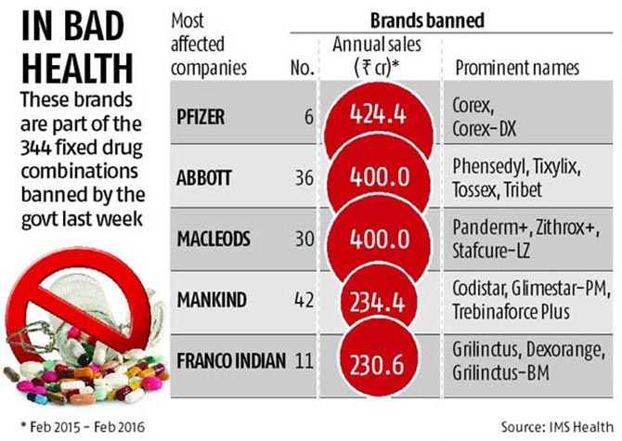

Slide 14
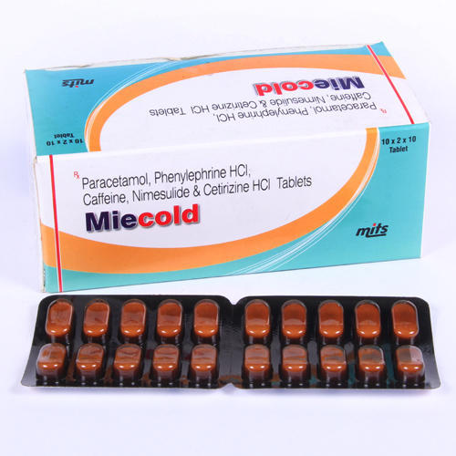
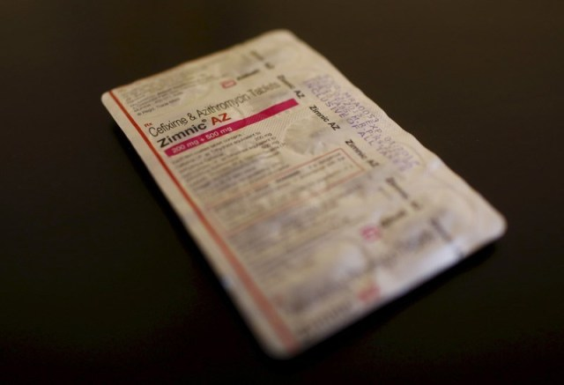

Slide 15
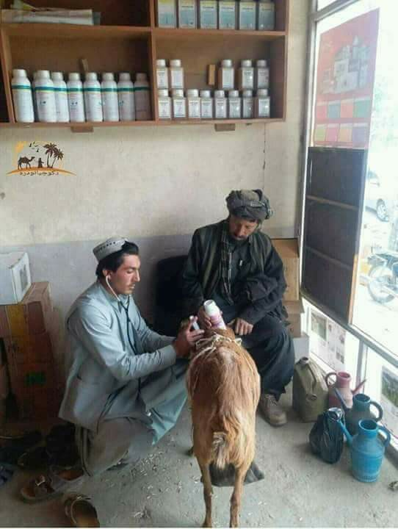

Slide 16
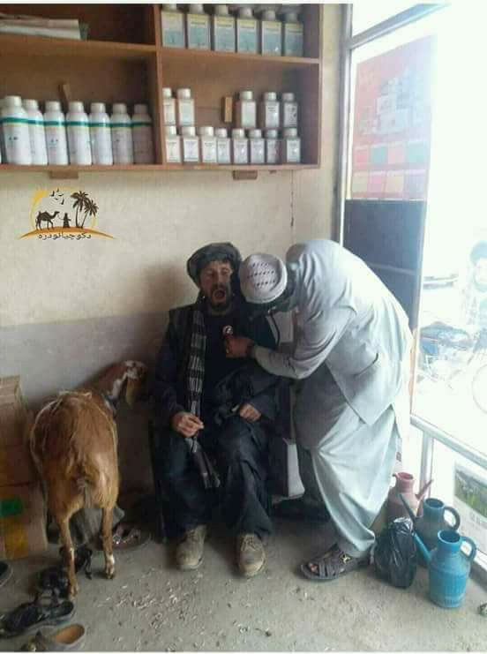

Slide 17


Slide 18
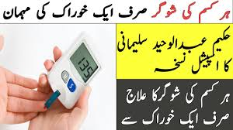

Slide 19
Definition
Pharmacoepidemiology is the study of the use of and the effects of medicines in large numbers of people.
New applied field bridging between clinical pharmacology and epidemiology.
Pharmacoepidemiology started with increasingly frequent accusations about adverse drug reactions, often arising out of spontaneous reporting system, followed by formal studies proving or disproving those associations.

Slide 20
Potential Contributions Of Pharmacoepidemiology
Information which supplements the information available from premarketing studies—better quantization of the incidence of known adverse and beneficial effects
Higher precision (e.g.. Digoxin)
In patients not studied prior to marketing, e.g. the elderly, children, pregnant women
As modified by other drugs and other illnesses (eg. Timolol)
Relative to other drugs used for the same indication

Slide 21
Potential Contributions Of Pharmacoepidemiology
New types of information not available from premarketing studies
(1) Discovery of previously undetected adverse and beneficial effects, uncommon effects, delayed effects
(2) Patterns of drug utilization
(3) The effects of drug overdoses
(4) The economic implications of drug use

Slide 22
Pharmacoepidemiology
One of the most pressing problems facing public health providers and administrators in many countries is ensuring the rational use of drugs.
In recent years, the term rational itself has gone through drastic changes:
Rational use…………. Quality use…………. Responsible us

Slide 23
Pharmacoepidemiology
In practice, success of treatment largely depends on the ability of a physician to diagnose, prescribe, foresee probable adverse reactions and prevent unnecessary or dangerous duplication therapy.
Further success depends on performance of the pharmacy and nursing departments in preparing and administering drugs.
However, the existence of a rationally derived list of drugs approved for procurement and health care consultants performance does not ensure that they are prescribed and used correctly.
One mechanism to ensure correct prescribing and use is the drug utilization evaluation (DUE)/ Drug Utilization Review.

Slide 24

Responsible Use Of Medicines

Slide 25
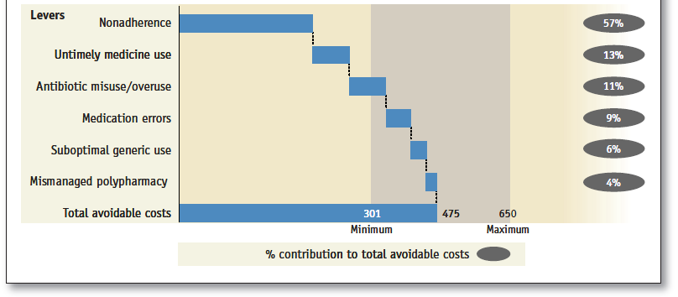
Responsible Use Of Medicines
About $ 500 Billion can be avoided through better responsible medicine use, worldwide.

Slide 26
Responsible Use Of Medicines
The term ‘responsible use of medicines (RUM)’ implies that the activities, capabilities, and existing resources of health system stakeholders are aligned to ensure patients receive the right medicines at the right time, use them appropriately, and benefit from them.
The concept of RUM incorporates the importance of stakeholder responsibility and recognizes the challenge of finite resources.
RUM is essential to avoid or reduce avoidable adverse events, worse quality of life, and inferior health outcomes.
RUM is essential to contain the escalating pharmaceutical expenditure.

Slide 27
DUE/DUR
DUE is an ongoing, systematic process designed to maintain the appropriate and effective use of medicines.
It involves a comprehensive review of patients' prescription and medication data before, during, and after dispensing in order to assure appropriate therapeutic decision making and positive patient outcomes.

Slide 28


Slide 29
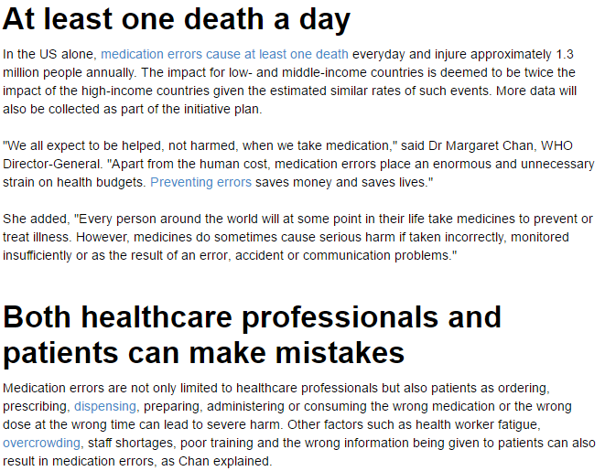

Slide 30
DUE/DUR
Pharmacists participating in DUE programs can directly improve the quality of care for patients, individually and as populations, by preventing the use of unnecessary or inappropriate drug therapy and by preventing adverse drug reactions.
The process of DUE goes by many names. In certain settings, it may be referred to as drug utilization review (DUR). At one time, a distinction was drawn between DUE and DUR based on the notion that the former was prospective and the latter retrospective. However, most experts agree that there is little difference between the two and favor use of the term DUE.

Slide 31
DUE/DUR
DUE is defined as an authorized, structured, ongoing review of practitioner prescribing, pharmacist dispensing, and patient use of medications.
The purpose of a DUE is to ensure that drugs are used appropriately, safely, and effectively to improve patient health status.
DUE is typically classified in three different categories: prospective, concurrent, and retrospective

Slide 32
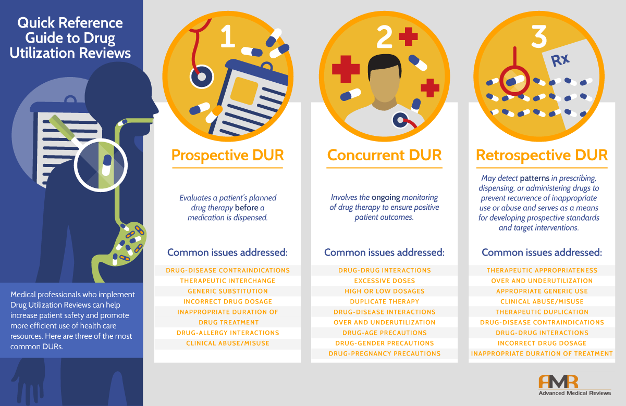

Slide 33
Prospective DUE/DUR
Prospective review involves evaluating a patient's planned drug therapy before a medication is dispensed.
This process allows the pharmacist to identify and resolve problems before the patient has received the medication.
Pharmacists routinely perform prospective reviews in their daily practice by assessing a prescription medication's dosage and directions and reviewing patient information for possible drug interactions or duplicate therapy.

Slide 34
Issues Commonly Addressed by Prospective DUE
Drug-disease contraindications
Therapeutic interchange
Generic substitution
Incorrect drug dosage
Inappropriate duration of drug treatment
Drug-allergy interactions
Clinical abuse/misuse

Slide 35
Concurrent DUE
Concurrent review is performed during the course of treatment and involves the ongoing monitoring of drug therapy to ensure positive patient outcomes.
Some refer to this as case management or health management. It presents pharmacists with the opportunity to alert prescribers to potential problems and to intervene in areas such as drug-drug interactions, duplicate therapy, over or underutilization, and excessive or insufficient dosing.
This type of review allows therapy for a patient to be altered if necessary.

Slide 36
Issues Commonly Addressed By Concurrent DUE
Drug-drug interactions
Excessive doses (High or low dosages)
Duplicate therapy
Drug-disease interactions
Over and underutilization
Drug-age precautions
Drug-gender precautions
Drug-pregnancy precautions

Slide 37
Retrospective DUE
A retrospective DUE is the simplest to perform since drug therapy is reviewed after the patient has received the medication.
A retrospective review may detect patterns in prescribing, dispensing, or administering drugs to prevent recurrence of inappropriate use or abuse and serves as a means for developing prospective standards and target interventions.
In retrospective DUE, patient medical charts or computerized records are screened to determine whether the drug therapy met approved criteria and aids prescribers in improving care for their patients, individually and within groups of patients, such as those with diabetes, asthma, or high blood pressure.

Slide 38
Issues Commonly Addressed by Retrospective DUE
Therapeutic appropriateness
Over and underutilization (Appropriate generic use)
Therapeutic duplication
Drug-disease contraindications
Drug-drug interactions
Incorrect drug dosage
Inappropriate duration of treatment
Clinical abuse/misuse

Slide 39
Steps In Conducting A Drug Use Evaluation
Identify or Determine Optimal Use - Criteria are defined to allow for comparisons of optimal use with actual use. Criteria should focus on relevant outcomes. For example, if the use of a drug prescribed to treat a patient with diabetes is being evaluated, then set standards should be determined to evaluate its effectiveness, such as a decrease in blood glucose or HbA1c (glycosylated hemoglobin) levels.
Measure Actual Use - This step is where data is gathered to measure the actual use of medications. This data can be obtained from medical and prescription records or electronic claim forms.

Slide 40
Steps In Conducting A Drug Use Evaluation
Compare - This involves the comparison between optimal or appropriate and actual use. During this process, the evaluator determines whether findings are expected and causes for any discrepancies. In this process, patterns or aberrations can be interpreted.
Intervene - This is the step where corrective action is implemented. Action should be targeted to areas of concern such as prescribing patterns, medication misadventures, the quality of drug therapy, or economic consideration.
Evaluate the DUE Program - The last step is to assess the effectiveness of the DUE program. Efforts should be made to evaluate the outcomes and document reasons for positive and negative results. Implementing appropriate changes to the DUE program and continued observation should be undertaken

Slide 41
Value of DUE Programs
DUE programs play a key role in helping a health organization to understand, interpret, and improve the prescribing, administration, and use of medications. This is often accomplished by using DUE programs to provide physicians with feedback on their performance and prescribing behaviors as compared to pre-set criteria or treatment protocols.
DUE information also allows physicians to compare their approach to treating certain diseases with their peers. The "peer pressure" generated by these comparisons is useful in stimulating physicians to change their prescribing habits in an effort to improve care.
DUE information also assists health policy makers in designing educational programs that improve rational prescribing, formulary compliance, and patient compliance.

Slide 42
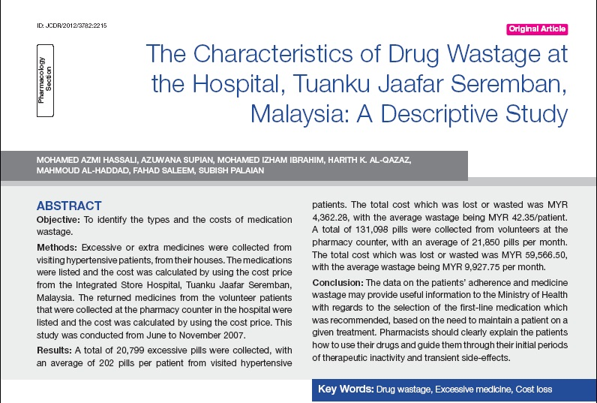
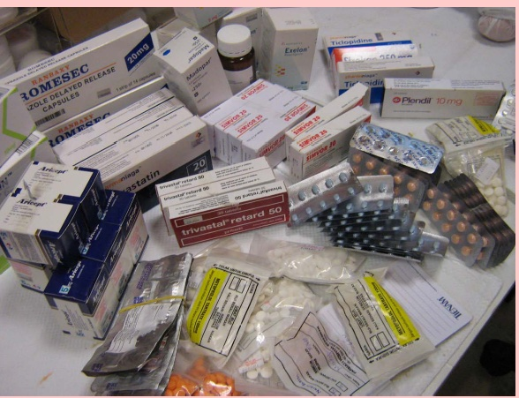
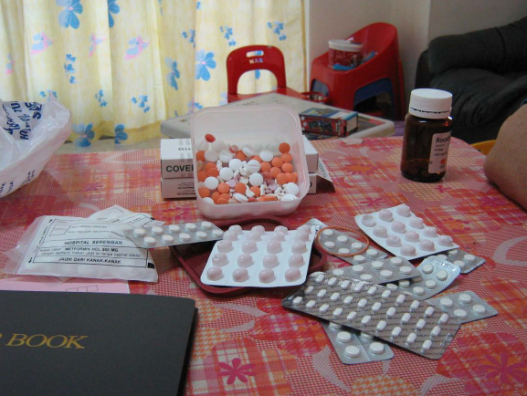
Role of the Pharmacist In DUE
Home visit by hospital pharmacists identified the total cost of collected excessive medications from 103 patients’ house was RM 4,869.91(USD1623) with average cost RM 47.28 (USD15.76) per patient

Slide 43
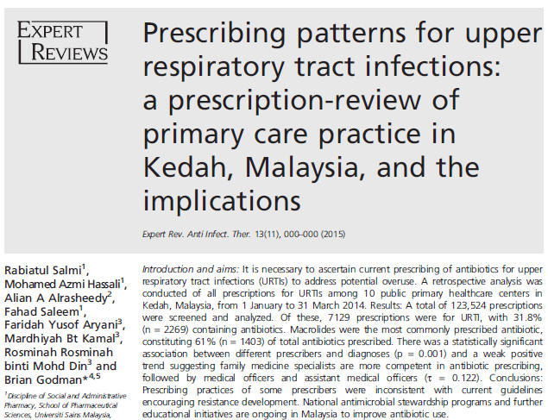

Slide 44
Conclusion
Using DUE information, pharmacists can identify prescribing trends in patient populations and initiate corrective action to improve drug therapy for groups of patients, as well as individuals.
As the variety of health care professionals (pharmacists, physicians, nurses, optometrists) involved in the medication use process expands, DUE will require a more multidisciplinary approach to improving patient care.
This will lead to the next logical step, the evolution of DUE into a more comprehensive "healthcare utilization evaluation."

Slide 45
Thank you

