Slide 1
Immunity is derived from Latin word “immunis” which means “free from burden”. In this case burden refers to disease caused by microorganisms or their toxic products.
Therefore Immunity is defined as “The state of resistance or insusceptibility to disease caused by particular microorganisms or their toxic products”.
OR
“Protective resistance against disease is called immunity”.
For example some individuals having genetic deficiency of glucose-6-phosphate dehydrogenase are resistant to malaria. Such individuals are said to be immune to Plasmodium.

Slide 2
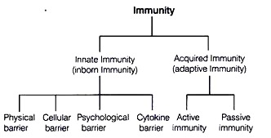
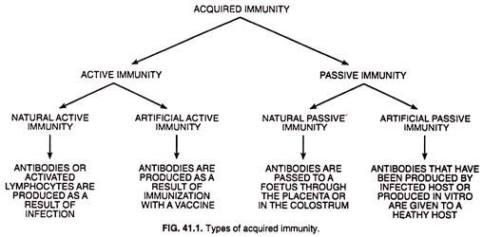
Types of immunity:
Broadly there are two types
of immunity.
Innate immunity
or Non specific
Acquired immunity
or Specific

Slide 3
Innate or Natural immunity:
Immunity with which an individual is born is called innate or natural immunity.
Innate immunity is provided by various components such as Skin, mucus membrane, phagocytic cells etc.
Innate immunity acts as first line of defense to particular microorganisms.
Mechanism of innate immunity:
Anatomical barrier
Physicochemical barrier
Phagocytic barrier or Phagocytosis
Inflammatory barrier or Inflammation

Slide 4
Types of innate immunity:
Species immunity
Racial immunity
Individual immunity
1. Species immunity:
If one specie is resistant to certain infection and the other specie is susceptible to the same infection then it is called as species immunity.
Anatomic, physiological and metabolic differences between species determine species immunity.
For example, Birds are resistant to anthrax but Human are susceptible. It is simply because higher body temperature of birds kills Bacillus anthracis.
Anatomic differences between species also determine species immunity. For example, Human are more susceptible to skin infection whereas Cattles are more resistant to the same skin infection. It is because of tough and hairy skin (hides) of Cattles.

Slide 5
2. Racial immunity:
If one race is susceptible while other race is resistant to same infection, then it is called Racial immunity.
For examples; certain African races are more resistant to malaria and yellow fever whereas Asian or Americans are susceptible to same infection. Similarly Orientals (East Asia) are relatively resistant to syphilis.
Racial immunity is determined by difference in Socio-economic status, habitat, culture feeding habits, environments, genetics, etc.
3. Individual immunity:
If one individual of certain race or cast is resistant while other individuals of the same race or cast is susceptible to certain infection, then it is called as individual immunity
Individual immunity is determined by various factors such as health status, nutritional status, previous illness, personal hygiene, genetic differences etc.
For examples; Individual with genetic deficiency of glucose-6 phosphate dehydrogenase are resistant to Malaria.
Notes:
As G6PD deficiency leads to increased oxidative stress in red blood cells, this may in turn have a negative influence on the parasite.

Slide 6
Anatomical barriers provide immunity by the following ways.
At first skin and mucus membrane prevent entry of microorganism into host body by mechanical separation.
For example, Skin surrounds the host body from external environment and mucus membrane surrounds the body tracts.
They also have mechanism to kill the pathogen before entry to body.
For example; lysozyme, acidic pH, sebum, high salt concentration in sweat are antimicrobial agents found in skin and mucus membrane.
Skin and mucus membrane provides first line of defense against microorganism as they are first component to encounter with microorganism.

Slide 7
Anatomical barriers
Skin and mucus membrane are the examples of anatomical barriers that provides immunity.
Skin and mucus membrane:
Skin consists of two distinct layer; a thin outer layer called epidermis and thick inner layer called dermis.
Epidermis consists of mostly dead cells filled with keratin. Dermis is composed of connective tissue, hair follicle, sebaceous gland and sweat gland.
Skin provides first line of defense by preventing entry of microorganisms. However skin may be penetrated by injury or insects.
Besides skin, the mucus membrane prevents the entry of microorganism to the body. And also it secrets mucus that entraps microorganisms.

Slide 8
Physico-chemical barriers
Physicochemical barrier includes physiological barrier and chemical barrier.
Physiological conditions of body such as normal body temperature, normal body pH etc provides immunity.
Some species are resistant to certain disease simply because of their higher body temperature. For example, mammals are susceptible to anthrax but birds are resistant to anthrax. It is because Bacillus anthracis is killed by higher body temperature of birds (39°C).
Similarly, body pH also provides immunity. For example acidity of stomach kills most of the ingested bacteria and provides immunity.
Chemical barriers include various antimicrobial chemicals found in body fluids. For examples, Lysozyme found in tear and mucus kills many Gram +ve bacteria.
Interferon found in blood and lymph kills viruses. Other antimicrobial chemicals found in body fluids include complement protein, collectins, etc.
Notes:
Collectins (collagen-containing C-type lectins) are a part of the innate immune system

Slide 9
Phagocytosis or Phagocytic barrier of immune system
Phagocytosis is an important defense mechanism of host to provide immunity.
Most of the bacteria that enter into host are killed by phagocytic cells such as Neutrophils, monocytes and macrophages.
Phagocytosis is an example of endocytosis.

Slide 10
Steps in phagocytosis:
At first phagocyte approaches to the site of infection
Phagocyte extends pseudopodia around bacterial cell.
Pseudopodia gradually increase in size and finally fused so that bacteria is engulfed in the form of phagosome or food vacuole.
The phagosome and lysosome come nearer to each other and fuse to form phago-lysosome.
Inside phago-lysosome ingested bacteria is killed by hydrolytic and digestive enzyme of lysosome.
Required materials released from digested bacteria are absorbed into surrounding cytoplasm and undigested residues are excreted out by exocytosis.

Slide 11
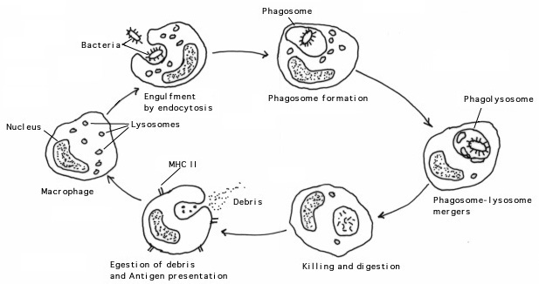

Slide 12
Killing Mechanism of phagocytosis:
Killing of ingested bacteria during phagocytosis occur by two different mechanism
Oxygen dependent mechanism:
During phagocytosis, phagocytic cell increases uptake of O2. At the same time rate of pentose phosphate pathway increases to generate more NADPH.
NADPH reduces molecular O2 to produce various toxic metabolic products such as Hydroxyl free radical, H2O2 and superoxide ions that kill ingested bacteria.
This process is also known as respiratory burst.
It is the major mechanism of killing of ingested bacteria during phagocytosis.
2. Oxygen independent mechanism:
In this mechanism, ingested bacteria are killed by hydrolytic and digestive lysozyme enzyme.

Slide 13
Inflammation or Inflammatory barrier of immune system
Inflammation is an important defense mechanism of host to prevent infection. It is induced in response to tissue damage caused by microorganism, toxins or by mechanical means.
The inflammation may be acute; for e.g. in response to tissue damage or chronic; for e. g. Arthritis, cancer etc.
Main aim of inflammation is to prevent spread of microorganism or toxins and kill them on spot by phagocytosis.
Characteristics of inflammation:
redness
swelling
heat
pain
loss of function

Slide 14
Steps of inflammatory response
Step I: Tissue damage and Release of histamine:
Tissue damage caused by toxin, microorganism or mechanical injury release histamine.
Step II: Vasodilation:
Histamine acts on surrounding blood capillaries and causes vasodilation.
When vasodilation occurs, speed of blood flow increases so that Neutrophils get chance to settle at the site of infection.
Step III: Increased permeability:
At the same time histamine increases the permeability of blood capillaries leading to leakage of fluid from blood capillaries. This results in accumulation of fluid causing edema.

Slide 15
Step IV: Extravasation:
Within few hours, Neutrophil migrates to the site of tissue damage by the process of chemotaxis and passes through capillaries wall and enter into tissue space by the process called extravasation.
Extravasation completes in 4 steps:
Rolling: neutrophils attach loosely to endothelium (the inner lining of blood vessels) by low affinity interaction.
Activation of chemotactic stimulus: chemokines are secreted and Neutrophil are attracted.
Arrest and adhesion: ICAMS (intercellular adhesion molecule) and integrin stabilize adhesion of neutrophil and endothelium
Transendothelial migration: Neutrophil enter through endothelium layer.

Slide 16
Step V: Phagocytosis:
Neutrophil kills the microorganism or toxins by phagocytosis and release molecular mediators that contributes to inflammatory response. At the same time activates effectors cells.
Step VI: Inflammatory response:
As inflammatory response develops, various cytokines and other inflammatory mediators act on endothelium of local blood vessels, including increased expression of cell adhesion molecules (CAMs). The epithelium is then said to be inflamed.
Neutrophils are the first cell types to bind to inflamed endothelium and extravasate into tissue.

Slide 17
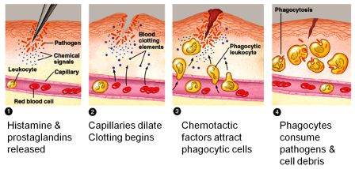

Slide 18
Acquired or Developed immunity:
Immunity which is developed later in life after microbial infection in host is called as Acquired or developed immunity.
For example, If an individual is infected with chicken pox virus, he/she become resistant to same virus in later life.
Acquired immunity is provided by Antibodies and certain T-lymphocytes.
Components of acquired immunity such as Antibodies and T- cells are specific to particular microorganism. Therefore acquired immunity is also known as Specific immunity.
Types of acquired immunity:
Active immunity
Passive immunity

Slide 19
Active immunity:
If host itself produces antibodies, it is called active immunity.
It is of two types; artificial active immunity and natural active immunity.
Artificial active immunity: Immunity provided by vaccination.
Natural active immunity: immunity provided by natural infection.

Slide 20
2. Passive immunity:
If host does not produce antibodies itself but antibodies produced in other host provides immunity, then it is known as Passive immunity.
It is of two types; natural passive immunity and Artificial passive immunity
Natural passive immunity: IgG antibody produced in mother cross placenta and protects fetus up to 6 month old age.
Artificial passive immunity: if preformed antibody are injected into host for immunity. Eg. Anti-venom, Rabies vaccine (* it is not a vaccine, it is preformed anti rabies antibody)

Slide 21
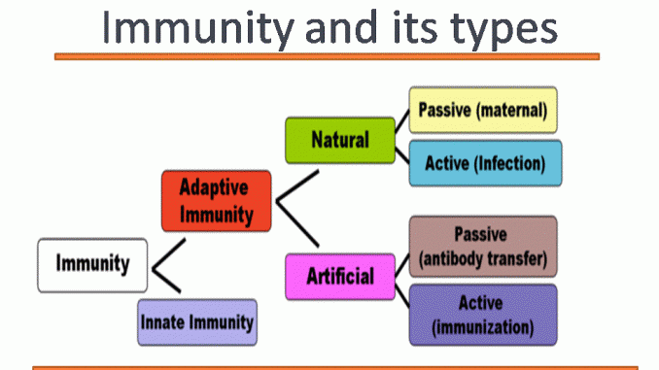

Slide 22
The end…

