Slide 1
Pharamaceutical Chemistry III-A
Pharmaceutical Analysis
Atomic absorption spectroscopy

Slide 2
Spectroscopy
Spectroscopy is a scientific technique that involves the study of the interaction between matter and electromagnetic radiation (Radio, microwave, IR, Visible light, UV etc). It is a powerful analytical tool used to investigate the composition, structure, and properties of substances by analyzing the way in which they interact with light or other forms of electromagnetic radiation. The resulting spectra provide information about the energy levels, molecular vibrations, electronic transitions, and other characteristics of the materials being studied.

Slide 3
Atomic Absorption Spectroscopy
Atomic Absorption Spectroscopy (AAS) is the analytical techniques that exploit the interaction of electromagnetic radiation with atoms. Atomic Absorption Spectroscopy is a technique that measures the absorption of light by ground-state atoms in the gaseous phase. In AAS, the absorption of specific wavelengths of light by ground-state atoms is used to quantify the concentration of elements in a sample.

Slide 4
When atoms are subjected to energy, electrons in their ground state absorb energy and transition to higher energy levels. In AAS, the sample is exposed to a light source containing the element-specific wavelengths. The atoms absorb light energy, and the extent of absorption is proportional to the concentration of the element.

Slide 5
Absorption of Light: When atoms in a sample are exposed to light with a specific wavelength corresponding to the electronic transition energy of the atoms, they absorb photons and move from the ground state to an excited state.

Slide 6
Beer-Lambert Law: The absorption of light is proportional to the concentration of the absorbing species and the path length of the light through the sample, as described by the Beer-Lambert Law:
A = ε x c x l
where A is absorbance, ε is molar absorptivity, c is concentration, and l is path length.

Slide 7
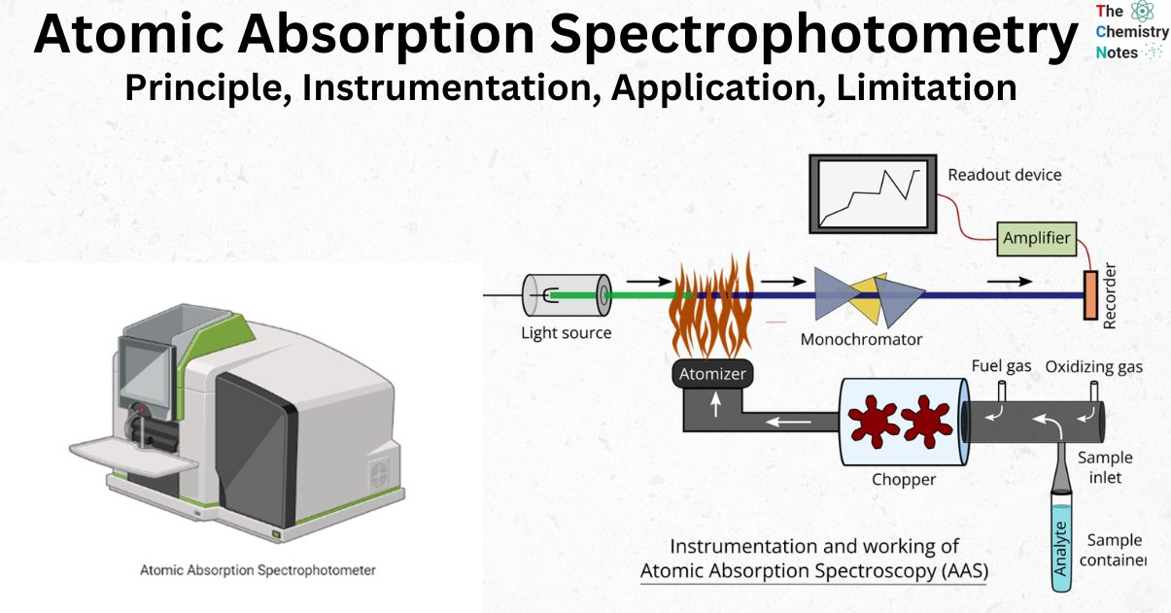
Instrumentation

Slide 8
Light Source
Typically a hollow cathode lamp (HCL) that emits light at the characteristic resonance line of the element of interest.
Hollow Cathode Lamp (HCL):
The HCL is a discharge lamp that emits characteristic wavelengths of light for the specific element of interest. It serves as the primary light source in AAS.

Slide 9
Atomization Source
The sample is introduced into a flame or graphite furnace to convert the analyte into free atoms.
In AAS, the atomizer converts the sample into a fine aerosol or a gaseous form to facilitate atomization and absorption. Common atomizers include flame atomizers (for liquid samples) and graphite furnace atomizers (for solid samples).

Slide 10
Monochromator
Selects the specific wavelength of light corresponding to the absorption line of the analyte.
A device that isolates the desired wavelength of light emitted or absorbed by the sample. It ensures that only the characteristic lines of the element being analyzed reach the detector.

Slide 11
Detector
Measures the intensity of the transmitted light, allowing for the calculation of absorbance.
Photomultiplier/Photodetector tubes or solid-state detectors are commonly used, converts the optical signal into an electrical signal for further analysis and quantification.

Slide 12
Pharmaceutical Applications
Drug Analysis: Determination of trace metals in pharmaceutical formulations, ensuring product quality and adherence to regulatory standards.

Slide 13
Toxicology Studies: Detection and quantification of toxic metals in drug products, ensuring patient safety.
Biological Sample Analysis: Measurement of trace elements in biological fluids and tissues for pharmacokinetic and toxicity studies.

Slide 14
Heavy Metal Detection:
AAS is utilized to detect and quantify heavy metals, such as lead, arsenic, and cadmium, in pharmaceutical products. These metals can be harmful in excessive amounts.

Slide 15
Quality Control of Raw Materials:
AAS is applied to assess the elemental composition of raw materials used in pharmaceutical manufacturing, helping maintain consistent quality in the production process.

