Slide 1
Cells of the Innate Immune System
There are many types of white blood cells, or leukocytes, that work to defend and protect the human body.
In order to patrol the entire body, leukocytes travel by way of the circulatory system.
The following cells are leukocytes of the innate immune system:

Slide 2
Phagocytes, or Phagocytic cells:
Phagocyte means “eating cell”, which describes what role phagocytes play in the immune response.
Phagocytes circulate throughout the body, looking for potential threats, like bacteria and viruses, to engulf and destroy.
You can think of phagocytes as security guards on patrol.
Monocytes and macrophages are mononuclear phagocytic cells as the major phagocytic cells. They are present in all parts of the body, constituting mononuclear phagocytic system (MPS).

Slide 3
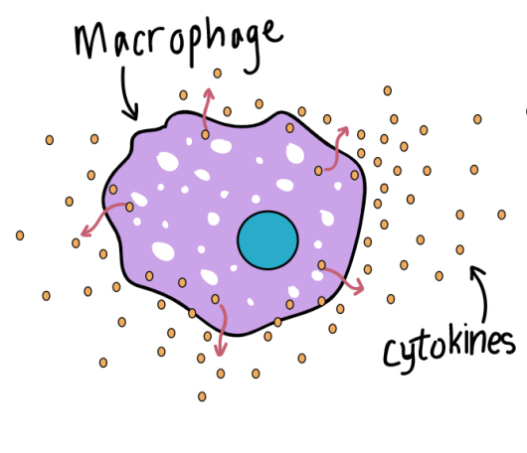
Monocytes:
Monocytes circulates in blood for about 8 hours, during which they enlarges and then enter into tissues and differentiates into specific macrophages and dendritic cells.
Blood monocytes measure 12-15 µm with a single lobed kidney shaped nucleus.
It accounts for (2-8%) of blood leukocytes.
Helps in antigen processing and presentation
Releases cytokines
Involved in Cytotoxicity
Macrophages:
Macrophages are efficient phagocytic cells that can leave the circulatory system by moving across the walls of capillary vessels.
Macrophages can also release cytokines in order to signal and recruit other cells to an area with pathogens.

Slide 4
Monocyte migrates to tissue and differentiates into macrophages.
Differentiation of monocytes into macrophages involves following changes:
Cell enlarges 5-10 folds
Intracellular granules increases in number and complexity
Increase phagocytic ability
Produces higher level of hydrolytic enzymes and cytokines
Macrophages serve different functions in different tissues.
Alveolar macrophages : in lungs
Histiocyte: connective tissue
Kuffer cell: liver
Messangial cell: kidney
Microglial cell: brain
Osteoclast: bone
Immunological functions of macrophages:
Phagocytosis
Secretion of lymphokines IL-1, IL-6. IL-12. TNF-α etc to activates inflammatory response
Antigen presentation to T-cell
Notes:
Cytokines are a collective name of lymphokines (cytokines secreted by lymphocytes), monokines (cytokines secreted by monocytes), interleukins (cytokines secreted by one leukocyte and acting on other leukocytes), chemokines (cytokines with chemotactic activities)

Slide 5
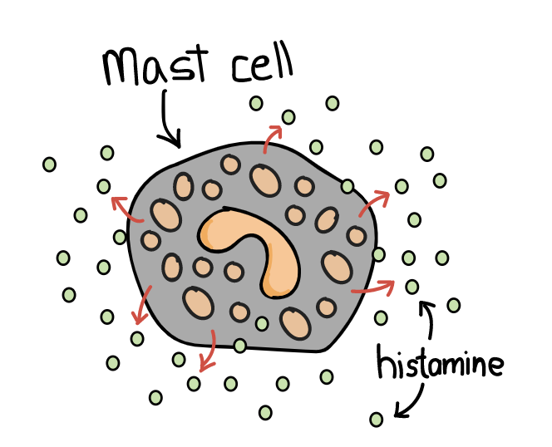
Mast cells:
Mast cells are found in mucous membranes and connective tissues, and are important for wound healing and defense against pathogens via the inflammatory response.
When mast cells are activated, they release cytokines and granules that contains histamine to create an inflammatory cascade.
Mediators, such as histamine, cause blood vessels to dilate, increasing blood flow and cell trafficking to the area of infection.
The cytokines released during this process act as a messenger service, alerting other immune cells, like neutrophils and
macrophages, to make their way to the area of
infection, or to be on alert for circulating threats.

Slide 6
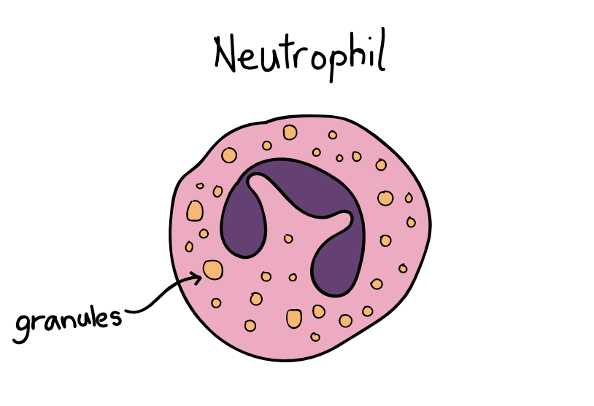
Neutrophils:
Neutrophils are phagocytic cells that are also classified as granulocytes because they contain granules in their cytoplasm.
These granules are very toxic (containing a variety of proteins-antimicrobial peptides, enzymes and other molecules) to bacteria and fungi, and cause them to stop proliferating or die on contact.
The bone marrow of an average healthy adult makes approximately 100 billion new neutrophils per day.
Neutrophils are typically the first cells to arrive at the site of an infection because there are so many of them in circulation at any given time.
Neutrophils are (11-14µm) in diameter with multilobed
nucleus with granules in cytoplasm.
It constitutes 50-70 % of total circulating WBC and
remains for 7-8 hours in blood and then migrates to
tissues
Life span is 3-4 days.
Also known as polymorphonuclear (PMN) leucocyte.

Slide 7
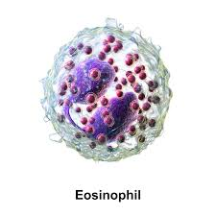
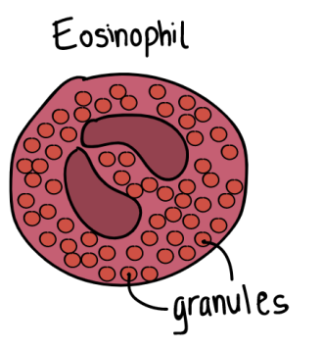
Eosinophils:
Eosinophils are granulocytes targeting foreign pathogens/ parasites.
Eosinophils secrete a range of highly toxic proteins and free radicals that kill bacteria and parasites.
The use of toxic proteins and free radicals also causes tissue damage during allergic reactions, so activation and toxin release by eosinophils is highly regulated to prevent any unnecessary tissue damage.
While eosinophils only make upto 1-6% of the white blood cells, they are found in many locations, including the thymus, lower gastrointestinal tract, ovaries, uterus, spleen, and lymph nodes.
Eosinophils are (11-15µm) in diameter, heavily
granulated with bilobed nucleus

Slide 8
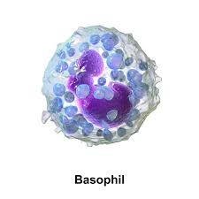
Basophils:
Basophils are also granulocytes that attack multicellular parasites.
Basophils are non-phagocytic cell found in small number in blood and tissue
Cytoplasm contains large number of prominent basophilic granules containing histamine, heparin, serotonin, and other hydrolytic enzymes

Slide 9
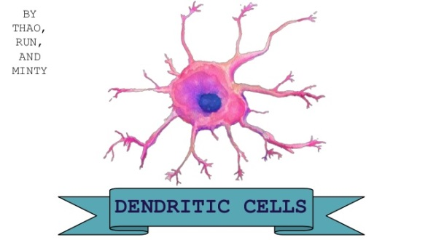
Dendritic cells:
Dendritic cells are antigen-presenting cells that are located in tissues.
Since dendritic cells are located in tissues that are common points for initial infection, they can identify threats and act as messengers for the rest of the immune system by antigen presentation.
Dendritic cells also act as bridge between the innate immune system and the adaptive immune system.
Dendritic cells have long cytoplasmic extensions that resembles to dendrites of nerve cell.
They have highly pleomorphic with a small central body and many long needle like processes.
Involved in antigen presentation to T-cells during
primary immune response.
Very little role in phagocytosis.

Slide 10
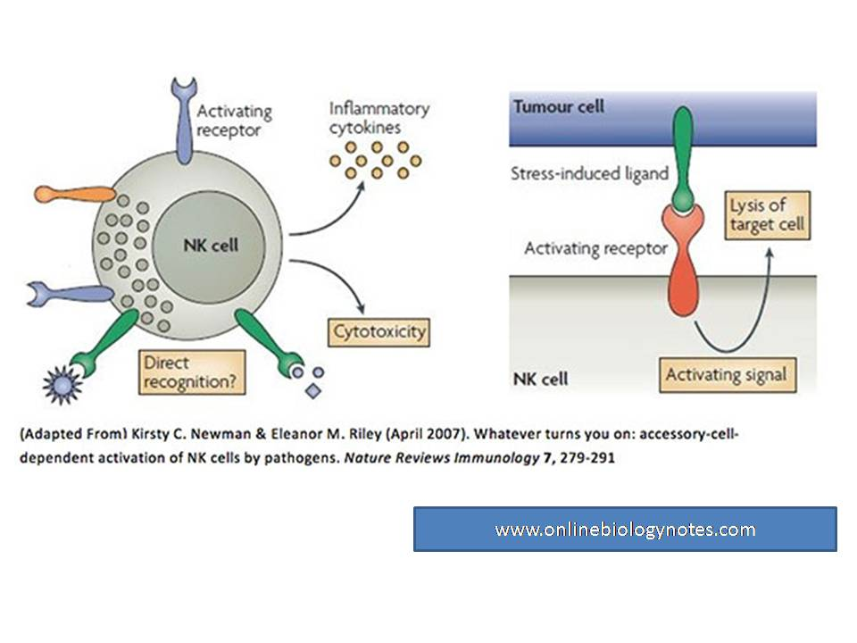
Natural Killer cells:
Natural Killer cells (NK cells), do not attack pathogens directly.
Instead, natural killer cells destroy infected host cells in order to stop the spread of an infection.
Natural Killer (NK) cells are large granular lymphocytes (LGL) present in small proportion in spleen and peripheral blood.
Infected or compromised host cells can signal natural kill cells for destruction through the expression of specific receptors and antigen presentation.
They are called as natural killer cell because they do not require activation in order to kill tumor cells or virus infected cells.

Slide 11
The Complement System
The complement system (also called the complement cascade) is a mechanism that complements (augment) other aspects of the immune response.
Typically, the complement system acts as a part of the innate immune system, but it can work with the adaptive immune system if necessary.
The complement system is made of a variety of proteins that enhance the ability of antibodies and phagocytic cells to clear microbes and damaged cells, promote inflammation and attack pathogen cell membranes.
When activated, these proteins come together to initiate the complement cascade, which may result in the following processes:

Slide 12
Opsonization:
Opsonization is a process in which foreign particles are marked for phagocytosis.
All of the pathways require an antigen to signal that there is a threat present.
Opsonization tags infected cells and identifies circulating pathogens expressing the same antigens.
Chemotaxis:
Chemotaxis is the attraction and movement of macrophages to a chemical signal.
Chemotaxis uses cytokines and chemokines to attract macrophages and neutrophils to the site of infection, ensuring that pathogens in the area will be destroyed.
By bringing immune cells to an area with identified pathogens, it improves the likelihood that the threats will be destroyed and the infection will be treated.

Slide 13
Cell Lysis:
Lysis is the breaking down or destruction of the membrane of a cell.
The proteins of the complement system puncture the membranes of foreign cells, destroying the integrity of the pathogen.
Destroying the membrane of foreign cells or pathogens weakens their ability to proliferate, and helps to stop the spread of infection.

Slide 14
Agglutination:
Agglutination uses antibodies to cluster and bind pathogens together.
By bringing as many pathogens together in the same area, the cells of the immune system can mount an attack and weaken the infection.
Other innate immune system cells continue to circulate throughout the body in order to track down any other pathogens that have not been clustered and bound for destruction.

Slide 15
The steps of the complement cascade facilitate the search for and removal of antigens by placing them in large clumps, making it easier for other aspects of the immune system to do their jobs.
Remember that the complement system is a supplemental cascade of proteins that assists, or “complements” the other aspects of the innate immune system.
The innate immune system works to fight off pathogens before they can start an active infection.
For some cases, the innate immune response is not enough, or the pathogen is able to exploit the innate immune response for a way into the host cells.
In such situations, the innate immune system works with the adaptive immune system to reduce the severity of infection, and to fight off any additional invaders while the adaptive immune system is busy destroying the initial infection.

Slide 16
Jules Bordet (1895) identified complements as heat-sensitive components in the blood, bearing non-specific antimicrobial activity
More than 20 types of complements are present in serum, found circulating normally in human body in inactive forms (called as zymogens or proenzymes).
Complement activation is triggered by an antibody when it is bound to the antigen. It can also be triggered by some components of innate immunity.
Thus the complement system works in both innate and acquired immunity.

Slide 17
Complements are mainly denoted by the capital letter C with numbers; like, C1, C2, C3, and so on. Some have only alphabet, like, B, D. Some are simply represented by names, like, homologous restriction factor.
C1 has three sub-units; C1q, C1r and C1s. C2-C5 have two components, a and b. Larger subunits are denoted by b whereas the smaller are denoted by a.

Slide 18
The end……

