Slide 1
Pharmaceutical Compounding and Dispensing (Extemporaneous)
Dr. Umar Farooq
Pharm.D., M.Phil., Ph.D. Scholar
Assistant Professor
Head of Department (Pharmaceutics)
Rashid Latif College of Pharmacy, Lahore

Slide 2
Principles of Compounding
Compounding as it relates to pharmacy; includes the preparation, mixing, assembling, packaging or labeling of a drug in response to a prescription written by a licensed practitioner.
Extemporaneous compounding is defined as the timely preparation of a drug product according to a physicians prescription, a drug formula, or a recipe in which calculated amounts of ingredients are made into a homogenous (uniform) mixture. Extemporaneous compounding is done when certain medical needs of individual patients cannot be met by the use of an approved commercial drug product.

Slide 3
Reasons for Extemporaneous Compounding Today
Unavailable dosages, strengths and routes of commercial products
Dilution of adult doses of medications to Pediatric/Geriatric strengths.
Conversion of solid dosage forms to solutions or suspensions.
Combination of topical dermatological products not available by the manufacturer.
Inactive ingredients of commercial products which may cause allergic reactions in individuals.

Slide 4
Equipment : Balance
Class A Prescription Balance
The Class A Prescription Balance is a two-pan torsion type balance that utilizes both internal and external weights. The Class A Prescription Balance is used in the Pharmacy setting as a means of determining the weight of a material to be used in the compounding of a prescription or manufacturing of a dosage form. This balance is currently required in all pharmacy settings and must meet the requirements of the National Bureau of Standards (NBS).

Slide 5
Class A Prescription Balance Weighing Procedure
With the balance locked, place a weighing paper on each pan. Place the desired weight on the RIGHT pan; place the material to be weighed on the LEFT pan.
Release the lock of the balance and observe the position of the indicator.
Lock the beam and adjust the amount of material.
A swinging balance is the most accurate method of measuring. This is indicated when the pointer swings an equal number of divisions to both sides of the central position.
The final measurement should be determined with the cover down.
To avoid mistakes in totaling the weights, they should be totaled three times as they are placed on the pan from the vacant positions in the weight box and as they rest on the pan.

Slide 6
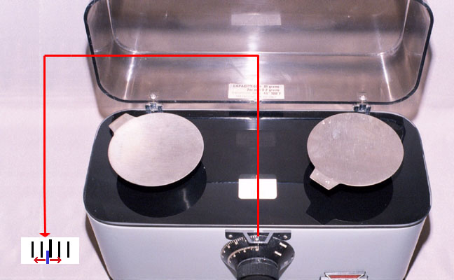
Class A Prescription Balance

Slide 7
Class A Prescription Balance
The minimum weight that can be weighed on this balance is 120 milligrams (mg) and the maximum weight is 120 grams (gms). The Class A prescription balance has a sensitivity of 6 mg that means just 6 mg of a substance will move the pointer of the balance one division off equilibrium or one degree.
Proper care of the Class A Prescription Balance is important to ensure accurate measurements.
The balance should be kept clean at all times, and care should be taken to avoid vibration, dust, moisture and corrosive vapors.
The balance cover should be kept down at all times except when the balance is in use.

Slide 8
Bulk Balance
The Bulk Balance or Counter Balance is less accurate than the Class A Prescription Balance and is primarily used to weigh large quantities of material. It has a limit of 5 Kilograms (Kg) and a sensitivity of 100 mg.

Slide 9
Analytical Balance
With the advent of new technology, the Analytical Balance is finding its way from Pharmaceutical analytical laboratories into the Pharmacy setting. Due to convenience, precision and accuracy, as well as a sensitivity of a digital readout of 0.1 mg, most pharmacies prefer the use of this balance.

Slide 10
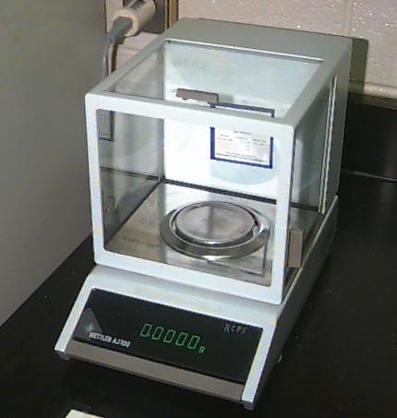
Analytical Balance

Slide 11
Weights
Weights used for the Class A Prescription Balance and other balances are made of brass or polished metal and must be maintained and handled properly. These sets usually contain cylindrical weights ranging from 1 to 50 gms and fractional weights of 10 to 500 mg.
Once yearly the weights should be calibrated to ensure accuracy.

Slide 12
Spatula
Spatulas are used to transfer solid ingredients such as powders, ointments, creams to weighing pans. They are also used to mix ingredients together into homogenous mixtures. Spatulas are available in stainless steel, plastic and hard rubber, the type of spatula to use is dependent on what is being transferred or mixed.

Slide 13
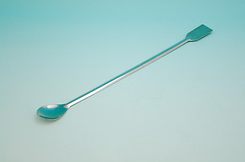
Spatula made of stainless steel

Slide 14
Mortar and Pestle
The mortar and pestle is used to grind particles into fine powders (trituration). The incorporation of a liquid (levigation) can further reduce particle size. Mortar and Pestles are made of Glass, Porcelain, Wedgwood or Marble. Glass is preferable for mixing liquids and semi-soft dosage forms.

Slide 15
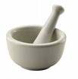
Mortar and Pestle

Slide 16
Graduates
Graduates are used in the measurement of liquids. Most graduates are marked “TD” which means, “to deliver”. This marking indicates that the measurement of this graduate will compensate for the excess liquid that adheres to the surface of the graduate after emptying.

Slide 17
Conical Graduates
The Conical graduate has a wide mouth and wide base to allow the stirring of liquids with a glass stirring rod. As the diameter of the graduate increases, the accuracy decreases. The conical graduate varies in size from 10ml to 4000ml.

Slide 18
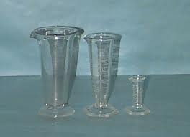
Conical Graduates

Slide 19
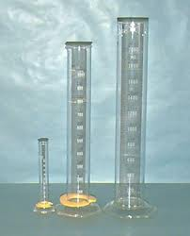
Cylindrical Graduates
The Cylindrical graduate is uniform from top to bottom and is the most accurate graduate for the measurement of liquids.

Slide 20
Ointment Slabs
Along with the mortar, pestle and spatula, the Ointment Slab is mainstay in the Pharmacy setting.
Ointment slabs provide a clean, hard surface for the mixing of compounds. Most ointment slabs are ground glass plates, that provide a non-absorbable surface area.
For multiple compounding, many pharmacies purchase Parchment Papers that serve the same purpose when placed over an ointment slab, but are easily disposed of after use without the necessary cleaning involved between mixtures.

Slide 21
Geometric Dilution
Geometric Dilution is the process by which a homogenous mixture or even distribution of two or more substances is achieved. When using this method, the smallest quantity of active ingredient is mixed thoroughly with an equal volume of the diluent or base on the ointment slab. More diluent (base) is added in amounts equal to the volume of the mixture on the ointment slab. This process is repeated until all of the diluent (base) is incorporated in the mixture. This method, though time consuming, will create a homogenous mixture or smooth dispersion of the drug in the ointment/cream base.

Slide 22
Geometric Dilution
In some cases, due to time constraints or lack of experience, Geometric Dilution is not used in the Pharmacy setting and mixtures are just mixed together haphazardly. This “slap them together mixture” may result in gritty and scattered powder that fails to blend in the ointment/cream base being used. A non-homogenous mixture can not only pharmacologically affect the therapeutic effect, but can also cause serious topical skin reactions.

Slide 23
It is generally agreed that pharmaceutical products should be prepared with a low percentage of error. The Official Compendium allows a tolerance of plus or minus 5 percent for most formulas.

Slide 24
Storage and labelling requirements after dispensing
The label of a pharmaceutical product has many functions:
1. To indicate clearly the contents of the container
2. To indicate clearly to patients how and when the medicinal product should be taken or used.
3.To indicate clearly to patients how the product should be stored and for how long.
4.To indicate clearly to patients any warnings or cautions of which they need to be made aware.

Slide 25
Storage and labelling requirements after dispensing
The label of a pharmaceutical product must be in the right place and contain the right information. The following need to be taken into consideration:
Appearance
Correct position
Clean
Secure
Information
Legible
Concise
Adequate
Intelligible
Accurate

Slide 26
Storage and labelling requirements after dispensing
The labels for extemporaneous products need to contain the following:
Full name (including title) of the patient
Name of the product
Quantitative particulars (for unofficial products)
Appropriate expiry date
Additional warnings (where appropriate)
Directions for use

Slide 27
An example of Quantitative particulars
Quantitative particulars for 100 ml Sodium Chloride BP Lotion 4% would be labelled:
The Lotion
Containing:
Sodium Chloride BP 4 g
Freshly boiled and cooled purified water to 100 ml

Slide 28
Storage and labelling requirements after dispensing
Remember, the label of a pharmaceutical product will need to indicate the contents -
For official preparations, it will be sufficient to put the official title (as this indicates the contents).
For unofficial products, the formula will need to be detailed on the label. For internal products this information is given per dose; for external products, per container.

Slide 29
Pharmaceutical Packaging
The ideal container should be:
Robust enough to protect the contents against crushing during handling and transport .
Convenient to use in order to promote good patient compliance (i.e. encourage patients to take their medication at the correct times).
Easy to open and close, especially if the medication is for an elderly or arthritic patient.
Constructed of materials which do not react with the medicine, so the materials of construction
should be inert.
Sufficiently transparent to allow for inspection of the contents in the case of liquid preparations.

Slide 30
Pharmaceutical Packaging
Tablet bottles: Tablet bottles come in a variety of shapes and sizes and are usually made of either glass or plastic. Generally, tablet bottles are colored amber to reduce the likelihood of the contents reacting with light. They are used for solid, single-dose preparations that are intended for oral use (i.e. tablets and capsules).

Slide 31
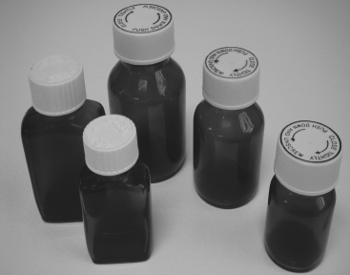
A selection of tablet bottles.

Slide 32
Medical Bottles
Plain amber medicine bottles: Plain amber medicine bottles can be used to package all internal liquid preparations. The label or labels are usually placed on the curved side of the bottle as the patient’s natural action will be to pick the bottle up with the curved side of the bottle facing the inside of the palm.
Fluted amber medicine bottles: Fluted (or ribbed) amber medicine bottles are similar to the plain amber medicine bottles but, instead of having a fl at plain side, this side is curved and contains a number of ridges or grooves running from the top of the bottle down to the bottom.

Slide 33
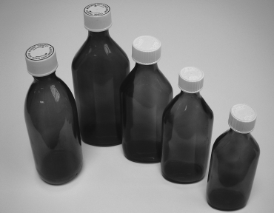
Plain amber medicine bottles

Slide 34
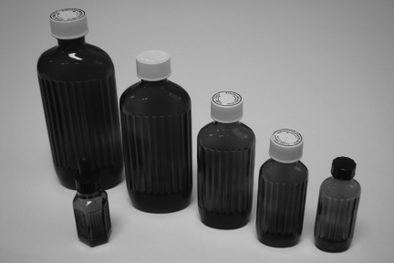
Fluted amber medicine bottles

Slide 35
Pharmaceutical Packaging
Calibrated containers for liquid preparations: Liquid preparations are normally made up to volume in a conical measure. There are occasions where a tared or calibrated bottle may be used. A tared bottle is normally only employed when, because of the viscosity of the final product, the transference loss from the measure to the container would be unacceptable. For example, Kaolin Mixture BP is a very dense suspension and transference may cause problems; similarly, a thick emulsion will also prove difficult and time-consuming to transfer in its entirety because of the viscosity of the finished product.

Slide 36
Pharmaceutical Packaging
Cartons: Cardboard cartons come in a variety of differing sizes, the sizes being dependent on the manufacturer. They tend to be rectangular in shape and the label is placed on the larger side of the box. They are used to package blister strips of tablets for pharmaceutical Compounding and Dispensing or capsules, powder papers and other pharmaceutical products that may be of a shape that is not suitable for labelling.

Slide 37
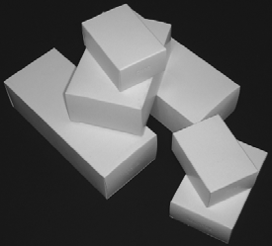
A selection of cartons

Slide 38
Pharmaceutical Packaging
Ointment jars: Ointment jars come in a variety of different sizes and can be made of either colourless glass or amber glass. Amber ointment jars are used for preparations that are sensitive to light. They are used to package ointments and creams and can be used for individually wrapped suppositories.
Collapsible tubes: Collapsible tubes come in a variety of different sizes and can be used to package creams or ointments. They are less convenient to fill than ointment jars and as such are rarely used for individual patient formulations.

Slide 39
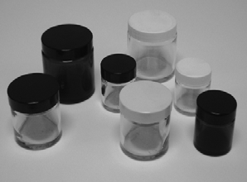
Ointment jars

Slide 40
Solution
Essentially a solution is a homogeneous liquid preparation that contains one or more dissolved medicaments. Since, by definition, active ingredients are dissolved within the vehicle, uniform doses by volume may be obtained without any need to shake the formulation. This is an advantage over some other formulation types, e.g. suspensions.
Advantages of solution dosage form:
Drug available immediately for absorption
Flexible dosing
May be designed for any route of administration
No need to shake container
Facilitates swallowing in difficult cases

Slide 41
Solution
Disadvantages of solution dosage form:
Drug stability often reduced in solution.
Difficult to mask unpleasant tastes.
Bulky, difficult to transport and prone to container breakages.
Technical accuracy needed to measure dose on administration.
Measuring device needed for administration.
Dissolution will normally take place in a glass beaker, not a conical measure, for a number of reasons:
Firstly, owing to the shape of the conical measure, any solid added to a conical measure will tend to cake at the bottom of the measure and hamper any attempt to stir the solid around with the stirring rod which aids dissolution. Secondly, the action of the stirring rod may scratch the inside of the glass conical measure, permanently altering the internal volume of the measure.

Slide 42
Solution
Further considerations during the preparation of a solution:
To aid dissolution, high-viscosity liquid components should be added to those of lower viscosity.
Completely dissolve salts in a small amount of water prior to the addition of other solvent elements.
In complex solutions, organic components should be dissolved in alcoholic solvents and water soluble components dissolved in aqueous solvents.
Aqueous solutions should be added to alcoholic solutions with stirring to maintain the alcohol concentration as high as possible – the reverse may result in separation of any dissolved components.
Example:
The preparation of Ammonium Chloride Mixture BP (Product formula and method of compounding).
The preparation of Sodium Chloride Compound Mouthwash BP (Product formula and method of compounding).

Slide 43
Calculation during Solution Dispensing and Compounding
Basic strength calculations:
The simplest way to express the strength of a solution is to specify the amount of solute to be dissolved in a stated amount of solvent.
If the solute is a solid dissolved in a liquid, the strength of the solution may often be expressed as mg/ml, mg/100 ml, g/100 ml, mg/l or g/l. Similarly, if the solute is a liquid, the strength could be expressed as ml/10 ml, ml/100 ml or ml/l.
Example:
You are asked to prepare a 100 ml solution containing Sodium Chloride BP 9 mg/ml.
Sodium Chloride BP 9 mg 90 mg 900 mg
Potable water to 1 ml to 10 ml to 100 ml
Tailored strength calculations:
Often this type of calculation is required if you are attempting to give a tailored dose to a patient using existing pre-prepared stock mixtures.
Example: A common dose seen in paediatric prescribing is 62.5 mg phenoxymethylpenicillin four times a day. This is the recommended dose for a child 1 month–1 year. The readily available mixture is 125 mg/5 ml. Therefore to provide a dose of 62.5 mg we give 2.5 ml of a 125 mg/ml mixture.

Slide 44
Calculation during Solution Dispensing and Compounding
Percentage calculations:
Percentages are also commonly used to express the strength of solutions. Usually these solutions are not intended for the oral route of administration. As a percentage this can have four different meanings and in order to make clear the intention the following terms are used:
  % w/w percentage weight in weight. This expresses the amount in grams of solute in 100 g of product.
  % w/v percentage weight in volume. This expresses the amount in grams of solute in 100 ml of product.
  % v/v percentage volume in volume. This expresses the number of millilitres of solute in 100 ml of product.
  % v/w percentage volume in weight. This expresses the number of millilitres of solute in 100 g of product.
  The strength of solutions of solids in liquids is usually expressed as % w/v, whereas that of liquids in liquids is expressed as % v/v. When the type of percentage is not specified by convention the above rule will apply. For example, % solid in liquid is interpreted as % w/v.

Slide 45
Calculation during Solution Dispensing and Compounding
Parts calculations:
The concentration of solutions may also be expressed in terms of ‘parts’. By this we mean ‘parts’ of solute in ‘parts’ of product. This is interpreted as parts by weight (grams) of a solid in parts by volume (millilitres) of the final solution or in parts by volume (millilitres) of a liquid in parts by volume (millilitres) of the final solution. Solubility of ingredients is often expressed in this way.
Example:
Sodium Bicarbonate BP is soluble in 11 parts of water. This means that 1 g of Sodium Bicarbonate BP will dissolve in 11 ml of water. Therefore if you had a formula that required 4 g of Sodium Bicarbonate BP you would need a minimum of 4 × 11 = 44 ml of water in which to dissolve the 4 g of Sodium Bicarbonate BP.

Slide 46
Calculation during Solution Dispensing and Compounding
Millimolar calculations
The strength of active ingredient within a pharmaceutical preparation can be
expressed as the number of millimoles per unit volume or mass of product. The
mole is the unit of amount of substance and there are 1000 millimoles in a mole.
To calculate the number of millimoles of an ingredient in a medicinal product, you
will firstly need to know the molecular weight of the ingredient.
The number of moles of ingredient is the mass of ingredient divided by the
molecular mass:
Number of moles = Mass in grams
Molecular mass
For example, the molecular weight quoted for Sodium Chloride BP is 58.44.
Therefore a molar solution of Sodium Chloride BP would contain 58.44 g of
Sodium Chloride BP in a litre.

Slide 47
Suspension
A pharmaceutical suspension is a preparation where at least one of the active ingredients is suspended throughout the vehicle. In contrast to solutions, in a suspension at least one of the ingredients is not dissolved in the vehicle and so the preparation will require shaking before a dose is administered.
Diffusible and indiffusible suspensions:
Diffusible suspensions - These are suspensions containing light powders which are insoluble, or only very slightly soluble in the vehicle, but which on shaking disperse evenly throughout the vehicle for long enough to allow an accurate dose to be poured.
Indiffusible suspensions - These are suspensions containing heavy powders which are insoluble in the vehicle and which on shaking do not disperse evenly throughout the vehicle long enough to allow an accurate dose to be poured.
Choice of suspending agent - The amount of suspending agent used in any given formulation depends on the volume of vehicle being thickened. It does not vary with the amount of powder in the preparation. A suspending agent is intended to increase the viscosity of the vehicle and therefore slow down sedimentation rates. This outcome could also be achieved by decreasing the particle size of the powder in suspension. The most common suspending agents used in extemporaneous dispensing are Tragacanth BP (internal or external suspensions), Compound Tragacanth Powder BP (containing: 15% Tragacanth BP, 20% Acacia BP, 20% Starch BP and 45% Sucrose BP) (internal suspensions) and Bentonite BP (external suspensions).

Slide 48
Advantages of suspensions as dosage forms :
Advantages
Insoluble drugs may be more palatable.
Insoluble drugs may be more stable.
Suspended insoluble powders are easy to swallow.
The suspension format enables easy administration of bulk insoluble powders.
Absorption will be quicker than solid dosage forms.
Lotions will leave a cooling layer of medicament on the skin.
It is theoretically possible to formulate sustained-release preparations.
Example of suspension dispensing and compounding:
The preparation of Magnesium Trisilicate Mixture BP (Product formula and method of compounding).

Slide 49
Disadvantages of suspensions as dosage forms
Disadvantages:
Preparation requires shaking before use.
Accuracy of dose is likely to be less than with equivalent solution.
Storage conditions can affect disperse system.
Suspensions are bulky, difficult to transport and prone to container breakages

Slide 50
Emulsion
An emulsion is essentially a liquid preparation containing a mixture of oil and water that is rendered homogeneous by the addition of an emulsifying agent. The emulsifying agent ensures that the oil phase is finely dispersed throughout the water as minute globules. This type of emulsion is termed an ‘oil-in water’ emulsion. The oily phase(disperse phase) is dispersed through the aqueous phase(continuous phase). Generally all oral dose emulsions tend to be oil-in-water as the oily phase is usually less pleasant to take and more difficult to flavor. ‘Water in-oil’ emulsions can be formed but these tend to be those with external uses.
Stability of emulsions : Emulsions can break down in the following ways:
  - cracking
  - creaming
  - phase inversion.
Cracking - This is the term applied when the disperse phase coalesces and forms a separate layer. Redispersion cannot be achieved by shaking and the preparation is no longer an emulsion. Cracking can occur if the oil turns rancid during storage. The acid formed denatures the emulsifying agent, causing the two phases to separate.

Slide 51
Emulsion
Creaming - In creaming, the oil separates out, forming a layer on top of the emulsion, but it usually remains in globules so that it can be redispersed on shaking (e.g. the cream on the top of a pint of milk).This is undesirable as the product appearance is poor and if the product is not adequately shaken there is a risk of the patient obtaining an incorrect dose. Creaming is less likely to occur if the viscosity of the continuous phase is increased.
Phase inversion:
This is the process when an oil-in-water emulsion changes to a water-in-oil emulsion or vice versa. For stability of an emulsion, the optimum range of concentration of dispersed phase is 30–60% of the total volume. If the disperse phase exceeds this, the stability of the emulsion is questionable. As the concentration of the disperse phase approaches a theoretical maximum of 74% of the total volume, phase inversion is more likely to occur.

Slide 52
Advantages and disadvantages of emulsions as dosage forms
Advantages:
Unpalatable oils can be administered in palatable form.
Unpalatable oil-soluble drugs can be administered in palatable form.
The aqueous phase is easily flavored.
The oily sensation is easily removed.
The rate of absorption is increased.
It is possible to include two incompatible ingredients, one in each phase of the emulsion.
Disadvantages:
Preparation needs to be shaken well before use.
A measuring device is needed for administration.
A degree of technical accuracy is needed to measure a dose.
Storage conditions may affect stability.
Bulky, difficult to transport and prone to container breakages.
Liable to microbial contamination which can lead to cracking.

Slide 53
Calculation of the amount of emulsifying agent to be used in the preparation of an emulsion :
The amount of emulsifying agent used is dependent on the amount and type of oil to be emulsified. Oils can be divided into three categories: fixed oils, mineral oils and volatile oils.
Fixed oils:
Oil: 4 parts by volume
Aqueous phase: 2 parts by volume
Gum: 1 part by weight
Mineral oils:
Oil: 3 parts by volume
Aqueous phase: 2 parts by volume
Gum: 1 part by weight
Volatile (aromatic) oils:
Oil: 2 parts by volume
Aqueous phase: 2 parts by volume
Gum: 1 part by weight

Slide 54
CREAM
The term ‘cream’ is reserved for external preparations. Creams are viscous semi-solid emulsions for external use. Medicaments can be dissolved or suspended in creams. A cream may be ‘water-in-oil’ or ‘oil-in-water’ depending on the emulsifying agent used. A cream is always miscible with its continuous phase.
Water-in-oil creams (oily creams) as bases: These are produced by emulsifying agents of natural origin, e.g. beeswax, wool alcohols or wool fat. These bases have good emollient properties. They are creamy, white or translucent and rather stiff.
Oil-in-water creams(aqueous creams) as bases: These are produced by synthetic waxes, e.g. macrogol and cetomacrogol. They are the best bases to use for rapid absorption and penetration of drugs. They are thin, white and smooth inconsistency.

Slide 55
Ointment, paste & gels
Ointments are preparations for external application but differ from creams in that they have greasy bases. The base is usually anhydrous and therefore most ointments are immiscible with skin secretions. Ointments usually contain a medicament or a mixture of medicaments dissolved or dispersed in the base.
Pastes are semi-solid preparations for external use. They consist of finely powdered medicaments combined with White Soft Paraffin BP or Liquid Paraffin BP or with a non-greasy base made from glycerol, mucilages or soaps. Pastes contain a high proportion of powdered ingredients and therefore are normally very stiff. Because pastes are stiff they do not spread easily and therefore this localises drug delivery. This is particularly important if the ingredient to be applied to the skin is corrosive such as dithranol, coal tar or salicylic acid. It is easier to apply a paste to a discrete skin area such as a particular lesion or plaque and not therefore compromise the integrity of healthy skin.

Slide 56
Ointment, paste & gels
Pharmaceutical gels are often simple phase, transparent semi-solid systems that are being increasingly used as pharmaceutical topical formulations. The liquid phase of the gel may be retained within a three-dimensional polymer matrix. Drugs can be suspended in the matrix or dissolved in the liquid phase.
Advantages of gels
1. Stable over long periods of time
2. Good appearance
3. Suitable vehicles for applying medicaments to skin and mucous membranes giving high rates of release of the medicament and rapid absorption.
Gels are usually translucent or transparent and have a number of
uses:
Anaesthetic gels
Coal tar gels for use in treatment of psoriasis or eczema
Lubricant gels
Spermicidal gels.

Slide 57
Solutions

Slide 58
solutions
Solutions are homogeneous liquid mixtures containing completely dissolved components (One-phase system).

Slide 59
Solutions for oral dosage
The different forms of oral solutions are:
Syrups: which are concentrated, aqueous solutions of sugar or sugar-substitute.
Elixirs: which are clear, sweetened, hydroalcoholic solutions suitable for water insoluble drugs.
Linctuses: viscous liquids used in the treatment of cough. They usually contain a high proportion of sucrose, other sugars or polyhydric alcohol or alcohols.
Mixtures: pharmaceutical oral solutions and suspensions. Examples are chloral hydrate mixture.
Oral drops: are oral solutions or suspensions which are administered in small volumes, using a suitable measuring device. A proprietary example is Abidec® vitamin drops.

Slide 60
Solutions for oral dosage
Containers for dispensed oral solutions:
Plain, amber medicine bottles should be used, with a re-closable child-resistant closure with some exceptions.
A 5 mL measuring spoon or an appropriate oral syringe should be supplied to the patient.
Special labels and advice for dispensed oral solutions:
An expiry date should appear on the label for extemporaneously prepared solutions. Most 'official' mixtures and some oral solutions are freshly or recently prepared.
'Official' elixirs and linctuses and manufactured products are generally more stable, unless diluted.
Diluted products generally have a shorter shelf life than the undiluted preparation.
Linctuses should be sipped and swallowed slowly without the addition of water.

Slide 61
Solutions for other pharmaceutical uses
Mouthwashes and Gargles
Gargles are used to relieve or treat sore throats
Mouthwashes are used on the mucous membranes of the oral cavity, rather than the throat, to refresh and mechanically clean the mouth.
Both are concentrated solutions, and usually diluted with warm water before use.
Gargles tend to contain higher concentrations of active ingredients than mouthwashes.
They may contain antiseptics, analgesics or weak astringents. The liquid is usually not intended for swallowing.

Slide 62
Solutions for other pharmaceutical uses
Mouthwashes and Gargles
Containers for mouthwashes and gargles
An amber, ribbed bottle should be used for extemporaneously prepared solutions. Medicine bottles may be used for products which are intended to be swallowed.
Manufactured mouthwashes and gargles are usually packed in plain bottles.
Special labels and advice for mouthwashes and gargles
Directions for diluting the preparations should be given to the patient.
If the preparation is not intended for swallowing, the following label is appropriate: “Not to be swallowed in large amounts ”

Slide 63
Solutions for other pharmaceutical uses
Nasal solutions
Most nasal preparations are solutions, administered as nasal drops or nasal sprays.
They are isotonic to nasal secretions and buffered to the normal pH range of nasal fluids (pH 5.5-6.5) to prevent damage to ciliary transport in the nose.
The most frequent use of nose drops is as a decongestant for the common cold or to administer local steroids for the treatment of allergic rhinitis.
Nasal route may also be useful for new biologically active peptides and polypeptides which need to avoid the first pass metabolism or GI destruction.

Slide 64
Solutions for other pharmaceutical uses
Ear drops
They may also be referred to as otic or aural preparations.
Ear drops are solutions of one or more active ingredient which exert a local effect in the ear, e.g. by softening earwax or treating infection or inflammation.
Propylene glycol, oils, glycerol (to increase viscosity) and water may be used as vehicles.

Slide 65
Solutions for other pharmaceutical uses
Nasal and aural solutions
Containers for nasal and aural preparations:
Extemporaneously: should be packed in an amber, ribbed hexagonal glass bottle (which type?) which is fitted with a teat and dropper.
Manufactured nasal solutions may be packed in flexible plastic bottles which deliver a fine spray to the nose when squeezed, or in a plain glass bottle with a pump spray or dropper.
Manufactured ear drops are usually packed in small glass or plastic containers with a dropper.

Slide 66
Solutions for other pharmaceutical uses
Nasal and aural solutions
Special labels and advice for nasal and aural prep:
Not to share nasal sprays or nose and ear drops in order to minimize contamination and infection.
Patients should be given advice on how to administer extemporaneously prepared nose and ear drops, accompanied by written information if possible.
Extemporaneous preparations should be labeled with the appropriate expiry date following the official monographs.
“For external use” is not an appropriate label and so ‘Not to be taken” is advised.

Slide 67
Solutions for other pharmaceutical uses
Enemas
Enemas are oily or aqueous solutions that are administered rectally.
They are usually anti-inflammatory, purgative, sedative or given to allow X-ray examination of the lower bowel.
Retention enemas are administered to give either a local action of the drug or for systemic absorption. They are used after defecation.
Microenemas are single-dose, small volume solutions. They are packaged in plastic containers with a nozzle for insertion into the rectum.
Large-volume (0.5-1litre) enemas should be warmed to body temperature before administration.

Slide 68
Solutions for other pharmaceutical uses
Enemas
Containers for enemas:
If extemporaneously produced, enemas are packed in amber fluted glass bottles.
Manufactured enemas will usually be packed in disposable polythene or polyvinyl chloride bags sealed to a rectal nozzle.
Special labels and advice for enemas:
Patients should be advised on how to use the enema if they are self-administering and the time that the product will take to work.
The label 'For rectal use only' should be used.

Slide 69
EXPRESSION OF CONCENTRATION
By percentage strength as %w/v or %v/v,
In terms of amount of drug contained in 5 mL of vehicle.
FORMULATION OF SOLUTIONS
When compounding a solution:
Information on solubility and stability of each of the solutes ( drug, excipients) must be taken into account.
Chemical and physical interactions that may take place between constituents must also be taken into account.
e.g. Esters of p-hydroxybenzoic acid (parabens) with some flavoring oils.

Slide 70
Reference:
Pharmaceutical Compounding and Dispensing: Chris Langley and Dawn Belcher.
Cooper and Gunn’s : Dispensing for Pharmaceutical Students

