Slide 1
Pharamaceutical Chemistry III-A
Pharmaceutical Analysis
Atomic Emission spectroscopy

Slide 2
Atomic Emission Spectroscopy
Atomic Emission Spectroscopy (AES) is the analytical techniques that exploit the interaction of electromagnetic radiation with atoms. Atomic Emission Spectroscopy measures the light emitted by atoms in the excited state.

Slide 3
Excitation of Atoms: Atoms are energized to higher energy levels, typically by a flame atomization.

Slide 4
De-Excitation and Emission: As the excited atoms return to lower energy levels, they emit light at specific wavelengths characteristic of the element.

Slide 5
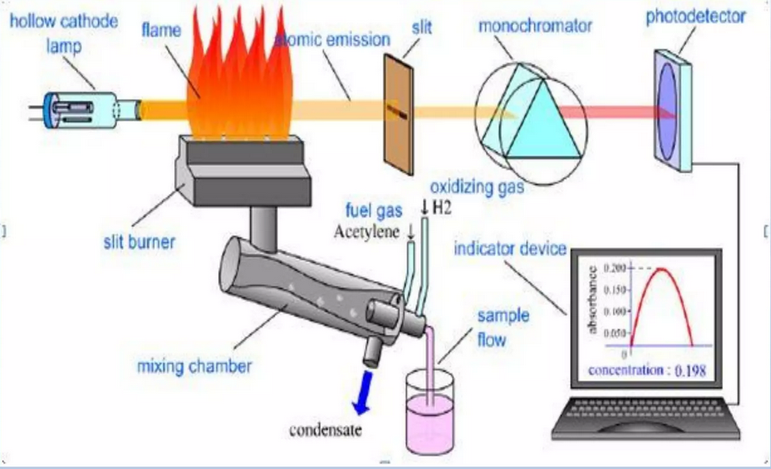
Instrumentation

Slide 6
Light Source
Typically a hollow cathode lamp (HCL) that emits light at the characteristic resonance line of the element of interest.
Hollow Cathode Lamp (HCL):
The HCL is a discharge lamp that emits characteristic wavelengths of light for the specific element of interest. It serves as the primary light source in AES.

Slide 7
Excitation Source
A flame or inductively coupled plasma (ICP) that produces high-energy conditions to excite atoms.

Slide 8
Slit
The slit limits the width of the light beam entering monochromator. By controlling the width of the beam, it helps to ensure that only a narrow, well-defined portion of the light enter monochromator.

Slide 9
Monochromator
Selects the specific wavelength of light corresponding to the emission line of the analyte.
A device that isolates the desired wavelength of light emitted by the sample. It ensures that only the characteristic lines of the element being analyzed reach the detector.

Slide 10
Detector
Measures the intensity of the transmitted light, allowing for the calculation of absorbance.
Photomultiplier/Photodetector tubes or solid-state detectors are commonly used, converts the optical signal into an electrical signal for further analysis and quantification.

Slide 11
Pharmaceutical Applications
Drug Analysis: Determination of trace metals in pharmaceutical formulations, ensuring product quality and adherence to regulatory standards.

Slide 12
Stability Studies: Assessing the stability of pharmaceutical formulations by tracking changes in elemental content.

Slide 13
Quality Control of Raw Materials:
AES is applied to assess the elemental composition of raw materials used in pharmaceutical manufacturing, helping maintain consistent quality in the production process.

