Slide 1

EMESIS AND ANTI-EMETICS
DR. IRFAN HAMID
PhD Pharmacology
ASSOCIATE PROFESSOR
CADSON COLLEGE OF PHARMACY

Slide 2
EMESIS
Emesis: Vomiting occurs due to stimulation of the emetic (vomiting) centre situated in the medulla oblongata.

Slide 3
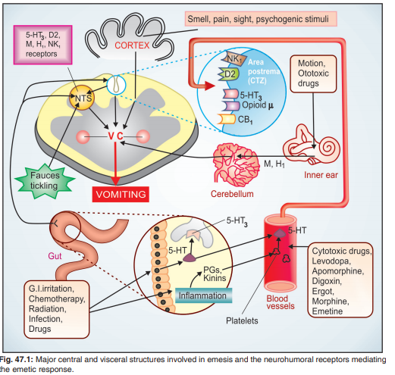
Multiple pathways can elicit vomiting

Slide 4
Multiple pathways can elicit vomiting
The chemoreceptor trigger zone (CTZ) located in the area postrema and the nucleus tractus solitarius (NTS) are the most important relay areas for afferent impulses arising in the GIT, throat and other viscera.
The CTZ is also accessible to bloodborne drugs, mediators, hormones, toxins, etc. because it is unprotected by the blood-brain barrier.

Slide 5
Cytotoxic drugs, radiation and other GIT irritants release 5-HT from enterochromaffin cells → acts on 5-HT3 receptors present on extrinsic primary afferent neurones (PAN) of the enteric nervous system (ENS).
These neurones connect with vagal and spinal visceral afferents to send impulses to NTS and CTZ.
Released in large quantity, 5-HT may also spill into circulation and reach CTZ via the vascular route.
5-HT may as well be released from platelets by inflammatory mediators.

Slide 6
The CTZ and NTS express a variety of receptors, e.g.
Histamine H1,
Dopamine D2,
Serotonin 5-HT3,
Cholinergic M,
Neurokinin NK1 (activated by substance P),
Cannabinoid CB1 and
Opioid µ receptors
through which the emetic signals are relayed and which could be targets of antiemetic drug action

Slide 7
The vestibular apparatus generates impulses when body is rotated or equilibrium is disturbed or when ototoxic drugs act.
These impulses reach the vomiting centre mainly relayed from the cerebellum and utilize muscarinic as well as H1 receptors.
Various unpleasant sensory stimuli such as bad odour, ghastly sight, severe pain as well as fear, recall of an obnoxious event, anticipation of an emetic stimulus (repeat dose of cisplatin) cause nausea and vomiting through higher centres.

Slide 8
Nausea
Nausea is accompanied by reduced gastric tone and peristalsis.
In the emetic response fundus and body of stomach, esophageal sphincter and esophagus relax and glottis closes, while duodenum and pyloric stomach contract in a retrograde manner.
Rhythmic contractions of diaphragm and abdominal muscles then compress the stomach and evacuate its contents via the mouth.
Conditions that inhibit gastric emptying predispose to vomiting.

Slide 9
EMETICS
These are drugs used to evoke vomiting.
1. Act on CTZ : Apomorphine
2. Act reflexly and on CTZ : Ipecacuanha
Vomiting needs to be induced only when an undesirable substance (poison) has been ingested.
Powdered mustard suspension or strong salts solution may be used in emergency.
They act reflexly by irritating the stomach.

Slide 10
Apomorphine
It is a semisynthetic derivative of morphine; acts as a dopaminergic agonist on the CTZ.
Injected i.M./s.c. in a dose of 6 mg,
it promptly (within 5 min) induces vomiting.
It should not be used if respiration is depressed, because it has inherent respiratory and CNS depressant actions.
Oral use of apomorphine is not recommended because the emetic dose is larger, slow to act and rather inconsistent in action.
Apomorphine has a therapeutic effect in parkinsonism, but is not used due to side effects

Slide 11
Ipecacuanha
The dried root of Cephaelis ipecacuanha contains emetine and is used as syrup ipecac (15–30 ml in adults, 10–15 ml in children, 5 ml in infants) for inducing vomiting.
It takes 15 min or more for the emetic effect,
It has been used as a household remedy because it is safer.
It acts by irritating gastric mucosa as well as through CTZ.

Slide 12
All emetics are contraindicated in:
(a) Corrosive (acid, alkali) poisoning:
risk of perforation and further injury to esophageal mucosa.
(b) CNS stimulant drug poisoning:
convulsions may be precipitated.
(c) Kerosine (petroleum) poisoning:
chances of aspiration of the liquid (due to low viscosity) and chemical pneumonia are high.
(d) Unconscious patient:
may aspirate the vomitus, because laryngeal reflex is likely to be impaired.
(e) Morphine or phenothiazine poisoning:
emetics may fail to act.
ANTIEMETICS: These are drugs used to prevent or suppress vomiting

Slide 13
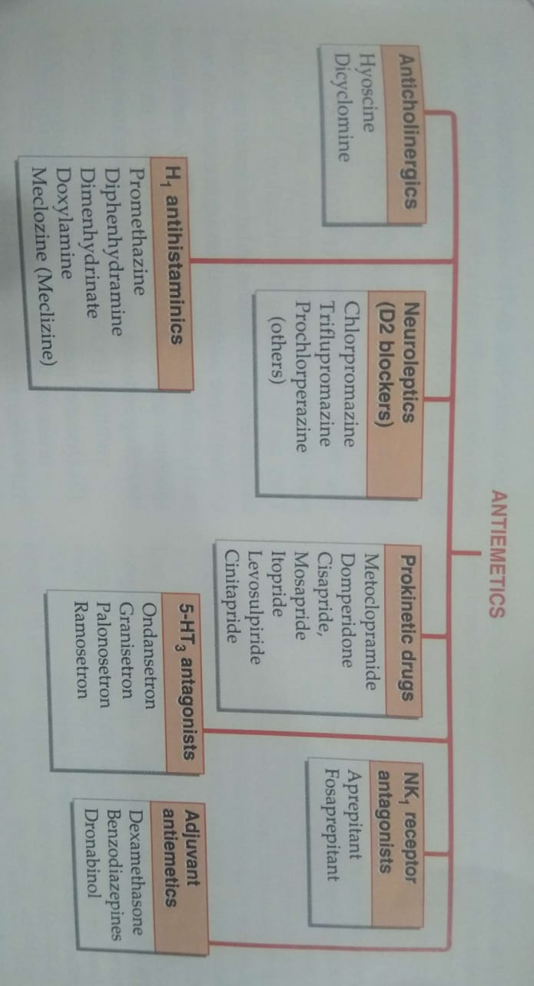
Classification of anti-emetics

Slide 14
PROKINETIC DRUGS
These are drugs which promote gastrointestinal transit and speed gastric emptying by enhancing coordinated propulsive motility.
This excludes traditional cholinomimetics and anti-ChEs which produce tonic and largely uncoordinated contraction

Slide 15
Metoclopramide
Metoclopramide, a substituted benzamide, is chemically related to procainamide, but has no pharmacological similarity with it.
Introduced in early 1970s as a ‘gastric hurrying’ agent, it is a commonly used antiemetic.

Slide 16
Pharmacological actions GIT:
Metoclopramide has more prominent effect on upper GIT.; increases gastric peristalsis while relaxing the pylorus and the first part of duodenum → speeds gastric emptying, especially if it was slow.
This action is independent of vagal innervation, but is stronger when vagus is intact.
Lower esophageal sphincter (LES) tone is increased and gastroesophageal reflux is opposed.
It also increases intestinal peristalsis to some extent, but has no significant action on colonic motility and gastric secretion.

Slide 17
CNS
Metoclopramide is an effective antiemetic; acting on the CTZ, blocks apomorphine induced vomiting.
The gastrokinetic action may contribute to the antiemetic effect.
It has no chlorpromazine (CPZ) like antipsychotic property, though it does share the extrapyramidal and prolactin secretion augmenting action of CPZ.

Slide 18
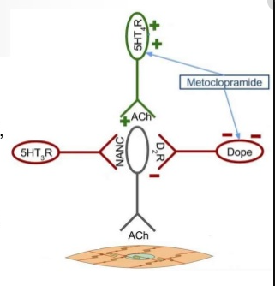
Mechanism of action:
Metoclopramide acts through both
dopaminergic receptors
(D2-Receptor)
serotonergic receptors
(5-HT- Receptor)

Slide 19
(a) D2 antagonism
Dopamine (acting through D2 receptors) is an inhibitory transmitter in the GIT. Normally acts to delay gastric emptying when food is present in stomach. It also appears to cause gastric dilatation and LES relaxation attending nausea and vomiting.
Metoclopramide blocks D2 receptors and has an opposite effect— hastening gastric emptying and enhancing LES tone by augmenting ACh release.
The central anti-dopaminergic (D2) action of metoclopramide on CTZ is clearly responsible for its antiemetic property.
Other manifestations of D2 blockade are antagonism of apomorphine induced vomiting, CPZ like extrapyramidal effects and hyperprolactinaemia

Slide 20
(b) 5-HT4 agonism
Metoclopramide acts in the GIT to enhance ACh release from myenteric motor neurones. This results from 5-HT4 receptor activation on primary afferent neurones (PAN) of the ENS via excitatory interneurones (Fig. 47.2).
The gastric hurrying and LES tonic effects are mainly due to this action which is synergised by bethanechol and attenuated by atropine.

Slide 21
(c) 5-HT3 antagonism
At high concentrations metoclopramide can block 5-HT3 receptors present on inhibitory myenteric interneurones and in NTS/ CTZ.
The peripheral action can augment ACh release in the gut, but appears to be minor.
The central anti 5-HT3 action appears to be significant only when large doses are used to control CINV.

Slide 22
Pharmacokinetics
Metoclopramide is rapidly absorbed orally,
It enters brain, crosses placenta and is secreted in milk.
It is partly conjugated in liver and excreted in urine within 24 hours; t½ is 3– 6 hours.
Orally it acts in ½–1 hr, but within 10 min after I.M. and 2 min after I.V. injection.
Action lasts for 4–6 hours

Slide 23
Interactions
It hastens the absorption of many drugs, e.g. aspirin, diazepam, etc. by facilitating gastric emptying.
The extent of absorption of digoxin is reduced by allowing less time for it.
Bioavailability of cimetidine is also reduced.
By blocking DA receptors in basal ganglia, it abolishes the therapeutic effect of levodopa.

Slide 24
Adverse effects
Metoclopramide is generally well tolerated.
Sedation, dizziness, loose stools, muscle dystonias (especially in children) are the main side effects.
Long-term use can cause parkinsonism, galactorrhoea and gynaecomastia, but it should not be used to augment lactation.
No harmful effects are known when used during pregnancy. Though the amount secreted in milk is small, but suckling infant may develop loose motions, dystonia, myoclonus

Slide 25
Therapeutic Uses 1. Antiemetic:
Metoclopramide is an effective and popular drug for many types of vomiting— postoperative, drug induced, disease associated (especially migraine), radiation sickness, etc, but is less effective in motion sickness.
Metoclopramide continues to be used for prophylaxis and treatment of vomiting induced by emetogenic anticancer drugs (cisplatin, etc.).

Slide 26
Gastrokinetic:
To accelerate gastric emptying:
(a) When emergency general anaesthesia has to be given and the patient has taken food less than 4 hours before.
(b) To relieve postvagotomy or diabetic gastroparesis associated gastric stasis.
(c) To facilitate duodenal intubation. Clinical efficacy is moderate.

Slide 27
Dyspepsia other functional GIT disorders
Metoclopramide may succeed in stopping persistent hiccups.

Slide 28
Gastroesophageal reflux disease (GERD)
Metoclopramide may benefit milder cases of GERD, but is much less effective than PPIs/H2 blockers.
It does not aid healing of esophagitis, but may be used as adjuvant to acid suppressive therapy.

Slide 29
Domperidone
It is a D2 receptor antagonist, chemically related to haloperidol, but pharmacologically related to metoclopramide.
The antiemetic and prokinetic actions have a lower ceiling. Unlike metoclopramide, its prokinetic action is not attenuated by atropine and is based only on D2 receptor blockade in upper GIT.
Domperidone crosses blood-brain barrier poorly.
Accordingly, extrapyramidal side effects are rare, but hyperprolactinaemia can occur.
The antiemetic action is exerted mainly through CTZ which is not protected by blood-brain barrier.

Slide 30
Domperidone
Because of poor entry into CNS, it does not block the therapeutic effect of levodopa and bromocriptine in parkinsonism, but counteracts their dose-limiting emetic action.
Domperidone is absorbed orally, but bioavailability is only ~15% due to first pass metabolism.
It is completely biotransformed and metabolites are excreted in urine.
Plasma t½ is 7.5 hr

Slide 31
Side effects
Dry mouth, loose stools, headache, rashes, galactorrhoea are generally mild.
Cardiac arrhythmias have developed on rapid i.v. injection.
Its indications are similar to that of metoclopramide, but it is a less efficacious gastrokinetic and not useful against highly emetogenic chemotherapy

Slide 32
5-HT3 ANTAGONISTS Ondansetron: Mode of Action
It is the prototype of a distinct class of antiemetic drugs developed to control cancer chemotherapy/radiotherapy induced vomiting, and later found to be highly effective in PONV and disease/drug associated vomiting as well.
It blocks the depolarizing action of 5-HT exerted through 5-HT3 receptors on vagal afferents in the GIT as well as in NTS and CTZ.

Slide 33
Ondansetron
Cytotoxic drugs/radiation produce nausea and vomiting by causing cellular damage → release of mediators including 5-HT from intestinal mucosa → activation of vagal afferents in the gut → emetogenic impulses to the NTS and CTZ.
Ondansetron blocks emetogenic impulses both at their peripheral origin and their central relay.
It does not block dopamine receptors.
Apomorphine or motion sickness induced vomiting is not suppressed.
A weak gastrokinetic action due to 5-HT3 blockade has been detected, but this is clinically insignificant.
A minor 5-HT4 antagonistic action has also been shown, but seems to have no clinical relevance.

Slide 34
Pharmacokinetics:
Oral bioavailability of ondansetron is 60–70% due to first pass metabolism.
It is hydroxylated by CYP1A2, 2D6 and 3A, followed by glucuronide and sulfate conjugation.
It is eliminated in urine and faeces, mostly as metabolites;
t½ is 3–5 hrs, and duration of action is 8–12 hrs (longer at higher doses).

Slide 35
Side effects:
Ondansetron is generally well tolerated:
Common side effect:
headache and dizziness.
Mild constipation
abdominal discomfort occur in few patients.
Hypotension, bradycardia, chest pain and allergic reactions are reported, especially after i.v. injection

Slide 36
D2 receptor antagonist (Phenothiazines)Prochlorperazine
The first group of drugs shown to be effective antiemetic agents, phenothiazines, such as prochlorperazine, act by blocking dopamine receptors.
Prochlorperazine is effective against low or moderately emetogenic chemotherapeutic agents (for example, fluorouracil and doxorubicin).
Although increasing the dose improves antiemetic activity,
side effects are dose limiting.

Slide 37
D2 receptor antagonist Butyrophenones: Droperidol
Butyrophenones: Droperidol and haloperidol act by blocking dopamine receptors.
The butyrophenones are moderately effective antiemetics.
Droperidol had been used most often for sedation in endoscopy and surgery, usually in combination with opioids or benzodiazepines.
It may prolong the QTc interval and should be reserved for patients with inadequate response to other agents.
High-dose haloperidol was found to be nearly as effective as high-dose metoclopramide in preventing cisplatin-induced emesis.

Slide 38
Benzodiazepines:
The antiemetic potency of lorazepam and alprazolam is low.
Their beneficial effects may be due to their sedative, anxiolytic, and amnesic properties.
These same properties make benzodiazepines useful in treating anticipatory vomiting.
Concomitant use of alcohol should be avoided due to additive CNS depressant effects

Slide 39
Corticosteroids:
Dexamethasone and methylprednisolone, used alone, are effective against mildly to moderately emetogenic chemotherapy.
Most frequently, however, they are used in combination with other agents.
Their antiemetic mechanism is not known, but it may involve blockade of prostaglandins

Slide 40
Substance P/neurokinin-1 receptor blocker:
Aprepitant targets the neurokinin receptor in the brain and blocks the actions of the natural substance.
Aprepitant is indicated only for highly or moderately emetogenic chemotherapy regimens.
It is usually administered orally with dexamethasone and 5-HT3 antagonist.
It undergoes extensive metabolism, primarily by CYP3A4, and it may affect the metabolism of other drugs that are metabolized by this enzyme, such as warfarin and oral contraceptives.

Slide 41
Combination regimens:
Antiemetic drugs are often combined to increase antiemetic activity or decrease toxicity.
Corticosteroids, most commonly dexamethasone, increase antiemetic activity when given with high-dose metoclopramide, a 5-HT3 antagonist, phenothiazine, butyrophenone, or a benzodiazepine.
Antihistamines, such as diphenhydramine, are often administered in combination with high-dose metoclopramide to reduce extrapyramidal reactions or with corticosteroids to counter metoclopramide-induced diarrhea.

