Slide 1
Pharamaceutical Chemistry III-A Pharmaceutical Analysis
Molecular fluorescence spectroscopy

Slide 2
Molecular fluorescence spectroscopy
Molecular fluorescence spectroscopy is a technique used to study the electronic structure and interactions of molecules. It exploits the phenomenon of fluorescence, where molecules absorb light at a particular wavelength and subsequently emit light at a longer wavelength.

Slide 3
Absorption: Molecules absorb photons of light at specific wavelengths, causing electronic transitions from the ground state to higher energy excited states.

Slide 4
Excitation: Upon absorbing light energy, molecules transition to higher electronic energy levels. This excitation is usually to a singlet excited state, although triplet excited states may also be populated, especially in heavy atoms or molecules containing heavy atoms.

Slide 5
Relaxation: The excited molecules return to lower energy states, typically the lowest vibrational level of the excited state, through various relaxation processes. One of the most common relaxation pathways is fluorescence emission.

Slide 6
Fluorescence Emission: Molecules emit photons of light as they return to the ground state from the excited state. The emitted light is typically of longer wavelength and lower energy than the absorbed light.

Slide 7
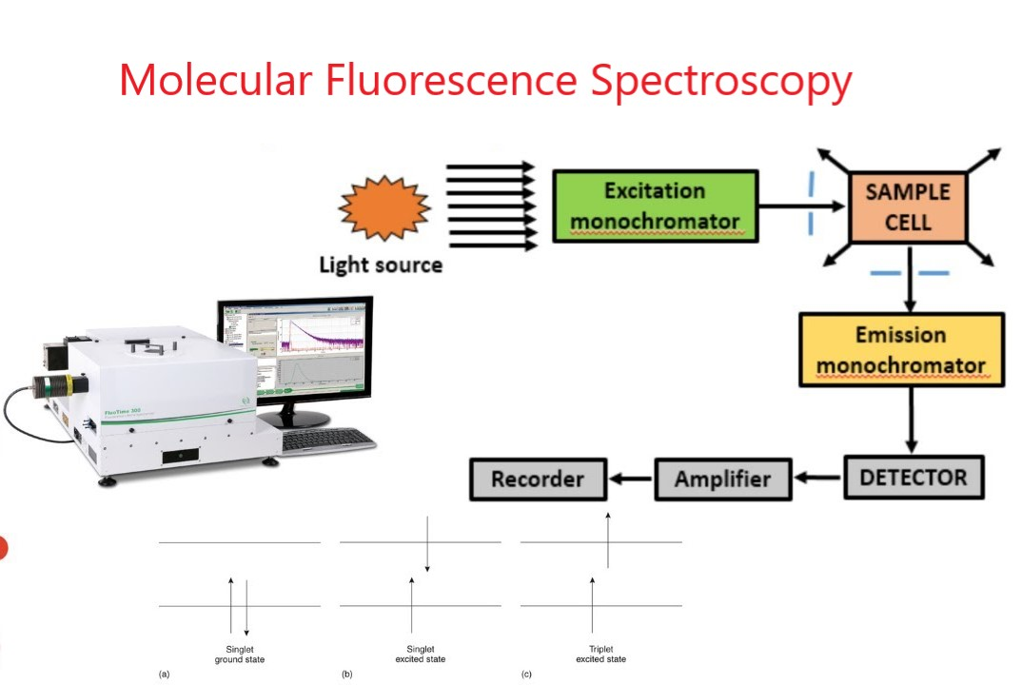
Instrumentation

Slide 8
Excitation Source: This provides the light energy to excite the molecules. Common sources include xenon arc lamps, mercury vapor lamps, and lasers.

Slide 9
Monochromators: These devices are used to select specific wavelengths of light for excitation and emission. They ensure that only light of the desired wavelength reaches the sample and detector.

Slide 10
Sample Holder: Samples are typically placed in quartz cuvettes to minimize fluorescence interference from the container material.

Slide 11
Detector: Photomultiplier tubes (PMTs) or photodiode arrays (PDAs) are commonly used to detect the emitted fluorescence light. These detectors convert photons into electrical signals that can be measured and analyzed.

Slide 12
Data Acquisition System: This system records the fluorescence emission spectra, typically as a function of wavelength. It may include software for data analysis and interpretation.

Slide 13
Pharmaceutical Applications
Drug Discovery: Fluorescence spectroscopy is used to study the interactions between drug molecules and target biomolecules such as proteins, nucleic acids, and membranes. It helps in screening potential drug candidates and understanding their binding mechanisms.

Slide 14
Quality Control: Fluorescence spectroscopy is employed for quality control of pharmaceuticals, including the analysis of drug formulations, detection of impurities, and monitoring of stability during storage.

Slide 15
Biological Assays: Fluorescence-based assays are widely used for quantifying various biological molecules such as proteins, enzymes, nucleic acids, and metabolites. These assays are essential for drug development and pharmacological research.

