Slide 1


PATHOLOGY
ALLERGY
Dr. Adil Khaliq
Pharm-D, MPH
MPhil, Ph. D Scholar
adilkhaliq@awkum.edu.pk
dradilkhaliq@yahoo.com

Slide 2
What is Allergy
An exaggerated reaction by immune system to some harmless substances (allergen) which normally does not affect most people.
What are Allergens?
  Allergens are harmless substances that are foreign to the body and can cause an allergic reaction in some people.
  Pollen, house dust mites, mold, and animal dander are examples of allergens.

Slide 3
Mechanism
In an allergic person, the body mistakes the allergen for a harmful substance. This causes the cells to release substances, such as histamine. The release of histamine and other chemicals causes the body to experience an allergic reaction.
An allergic reaction may cause a runny nose, sneezing, itching, swelling, or asthma.
The reason that some people have allergies is not entirely clear. The potential to develop allergies is thought to be hereditary.

Slide 4
Mechanism……contd
While first-time exposure may only produce a mild reaction, repeated exposures may lead to more serious reactions. Once a person is sensitized (has had a previous sensitivity reaction), even a very limited exposure to a very small amount of allergen can trigger a severe reaction.
Most occur within seconds or minutes after exposure to the allergen, but some can occur after several hours, particularly if the allergen causes a reaction after it is partially digested. In very rare cases, reactions develop after 24 hours.

Slide 5
The Immune System Foreign Substance (cat dander, pollen, virus, bacteria)
Non Allergic Individual Allergic Individual
Normal Immune Response IgM, IgG, IgA, IgD and various immune cells respond to attack. |  | Exaggerated Immune Response IgE is overproduced in response to cat dander, pollens, and other harmless allergens.
Foreign substance is eliminated. |  | Subsequent exposure results in an allergic reaction.

Slide 6
Common Allergens
Pollen
Dust mites
Mold spores
Pet dander
Food
Insect stings
Medicines

Slide 7
Why Some People Have Allergy
Heredity: Certain allergies are transferred genetically from parents to their children
Environmental factor; environmental pollution, allergen levels and dietary changes.
Infectious diseases during early childhood,
Allergies can develop at any age

Slide 8
Allergy Facts
It is estimated that 50 million North Americans are affected by allergic conditions.
The cost of allergies in the United States is more than $10 billion dollars yearly.
Allergic rhinitis (nasal allergies) affects about 35 million Americans, 6 million of whom are children.
Asthma affects 15 million Americans, 5 million of whom are children.
The number of cases of asthma has doubled over the last 20 years.

Slide 9
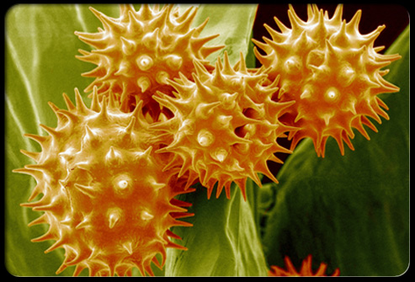
Pollen
What is it?
Fine powder like grains that are produced by seed plants.
Exposure to pollen from trees, grasses, and weeds can trigger hay fever or seasonal allergies.
Symptoms
Hay Fever: Sneezing, Runny nose, Nasal congestion, Itchy and watery eyes
Prevention
Prevent symptoms by staying indoors on windy days when pollen counts are high, closing windows, and running the air conditioning.
Paper Mulberry Pollen is the major Allergen in Islamabad

Slide 10
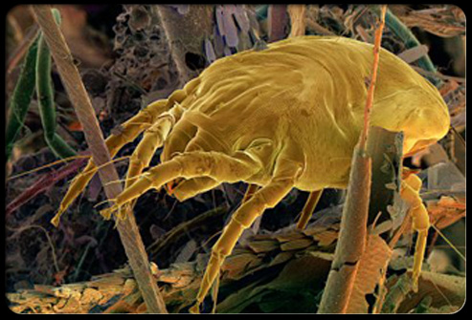
Dust Mites
What are they?
Dust mites are microscopic organisms that live in house dust. They thrive in areas of high humidity and feed on the dead skin cells of humans and their pets, as well as on pollen, bacteria, and fungi.
Symptoms:
Wheezing, dyspnea, tachypnea,asthma
Prevention
Help prevent dust mite allergies by covering mattresses, pillows, and box springs, using hypoallergenic pillows, washing sheets weekly in hot water, and keeping the house free of dust collecting-items such as stuffed animals, curtains, and carpet.

Slide 11
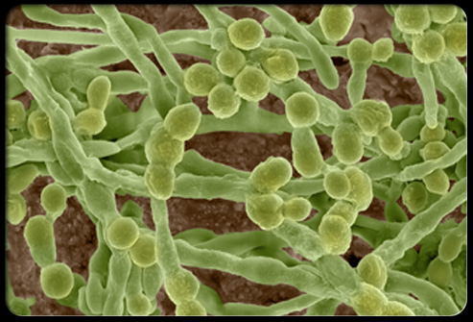
Mold
What is it?
It is a kind of fungi that grows in warm damp places
Molds produce allergens, irritants, and in some cases, potentially toxic substances.
Symptoms
Skin rashes and respiratory problems
Prevention
Avoid activities that trigger symptoms, such as raking leaves. Ventilate moist areas in the home.

Slide 12

Pet Dander
What is it?
Proteins secreted by oil glands in an animal's skin and present in their saliva.
It can cause allergic reactions for some. The allergy can take two or more years to develop and symptoms may not subside until months after ending contact with the animal.
Prevention
If your pet is causing allergies, make your bedroom a pet-free zone, avoid carpets, and wash the animal regularly. Frequent vacuuming may also help. Allergy shots may be beneficial.

Slide 13

Food
Which foods?
Milk, shellfish, nuts and wheat are among the most common foods that cause allergies.
An allergic reaction usually occurs within minutes of eating the offending food.
Symptoms
Asthma, hives, vomiting, diarrhea, and swelling around the mouth, can be severe
Prevention
Avoid offending foods altogether; but if exposed, treatment with antihistamines or steroids is recommended. In life-threatening situations, an epinephrine injection is needed.

Slide 14
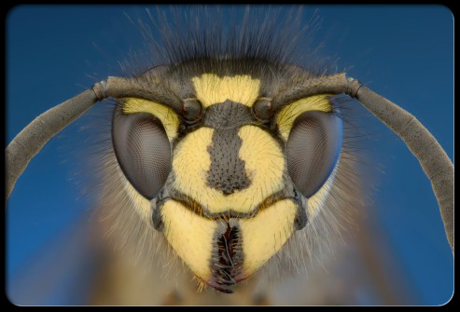
Insect Bites
People who are allergic to stings can have a severe or even life-threatening reaction.
Symptoms
Extensive swelling and redness, nausea, fatigue, and low-grade fever. Rarely, may cause anaphylaxis, with symptoms including difficulty breathing, hives, swelling of the face, throat, or mouth, rapid pulse, dizziness, or a sharp drop in blood pressure.
Treatment
For those severely allergic, epinephrine should be administered immediately after a sting; allergy shots are recommended to prevent anaphylaxis with future stings.

Slide 15
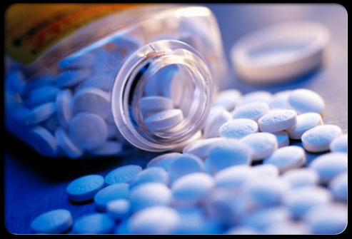
Medicines
Symptoms
Allergies to medications, such as penicillin or aspirin, can range from mild to life-threatening and can include hives, itchy eyes, congestion, and swelling in the mouth and throat.
Prevention & Treatment
It's best to avoid the drug altogether; however, if exposed, treatment with antihistamines or steroids is recommended. For coughing and lung congestion, bronchodilators may be prescribed. For severe symptoms, epinephrine may be needed.

Slide 16
Effects of allergic reactions on different organs of body
Main organ | Disease | Main symptoms | Typical allergens | Route of entry
Lung | Asthma | Wheezing, dyspnea, tachypnea | Pollens, house dust, animal dander | Inhalation
Nose and Eyes | Rhinitis, conjunctivitis Hay fever | Runny nose, redness and itching of eyes | Pollens | Contact with mucous membrane
Skin | Eczema (atopic dermatitis) Urticaria | Pruritic, vesicular lesions Pruritic, bullous lesions | Uncertain Various foods Drugs | Uncertain Ingestion Various
Intestinal tract | Allergic gastroenteropathy | Vomiting diarrhea | Various food | Ingestion
Systemic | Anaphylaxis | Shock, hypotension, wheezing | Insect venom;bee Drugs; penicillin Foods; Peanuts | Sting Various Ingestion

Slide 17
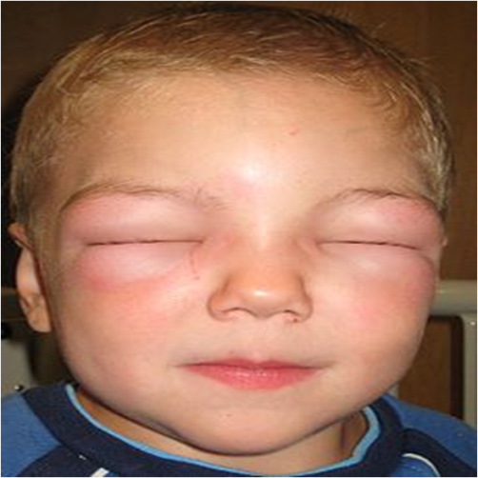
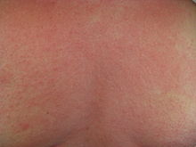
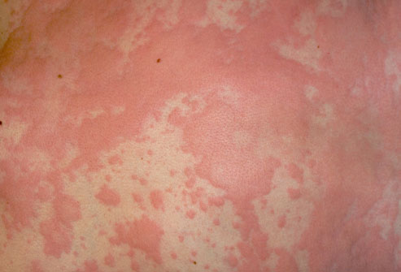
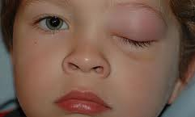

Slide 18
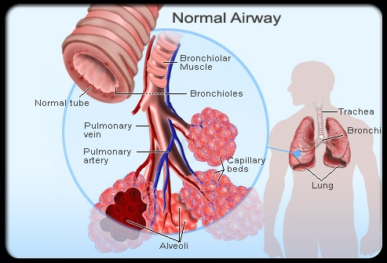
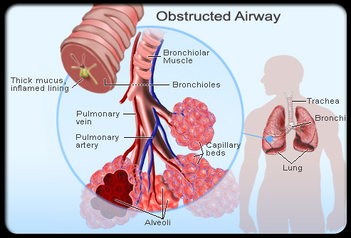
Asthma
Allergy can play a role in some, but not all, asthma patients. Symptoms of asthma include shortness of breath, wheezing, cough, and chest tightness.

Slide 19
Treatment
Mild Cases
Reassurance to the patient
Antihistamine drugs/Inhaler for asthma
Alternate Therapies:
Black seed oil
Honey
Hijamah cupping therapy
Dua and Ruqiya

Slide 20
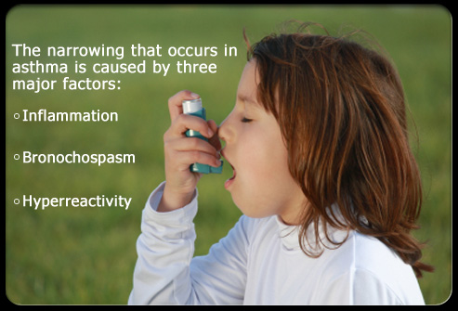
Use of Inhaler

Slide 21
Treatment

Slide 22
Severe cases
Severe cases like Severe attack of asthma , anaphylactic shock need emergency treatment.
Symptoms:
Shock
Difficulty in breathing and wheezing
Blood pressure drops
Management
Epinephrine/steroid injection may be required under supervision of doctor along with other measures

