Slide 1
SULPHONAMIDES
Prepared by;
Adeena Shafqat Roll 48
Deesha Shafqat Roll 08
Pharmacology

Slide 2
Sulphonamides
Sulfonamides were the first antimicrobial agents (AMAs) effective against pyogenic bacterial infections.
They are:
Bacteriostatic
interfere with intermediary metabolism
Sulphonamides are structural analogue of
paraaminobenzoic acid.(PABA)

Slide 3
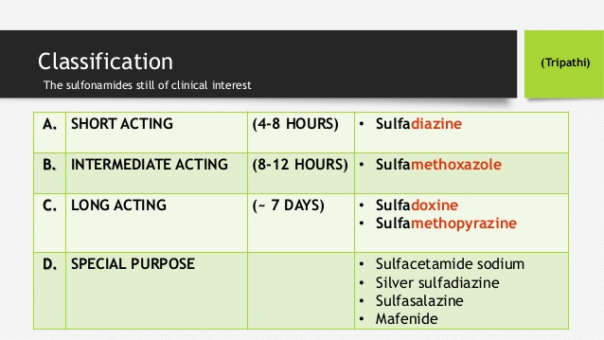
CLASSIFICATION

Slide 4
Resistance to Sulphonamides
Most bacteria are capable of developing resistance to sulfonamides. Prominent among these are gonococci,pneumococci, Staph. aureus, meningococci, E.coli, Shigella and some Strep. pyogenes, Strep.viridans and anaerobes.
The resistant mutants
either:
(a) produce increased amounts of PABA, or
(b) their folate synthase enzyme has low affinity for sulfonamides, or
(c) adopt an alternative pathway in folate metabolism.
Resistance developed in vivo is quite persistent.
Sensitivity patterns have changed depending on the extent of use. When an organism is resistant to one sulfonamide, it is resistant to them all.

Slide 5
Antibacterial Spectrum
Sulfonamides are primarily bacteriostatic against many gram-positive and gram-negative bacteria.
However, bactericidal concentrations may be attained in urine. Sensitivity patterns among microorganisms have changed from time-to-time and place-to-place. Those still sensitive are:many Strepto. pyogenes, Haemophilus influenzae, H. ducreyi, Calymmatobacterium granulomatis, Vibrio cholerae.
Only a few Staph. aureus, gonococci, meningococci,pneumococci, Escherichia coli, and Shigella respond, but majority are resistant.
Anaerobic bacteria are not susceptible.
Chlamydiae: trachoma, lymphogranuloma venereum, inclusion conjunctivitis, are sensitive, as are Actinomyces, Nocardia and Toxoplasma.

Slide 6
Pharmacokinetics
Sulfonamides are rapidly and nearly completely absorbed from g.i.t. Extent of plasma protein binding differs considerably (10–95%) among different members.
The primary pathway of metabolism of sulfonamides is acetylation at N4 by nonmicrosomal acetyl transferase, primarily in liver.
Sulfonamides are excreted mainly by the kidney through glomerular filtration.

Slide 7
Mechanism of Actions
Bacteria synthesize their own folic acid of which paraaminobenzoic acid is a constituent and is taken up from medium.
Sulphonamides are structural analogoues of PABA,inhibit bacterial folate synthase and formation of folate gets inhibited.
Sulphonamides competitively inhibit PABA with pteridine residue to form dihydropteric acid which conjugates with glutamic acid to produce dihydrofolic acid.
Sulphonamides altered folate which is metabolically injurious.

Slide 8
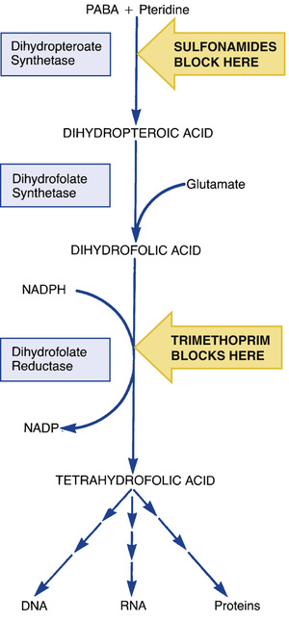


Slide 9
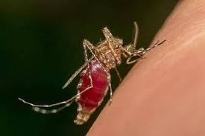
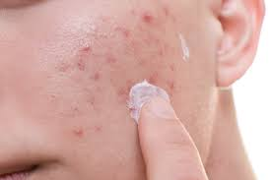
USES
Sulphonamides are used in the treatment of
UTI Infections
Narcardiosis
Toxoplasmosis
Malaria
U. colitis
Topical use

Slide 10

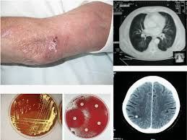
For Information
Nocardiosis is an infectious disease affecting either the lungs (pulmonary nocardiosis) or the whole body (systemic nocardiosis). It is due to infection by a bacterium of the genus Nocardia, most commonly Nocardia asteroides or Nocardia brasiliensis.

Slide 11

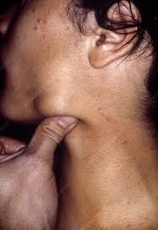
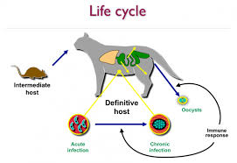
Toxoplasmosis
Toxoplasmosis (tok-so-plaz-MOE-sis) is a disease that results from infection with the Toxoplasma gondii parasite, one of the world's most common parasites. Infection usually occurs by eating undercooked contaminated meat, exposure from infected cat feces, or mother-to-child transmission during pregnancy.

Slide 12
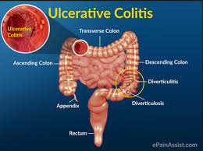
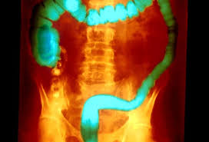
U. colitis
Ulcerative colitis (UC) is an inflammatory bowel disease that affects your large intestine, causing irritation, inflammation, and ulcers in the colon

Slide 13


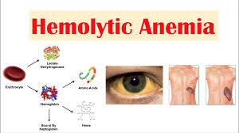

Adverse Effects
Urinary Irritation
Hematirea
Albuminurea
Crystal urea
Hypersensitivity
Anorexia
Nausea
Abdominal Pain
Hemolytic aneamia

Slide 14
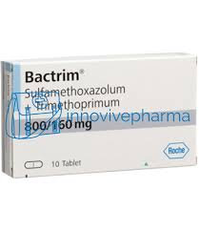
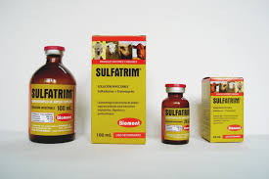
Pakistani Brand Names
Sulphamethoxazole is available in following trade names in Pakistan.
Prontosil (prodrug)
Bactrim
Sulphatrim (pediatrics)

Slide 15


Slide 16


