Slide 1
Cell Structure And Functions

Slide 2
OBJECTIVES
Description and explanation of cell, tissue, organ and system.
General characteristics of cell.
Prokaryotic and eukaryotic cell.
Membranous and non membranous structure of Cell.
Function of different cell organelles.

Slide 3
Introduction:
All the living things are composed of cells. A single cell is the smallest unit that has all the characteristics of life.
Cell is defined as the structural and functional unit of the living body.
Cells are the building blocks of the body, providing structure for the body’s tissues and organs, ingesting nutrients and converting them to energy, and performing specialized functions.
Cells also contain the body’s hereditary code that controls the substances synthesized by the cells and permits them to make copies of themselves.

Slide 4
General Characteristics of Cell
Each cell in the body:
1.Needs nutrition and oxygen.
2.Produces its own energy necessary for its growth,
repair and other activities.
3.Eliminates carbon dioxide and other metabolic wastes.
4. Maintains the medium, i.e. the environment for its
Survival.
5. Shows immediate response to the entry of invaders
like bacteria or toxic substances into the body.
6.Reproduces by division. There are some exceptions
like neuron, which do not reproduce.

Slide 5
TISSUE
Tissue is defined as the group of cells having similar
function. There are many types of tissues in the body. All the tissues are classified into four major types which are called the primary tissues. The primary tissues include:
1. Muscle tissue (skeletal muscle, smooth muscle and
cardiac muscle)
2. Nervous tissue (neurons and supporting cells)
3. Epithelial tissue (squamous, columnar and cuboidal
epithelial cells)
4. Connective tissue (connective tissue proper, cartilage, bone and blood).

Slide 6
ORGAN
An organ is defined as the structure that is formed by two or more primary types of tissues, which execute the functions of the organ. Some organs are composed of all the four types of primary tissues.
The organs are of two types,
Tubular or hollow organs and
Compact or parenchymal organs.
Some of the organs in the body are brain, heart, lungs, stomach, intestine, liver, gallbladder, pancréas, kidneys, endocrine glands, etc.

Slide 7
SYSTEM
Group of organs that work together to carry out specific functions of the body.
Each system performs a specific function. For example Digestive system is concerned with digestion of food particles.
Excretory system eliminates unwanted substances.
Cardiovascular system is responsible for transport of
substances between the organs.
Respiratory system is concerned with the supply of oxygen and removal of carbon dioxide.
Reproductive system is involved in the reproduction of species.
Endocrine system is concerned with growth of the body and regulation and maintenance of normal life.
Musculoskeletal system is responsible for stability and movements of the body.
Nervous system controls the locomotion and other activities including the intellectual functions.

Slide 8
ORGANIZATION OF THE CELL:
A typical cell, as seen by the light microscope, is shown in Figure .
Its two major parts are the nucleus and the cytoplasm.
The nucleus is separated from the cytoplasm by a nuclear membrane, and the cytoplasm is separated from the surrounding fluids by a cell membrane, also called the plasma membrane.

Slide 9
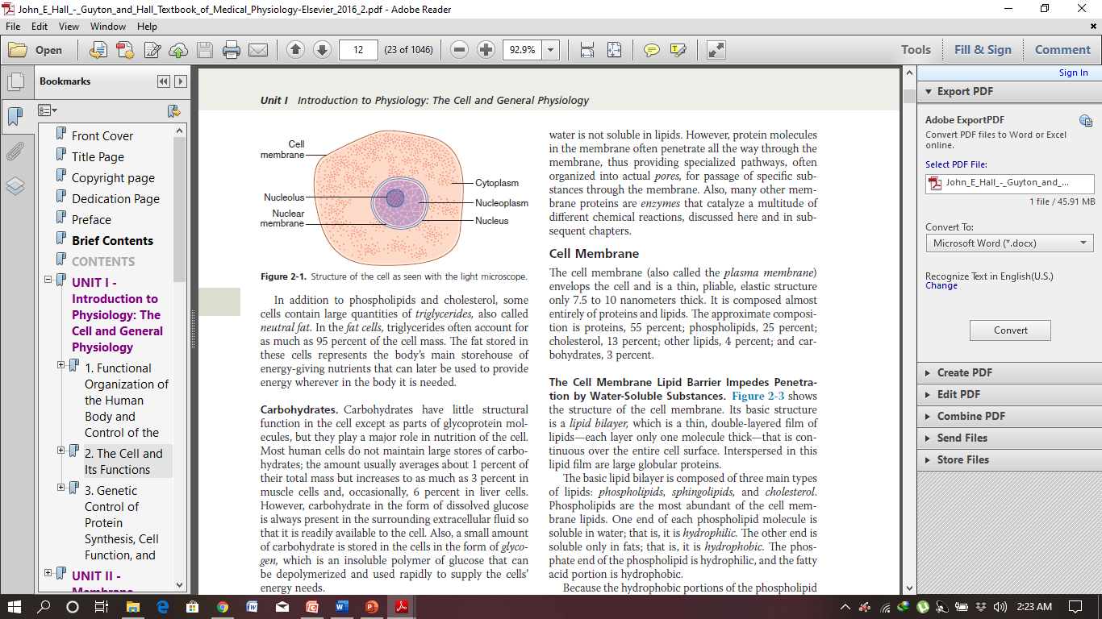

Slide 10
The different substances that make up the cell are collectively called protoplasm. Protoplasm is composed
mainly of five basic substances: water, electrolytes, proteins,
lipids, and carbohydrates.
Water:
The principal fluid medium of the cell is water,
which is present in most cells, except for fat cells, in a
concentration of 70 to 85 percent. Many cellular chemicals
are dissolved in the water.
Electrolytes:
Important ions in the cell include potassium, magnesium, phosphate, sulfate, bicarbonate, and smaller quantities of sodium, chloride, and calcium.
The ions provide inorganic chemicals for cellular reactions
and also are necessary for operation of some of the
cellular control mechanisms.

Slide 11
Proteins:
After water, the most abundant substances in most cells are proteins, which normally constitute 10 to 20 percent of the cell mass. These proteins can be divided into two types: structural proteins and functional
proteins.
Lipids:
Important lipids are phospholipids and cholesterol, which together constitute only about 2 percent of the total cell mass. They are mainly insoluble in water and therefore are used to form the cell membrane and intracellular membrane barriers that separate the different cell compartments.

Slide 12
Classification Of Cells:
Cells can be classified as
Eukaryotic cells and
Prokaryotic cells.
They can be distinguished by their structure. The cells of the human body, as well as those of other multicellular animals and plants, are eukaryotic (true-nucleus) cells. These cells contain a nuclear membrane surrounding the cell nucleus and also contain numerous other membrane-bound structures.
Prokaryotic cells, such as bacteria, lack these membranous structures

Slide 13
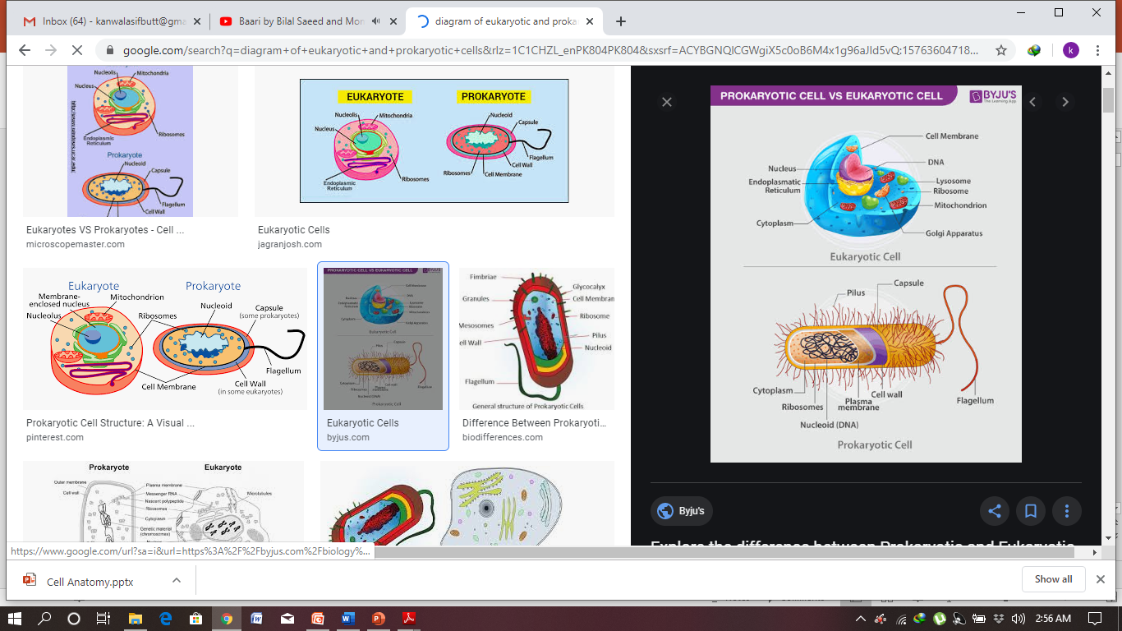

Slide 14
The interior of a cell is divided into two regions:
(1) The Nucleus, a spherical or oval structure usually near the center of the cell; and
(2) The Cytoplasm, the region outside the nucleus.
The cytoplasm contains cell organelles and fluid
surrounding the organelles, known as the cytosol.
The term intracellular fluid refers to all the fluid
inside a cell—in other words, cytosol plus the fluid inside all the organelles, including the nucleus. The chemical compositions of the fluids in cell organelles may differ from that of the cytosol. The cytosol is by far the largest intracellular fluid compartment.

Slide 15
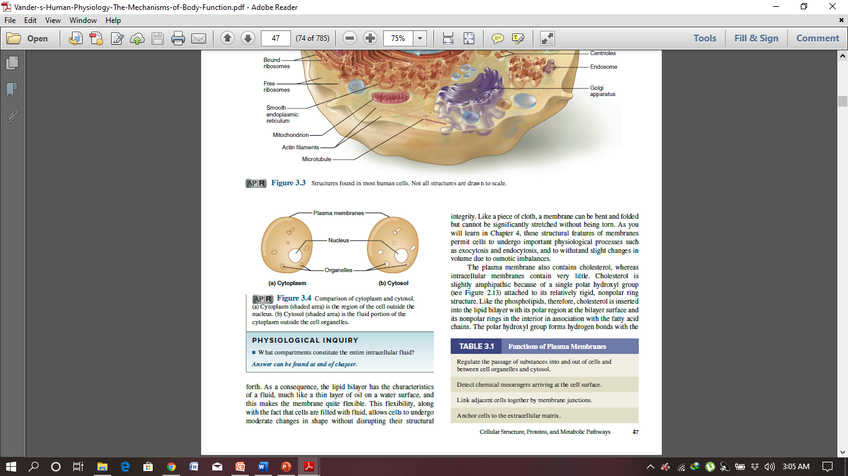
Comparison of cytoplasm and cytosol.
Cytoplasm (shaded area) is the region of the cell outside the nucleus.
(b) Cytosol (shaded area) is the fluid portion of the cytoplasm outside the cell organelles.

Slide 16
PHYSICAL STRUCTURE OF THE CELL
The cell contains highly organized physical structures, called intracellular organelles.
The physical nature of each organelle is as important as the cell’s chemical constituents
for cell function.
For instance, without one of the organelles, the mitochondria, more than 95 percent of the cell’s energy release from nutrients would cease immediately.
The most important organelles and other structures of the cell are as follows.

Slide 17
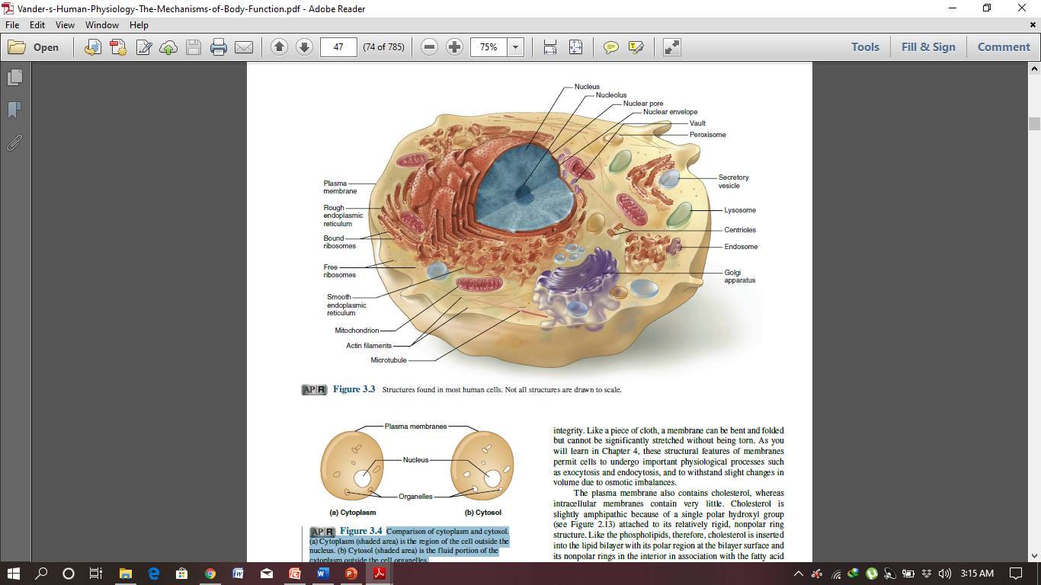

Slide 18
MEMBRANOUS STRUCTURES OF THE CELL:
Most organelles of the cell are covered by membranes composed primarily of lipids and proteins. These membranes include the cell membrane, nuclear membrane, membrane of the endoplasmic reticulum, and membranes of the mitochondria, lysosomes, and Golgi
apparatus.

Slide 19
Cell Membrane
The cell membrane or plasma membrane envelops the cell and is a thin, pliable, elastic structure only 7.5 to 10 nanometers thick. It is composed almost entirely of proteins and lipids.
This membrane separates the fluid outside the cell called extracellular fluid (ECF) and the fluid inside the cell called intracellular fluid (ICF).
The cell membrane is a semipermeable membrane. So, there is free exchange of certain substances between ECF and ICF.

Slide 20
COMPOSITION OF CELL MEMBRANE
Cell membrane is composed of:
Proteins (55%).
Lipids (40%).
Carbohydrates (5%).
Phospholipids (25%).
Cholesterol (13%).
Other lipids (4%).
The basic lipid bilayer is composed of three main types of lipids: phospholipids, sphingolipids, and cholesterol.
Phospholipids are the most abundant of the cell membrane lipids.

Slide 21
STRUCTURE OF CELL MEMBRANE
On the basis of structure, cell membrane is called a unit membrane or a three-layered membrane.
The electron microscopic study reveals three layers of cell membrane, namely, one central electron-lucent layer and two electron-dense layers.
The two electron-dense layers are placed one on either side of the central layer. The central layer is a lipid layer formed by lipid substances.
The other two layers are protein layers formed by proteins.
Cell membrane contains some carbohydrate molecules
also.

Slide 22
Structural Model of the Cell Membrane
1. Danielli-Davson model
The first proposed basic model of membrane structure was ‘Danielli Davson model’.
It was proposed by James F Danielli and Hugh Davson in 1935.
This model was basically a ‘sandwich of lipids’ covered by proteins on both sides.
2. Fluid mosaic model
The fluid mosaic model was proposed by Singer and Nicholson in 1972. According to that model the membrane is a fluid with mosaic of proteins, i.e. Mosaic is a pattern formed by arrangement of different colored pieces of stone, tile or glass. In this model, the proteins are found to float in the lipid layer instead of forming the layers of the sandwich-type model.

Slide 23
Fluid Mosaic Model
The surfaces of the membrane are
"hydrophilic" due to the polar
phosphate heads.
The internal portion of the membrane
is "hydrophobic" due to the non-polar
fatty acid tails;
The membrane proteins also have both hydrophilic and hydrophobic ends.

Slide 24
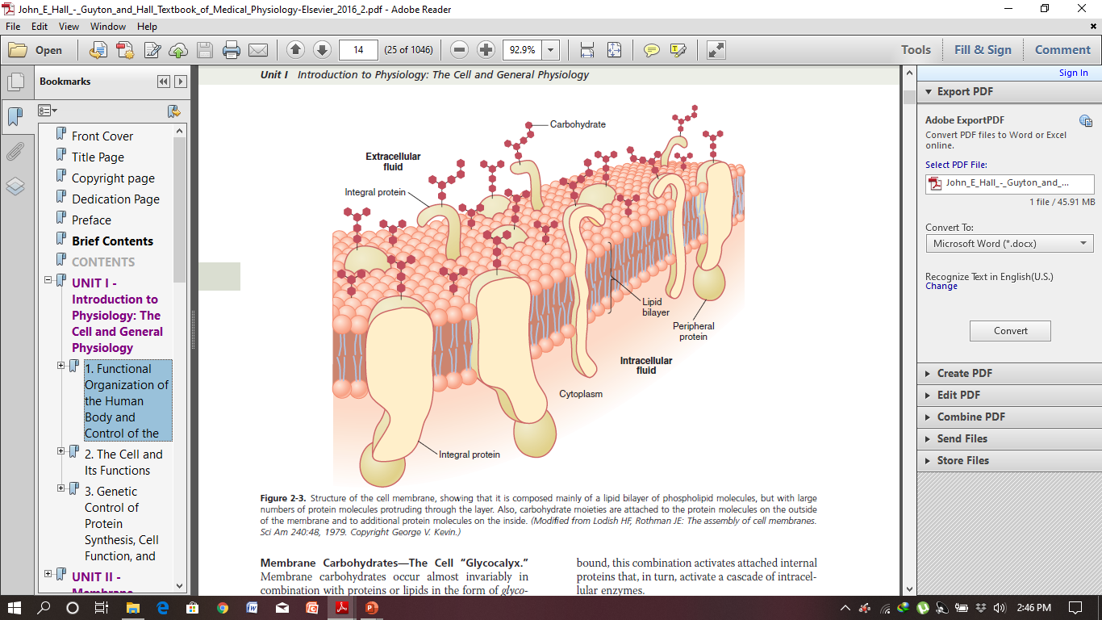

Slide 25
Functions of Plasma Membrane:
1. Protective function: Cell membrane protects the
cytoplasm and the organelles present in the cytoplasm.
2. Selective permeability: Cell membrane acts as a
semipermeable membrane, which allows only some
substances to pass through it and acts as a barrier
for other substances.
3. Absorptive function: Nutrients are absorbed into the
cell through the cell membrane.
4. Excretory function: Metabolites and other waste products from the cell are excreted out through the cell membrane.
5. Exchange of gases: Oxygen enters the cell from the
blood and carbon dioxide leaves the cell and enters the blood through the cell membrane.
6. Maintenance of shape and size of the cell: Cell membrane is responsible for the maintenance of shape and size of the cell.

Slide 26
Cell Membrane Surface Modifications
Cilia / Cilium:
Short, hair-like cellular extensions(eyelashes);
Help move substances through passageways;
Located in lining of respiratory tract & fallopian tube.
Flagella:
Tail-like projection;
Aids in cell locomotion;
Sperm cell.
Microvilli:
Small finger-like extensions of the external surface of the cell membrane;
Function is to increase surface area.
Located in the lining of the digestive tract.

Slide 27
CYTOPLASM
Cytoplasm of the cell is the jelly like material formed by
80% of water. It contains a clear liquid portion called
cytosol and various particles of different shape and
size.
These particles are proteins, carbohydrates, lipids
or electrolytes in nature. Cytoplasm also contains many
organelles with distinct structure and function.
Cytoplasm is made up of two zones:
1. Ectoplasm: Peripheral part of cytoplasm, situated
just beneath the cell membrane
2. Endoplasm: Inner part of cytoplasm, interposed
bet ween the ectoplasm and the nucleus.

Slide 28
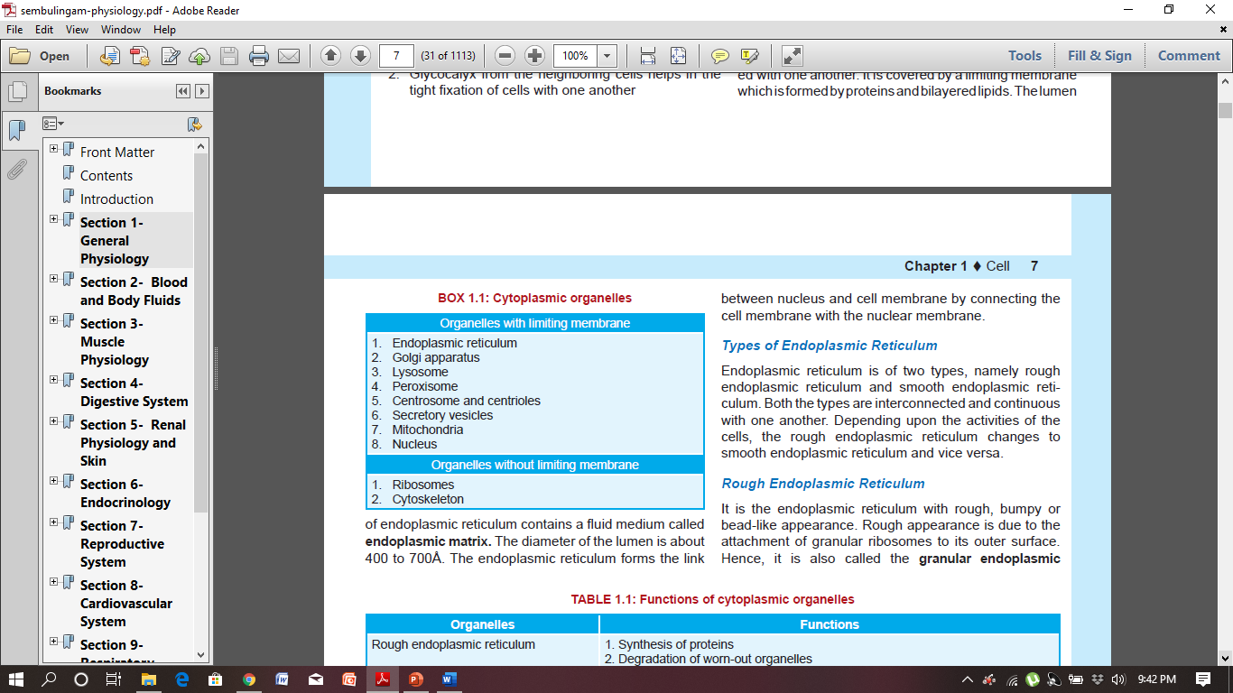
.

Slide 29
ORGANELLES WITH LIMITING MEMBRANE
ENDOPLASMIC RETICULUM:
Endoplasmic reticulum (ER) is a network of tubular and
microsomal vesicular structures which are interconnected
with one another. It is covered by a limiting membrane
which is formed by proteins and bilayered lipids.
Types of Endoplasmic Reticulum:
Rough Endoplasmic Reticulum
Smooth Endoplasmic Reticulum

Slide 30
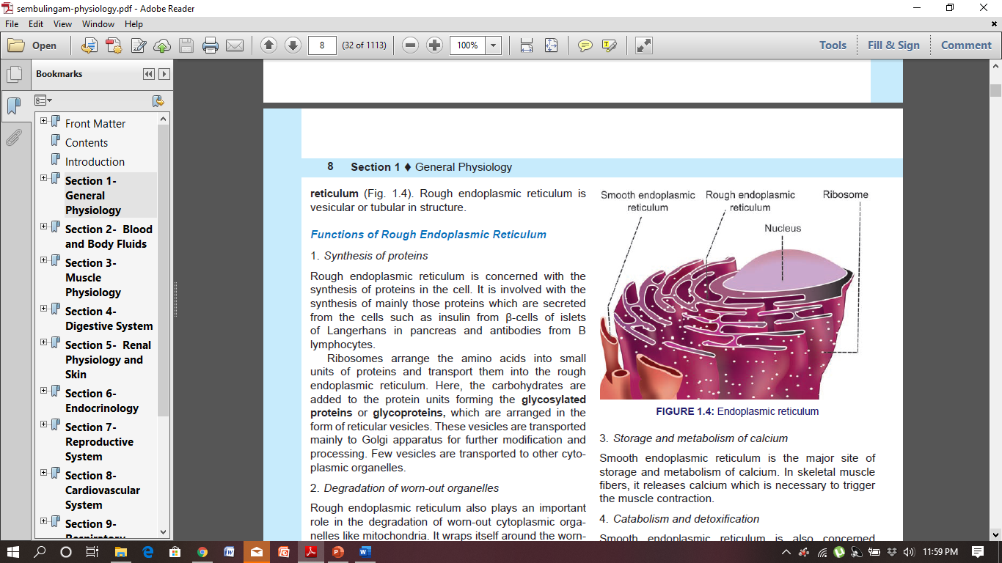
Rough Endoplasmic Reticulum
It is the endoplasmic reticulum with rough, bumpy or bead-like appearance. Rough appearance is due to the attachment of granular ribosomes to its outer surface.
Hence, it is also called the granular ER.

Slide 31
Functions of Rough ER
Synthesis of proteins.
Degradation of worn-out organelles.
Smooth ER:
It is the ER with smooth appearance.
It is also called agranular reticulum. It is formed by many interconnected tubules. It is also called tubular ER.

Slide 32
Functions of Smooth ER
Synthesis of non-protein substance.
Role in cellular metabolism.
Storage and metabolism of calcium.
Catabolism and detoxification.

Slide 33
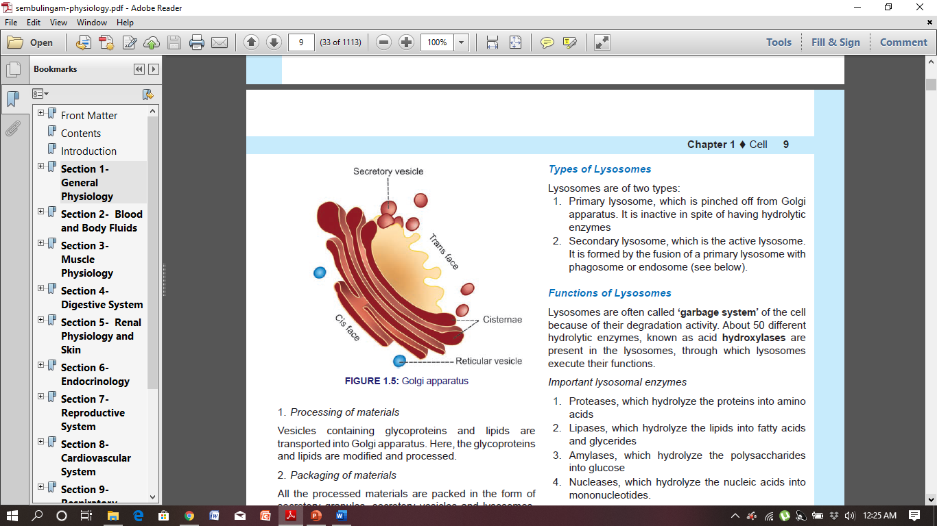
GOLGI APPARATUS
Golgi apparatus, Golgi body or Golgi complex is a
membrane-bound organelle, involved in the processing of proteins. It is present in all the cells except red blood cells. It is named after the discoverer Camillo Golgi.
Usually, each cell has one Golgi apparatus. Some of the cells may have more than one Golgi apparatus. Each Golgi apparatus consists of 5 to 8 flattened membranous sacs called the cisternae.
Golgi apparatus is situated near the nucleus. It has
two ends or faces, namely cis face and trans face. The cis face is positioned near the ER.
Reticular vesicles from ER enter the Golgi apparatus through cis face. The trans face is situated near the cell membrane. The processed substances make their exit from Golgi apparatus through trans face

Slide 34
Functions of Golgi Apparatus
Major functions of Golgi apparatus are processing,
packing, labeling and delivery of proteins and other
molecules like lipids to different parts of the cell.
LYSOSOMES
Lysosomes are the membrane-bound vesicular
organelles found throughout the cytoplasm. The lysosomes are formed by Golgi apparatus.
Types of Lysosomes
Lysosomes are of two types:
1.Primary lysosome, which is pinched off from Golgi
apparatus. It is inactive in spite of having hydrolytic
Enzymes.
2.Secondary lysosome, is the active lysosome.
It is formed by the fusion of a primary lysosome with
phagosome or endosome

Slide 35
Functions of Lysosomes
Lysosomes are often called ‘garbage system’ of the cell because of their degradation activity. About 50 different hydrolytic enzymes, known as acid hydroxylases are present in the lysosomes, through which lysosomes execute their functions.
Important lysosomal enzymes
1. Proteases, which hydrolyze the proteins into amino
Acids.
2. Lipases, which hydrolyze the lipids into fatty acids
and glycerides.
3. Amylases, which hydrolyze the polysaccharides
into glucose.
4. Nucleases, which hydrolyze the nucleic acids into
mononucleotides.

Slide 36
PEROXISOMES
Peroxisomes or microbodies are the membrane
limited vesicles like the lysosomes. Unlike lysosomes,
peroxisomes are pinched off from ER and not from the Golgi apparatus. Peroxisomes contain some oxidative enzymes such as catalase and urate oxidase.
Functions of Peroxisomes
Breakdown the fatty acids by means of a process called beta oxidation.
Degrade the toxic substances such as hydrogen peroxide and other metabolic products by means of detoxification.
Accelerate gluconeogenesis from fats.
Degrade purine to uric acid.
Participate in the formation of myelin.
Play a role in the formation of bile acids.

Slide 37
CENTROSOME AND CENTRIOLES
Centrosome is the membrane-bound cellular organelle
situated almost in the center of cell, close to nucleus.
It consists of two cylindrical structures called centrioles
which are made up of proteins. Centrioles are responsible
for the movement of chromosomes during cell division.
MITOCHONDRION
Mitochondrion is a membrane bound cytoplasmic organelle concerned with production of energy. It is a rod-shaped or oval-shaped structure with a diameter of 0.5 to 1 μ. It is covered by a bilayered membrane. The outer membrane is smooth and encloses the contents of mitochondrion. This membrane contains various enzymes such as acetyl-CoA synthetase.

Slide 38
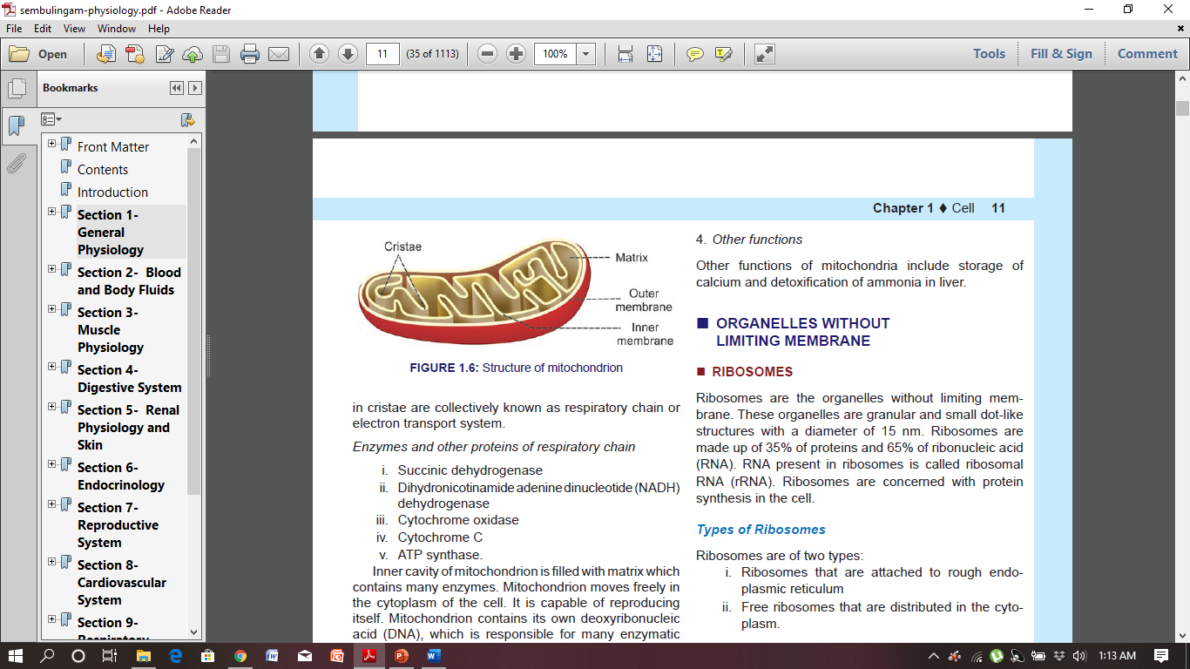
The inner membrane is folded in the form of shelf-like inward projections called cristae and it covers the inner matrix space. Cristae contain many enzymes and other protein molecules which are involved in respiration and synthesis of ATP.

Slide 39
Functions of Mitochondrion
Mitochondrion is called the “power house” of the cell because it produces the energy required
for cellular functions.
The energy is produced during the oxidation of digested food particles like proteins, lipids and carbohydrates by the oxidative enzymes in cristae.

Slide 40
ORGANELLES WITHOUT LIMITING MEMBRANE
RIBOSOMES:
Ribosomes are the organelles without limiting membrane.
These organelles are granular and small dot-like
structures with a diameter of 15 nm. Ribosomes are
made up of 35% of proteins and 65% of ribonucleic acid(RNA). RNA present in ribosomes is called ribosomal RNA (rRNA). Ribosomes are concerned with protein synthesis in the cell.

Slide 41
Types of Ribosomes
Ribosomes are of two types:
i. Ribosomes that are attached to rough ER.
ii. Free ribosomes that are distributed in the cytoplasm.
Functions of Ribosomes
Ribosomes are called ‘protein factories’ because they are
Involved in protein synthesis. Messenger RNA
(mRNA) carries the genetic code for protein synthesis
from nucleus to the ribosomes. The ribosomes, in turn
arrange the amino acids into small units of proteins.
Ribosomes attached to rough ER are involved in the synthesis of proteins such as the enzymatic proteins, hormonal proteins, lysosomal proteins.
Free ribosomes are responsible for the synthesis of
proteins in hemoglobin, peroxisome and mitochondria.

Slide 42
CYTOSKELETON
Cytoskeleton is the cellular organelle present throughout the cytoplasm. It determines the shape of the cell and gives support to the cell.
It is a complex network of structures with varying sizes. In addition to determining the shape of the cell, it is also essential for the cellular movements and the response of the cell to external stimuli.
Cytoskeleton consists of three major protein
components:
1. Microtubule
2. Intermediate filaments
3. Microfilaments.

Slide 43
Functions of microtubules
Microtubules may function alone or join with other
proteins to form more complex structures like cilia,
flagella or centrioles and perform various functions.
Microtubules:
i. Determine the shape of the cell
ii. Give structural strength to the cell
iii. Act like conveyer belts which allow the movement
of granules, vesicles, protein molecules and
some organelles like mitochondria to different
parts of the cell.
iv. Form the spindle fibers which separate the
chromosomes during mitosis.
v. Are responsible for the movement of centrioles
and the complex cellular structures like cilia.

Slide 44
Functions of intermediate filaments
Intermediate filaments help to maintain the shape of the
cell. These filaments also connect the adjacent cells
through desmosomes.
Functions of microfilaments
Microfilaments:
i. Give structural strength to the cell
ii. Provide resistance to the cell against the pulling
forces
iii. Are responsible for cellular movements like
contraction, gliding and cytokinesis (partition of
cytoplasm during cell division).

Slide 45
NUCLEUS
Nucleus is the most prominent and the largest cellular organelle. It has a diameter of 10 μ to 22 μ and occupies about 10% of total volume of the cell.
Nucleus is present in all the cells in the body except the red blood cells. Presence of nucleus is necessary for cell division. Most of the cells have only one nucleus (uninucleated cells). Few types of cells like skeletal muscle cells have many nuclei (multinucleated cells). Generally, the nucleus is located in the center of the cell. It is mostly spherical in shape.
.

Slide 46
STRUCTURE OF NUCLEUS
Nucleus is covered by a membrane called
Major components of nucleus are nucleoplasm, chromatin and nucleolus.
FUNCTIONS OF NUCLEUS
1.Control of all the cell activities that include metabolism,
protein synthesis, growth and reproduction (cell
division).
2. Synthesis of RNA.
3. Formation of subunits of ribosomes.
4. Sending genetic instruction to the cytoplasm for
protein synthesis through messenger RNA (mRNA).
5. Control of the cell division through genes.
6. Storage of hereditary information (in genes)
and transformation of this information from one
generation of the species to the next.

Slide 47
