Slide 1
Homeostasis
PREPARED BY: MAHREEN SIDDIQUE
LECTURER
PHARMACOLOGY DEPRATMENT

Slide 2
INTRODUCTION
‘Homeostasis’ refers to the maintenance of constant internal environment of the body (homeo = same; stasis = standing).
Internal environment in the body is the extracellular fluid (ECF) in which the cells live. It is the fluid outside the cell and it constantly moves throughout the body. It includes blood, which circulates in the vascular system and fluid present in between the cells called interstitial fluid. ECF contains nutrients, ions and all other substances necessary for the survival of the cells.

Slide 3
Normal healthy living of large organisms including human beings depends upon the constant maintenance of internal environment within the physiological limits. If the internal environment deviates beyond the set limits, body suffers from malfunction or dysfunction. Therefore, the ultimate goal of an organism is to have a normal healthy living, which is achieved by the maintenance of internal environment within set limits.

Slide 4
The concept of homeostasis forms basis of physiology because it explains why various physiological functions are to be maintained within a normal range and in case if any function deviates from this range how it is brought back to normal. Understanding the concept of homeostasis also forms the basis for clinical diagnostic procedures.
For example, increased body temperature beyond normal range as in the case of fever, indicates that something is wrong in the heat production-heat loss mechanism in the body. It induces the physician to go through the diagnostic proceedings and decide about the treatment.

Slide 5
For the functioning of homeostatic mechanism, the body must recognize the deviation of any physiological activity from the normal limits. Fortunately, body is provided with appropriate detectors or sensors, which recognize the deviation. These detectors sense the deviation and alert the integrating center. The integrating center immediately sends information to the concerned effectors to either accelerate or inhibit the activity so that the normalcy is restored.

Slide 6
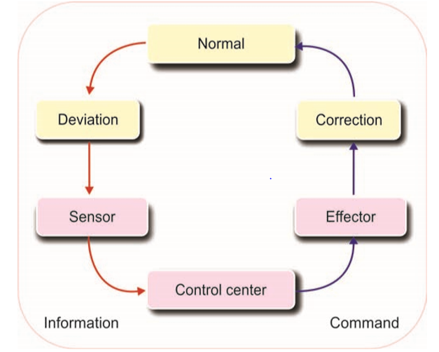

Slide 7
Homeostasis, therefore, does not imply that a given physiological function or variable is rigidly constant with respect to time but that it fluctuates within a predictable and often narrow range. When disturbed above or below the normal range, it is restored to normal.
homeostasis is a dynamic, not a static, process.
In general, if all the major organ systems are operating in a homeostatic manner, a person is in good health. Certain kinds of disease, in fact, can be defined as the loss of homeostasis in one or more systems in the body. when homeostasis is maintained, we refer to physiology; when it is not, we refer to pathophysiology (from the Greek pathos, meaning “suffering” or “disease”).

Slide 8
EXAMPLE:
Consider swings in the concentration of glucose in the blood over the course of a day After a typical meal, carbohydrates in food are broken down in the intestines into glucose molecules, which are then absorbed across the intestinal epithelium and released into the blood. As a consequence, the blood glucose concentration increases considerably within a short time after eating. Clearly, such a large change in the blood concentration of glucose is not consistent with the idea of a stable or static internal environment. What is important is that once the concentration of glucose in the blood increases, compensatory mechanisms restore it toward the concentration it was before the meal.
These homeostatic compensatory mechanisms do not, however, overshoot to any significant degree in the opposite direction. That is, the blood glucose usually does not decrease below the premeal concentration, or does so only slightly. In the case of glucose, the endocrine system is primarily responsible for this adjustment.

Slide 9
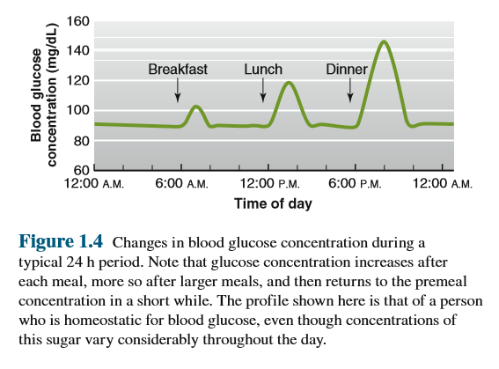

Slide 10
General Characteristics of Homeostatic Control Systems
Feedback Systems
    Negative feedback
    Positive feedback
Resetting of Set Points
Feedforward Regulation

Slide 11
1-FEEDBACK SYSTEMS:
Feedback is a process in which some proportion of the output signal of a system is fed (passed) back to the input. This is done more often intentionally in order to control the behavior pattern of the system.
Whenever any change occurs, system receives and reacts to two types of feedback:
      Negative feedback
      Positive feedback

Slide 12
I. NEGATIVE FEEDBACK
  Negative feedback is the one to which the system reacts in such a way as to arrest the change or reverse the direction of change. After receiving a message, effectors send negative feedback signals back to the system. Now, the system stabilizes its own function and makes an attempt to maintain homeostasis.
  Many homeostatic mechanisms in the body function through negative feedback.
  For example: Thyroid-stimulating hormone (TSH) released from pituitary gland, negative feedback mechanism for the maintenance of water balance in the body, thermoregulatory system to maintain temperature at set point against decrease and increase temperature.

Slide 13
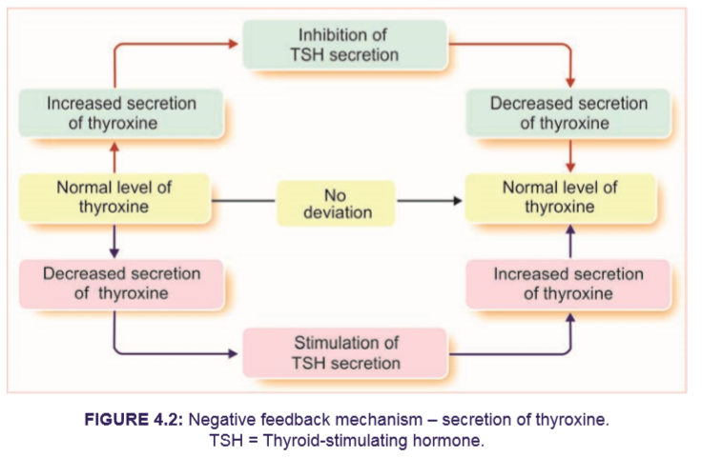
Thyroid-stimulating hormone (TSH) released from pituitary gland stimulates thyroid gland to secrete thyroxine. When thyroxine level increases in blood, it inhibits the secretion of TSH from pituitary so that, the secretion of thyroxin from thyroid gland decreases. On the other hand, if thyroxine secretion is less, its low blood level induces pituitary gland to release TSH. Now, TSH stimulates thyroid gland to secrete thyroxine.

Slide 14
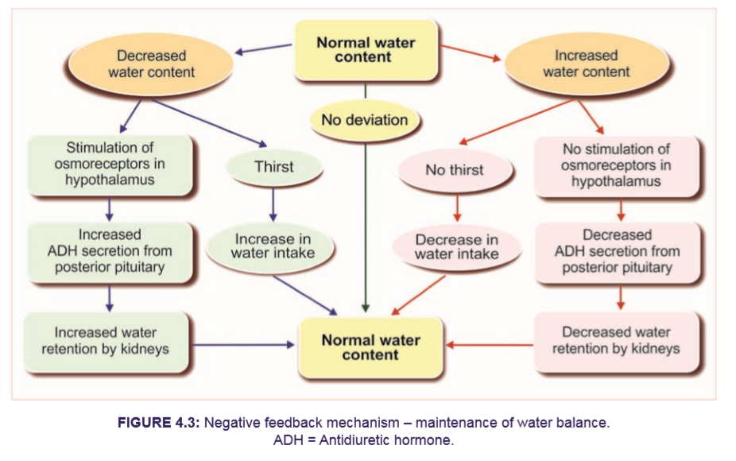

Slide 15
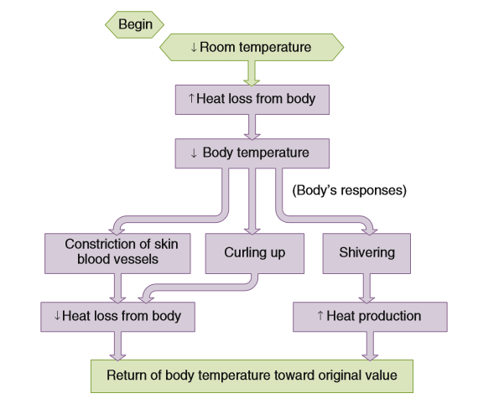
A homeostatic control system maintains body temperature when room temperature decreases. For example, decreased room temperature tends to cause an increase in heat loss from the body, and curling up tends to cause a decrease in heat loss from the body.

Slide 16
II. POSITIVE FEEDBACK:
    Positive feedback is the one to which the system reacts in such a way as to increase the intensity of the change in the same direction. Positive feedback is less common than the negative feedback. However, it has its own significance particularly during emergency conditions.
    Positive feedback is much less common in nature than negative feedback. Nonetheless, there are examples in physiology in which positive feedback is very important.
    Example: One of the positive feedbacks occurs during the blood clotting, process of parturition (birth).

Slide 17
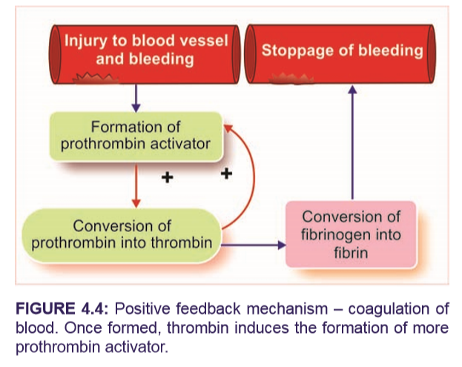
One of the positive feedbacks occurs during the blood clotting. Blood clotting is necessary to arrest bleeding during injury and it occurs in three stages. The three stages are:
    i. Formation of prothrombin activator
    ii. Conversion of prothrombin into thrombin
    iii. Conversion of fibrinogen into fibrin.
Thrombin formed in the second stage stimulates the formation of more prothrombin activator in addition to converting fibrinogen into fibrin

Slide 18
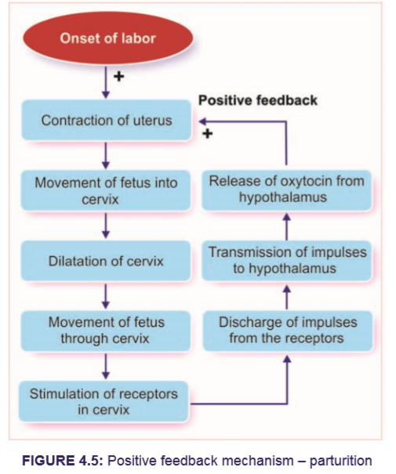
As the uterine muscles contract and a baby’s head is pressed against the mother’s cervix during labor, signals are relayed via nerves from the cervix to the mother’s brain. The brain initiates the secretion into the blood of a molecule called oxytocin from the mother’s pituitary gland. Oxytocin is a potent stimulator of further uterine contractions. As the uterus contracts even harder in response to oxytocin, the baby’s head is pushed harder against the cervix, causing it to stretch more; this stimulates yet more nerve signals to the mother’s brain, resulting in yet more oxytocin secretion. This self-perpetuating cycle continues until finally the baby pushes through the stretched cervix and is born.

Slide 19
2. Resetting of Set Points
As we have seen, changes in the external environment can displace a variable from its set point. In addition, the set points for many regulated variables can be physiologically reset to a new value.
A common example is fever, the increase in body temperature that occurs in response to infection and that is somewhat analogous to raising the setting of a thermostat in a room. The homeostatic control systems regulating body temperature are still functioning during a fever, but they maintain the temperature at an increased value. This regulated increase in body temperature is adaptive for fighting the infection, because elevated temperature inhibits proliferation of some pathogens.

Slide 20
In fact, this is why a fever is often preceded by chills and shivering. The set point for body temperature has been reset to a higher value, and the body responds by shivering to generate heat.
The example of fever may have left the impression that set points are reset only in response to external stimuli, such as the presence of pathogens, but this is not the case. Indeed, the set points for many regulated variables change on a rhythmic basis every day. For example, the set point for body temperature is higher during the day than at night.

Slide 21
3. Feedforward Regulation
Another type of regulatory process often used in conjunction with feedback systems is feedforward, in which changes in regulated variables are anticipated and prepared for before they actually occur.
Control of body temperature is a good example of a feedforward process. The temperature-sensitive neurons that trigger negative feedback regulation of body temperature when it begins to decrease are located inside the body.

Slide 22
In addition, there are temperature-sensitive neurons in the skin; these cells, in effect, monitor outside temperature. When outside temperature decreases, as in our example, these neurons immediately detect the change and relay this information to the brain. The brain then sends out signals to the blood vessels and muscles, resulting in heat conservation and increased heat production. In this manner, compensatory thermoregulatory responses are activated before the colder outside temperature can cause the internal body temperature to decrease.

Slide 23
COMPONENTS OF HOMEOSTATIC SYSTEM
Homeostatic system in the body acts through self-regulating devices, which operate in a cyclic manner.
This cycle includes four components:
    Sensors or detectors
    control center
    Effectors

Slide 24
Sensors or detectors:
  Which recognize the deviation
Control center:
  Transmission of this message to a control center.
  Transmission of information from the control center to the effectors for correcting the deviation.
  Transmission of the message or information may be an electrical process in the form of impulses through nerves or a chemical process mainly in the form of hormones through blood and body fluids
Effectors:
  Which correct the deviation

Slide 25
Intercellular Chemical Messengers in Homeostasis
Essential to reflexes and local homeostatic responses—and therefore to homeostasis—is the ability of cells to communicate with one another.
In this way, cells in the brain, for example, can be made aware of the status of activities of structures outside the brain, such as the heart, and help regulate those activities to meet new homeostatic challenges.

Slide 26
In the majority of cases, intercellular communication is performed by chemical messengers.
There are four categories of such messengers:
    Hormones,
    Neurotransmitters,
    Paracrine,
    Autocrine substances

Slide 27
HORMONE:
  A hormone is a chemical messenger that enables the hormone-secreting cell to communicate with other cells with the blood acting as the delivery system.
  The cells on which hormones act are called the hormone’s target cells.
  Hormones are produced in and secreted from endocrine glands or in scattered cells that are distributed throughout another organ.

Slide 28
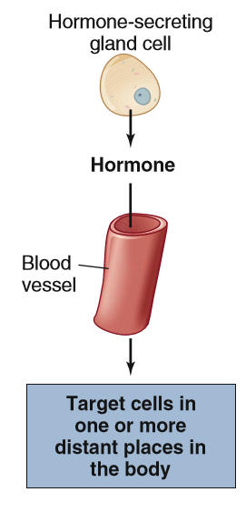
They have important functions in essentially all physiological processes, including growth, reproduction, metabolism, mineral balance, and blood pressure, and are often produced whenever homeostasis is threatened.

Slide 29
Neurotransmitter
  Neurotransmitters are chemical messengers that are released from the endings of neurons onto other neurons, muscle cells, or gland cells.
  A neurotransmitter diffuses through the extracellular fluid separating the neuron and its target cell; it is not released into the blood like a hormone.

Slide 30
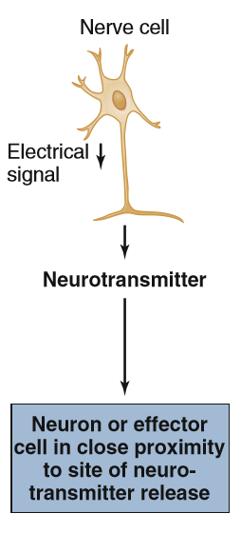
They form the signaling basis of many reflexes, as well as having a vital role in the compensatory responses to a wide variety of challenges, such as the requirement for increased heart and lung function during exercise.

Slide 31
Paracrine substances
  Chemical messengers participate not only in reflexes but also in local responses.
  Chemical messengers involved in local communication between cells are known as paracrine substances (or agents).
  Paracrine substances are synthesized by cells and released, once given the appropriate stimulus, into the extracellular fluid. They then diffuse to neighboring cells, some of which are their target cells.

Slide 32
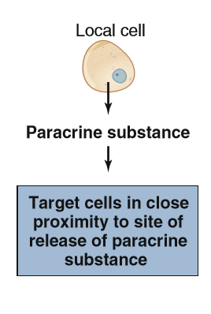
Once they have performed their functions, paracrine substances are generally inactivated by locally existing enzymes and therefore they do not enter the bloodstream in large quantities.

Slide 33
Autocrine substances
  There is one category of local chemical messengers that are not intercellular messengers—that is, they do not communicate between cells. Rather, the chemical is secreted by a cell into the extracellular fluid and then acts upon the very cell that secreted it. Such messengers are called autocrine substances (or agents).

Slide 34
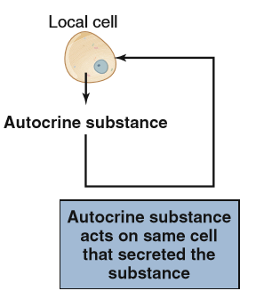
Frequently, a messenger may serve both paracrine and autocrine functions simultaneously—that is, molecules of the messenger released by a cell may act locally on adjacent cells as well as on the same cell that released the messenger.

Slide 35
PROCESSES RELATED TO HOMEOSTASIS
Adaptation and Acclimatization
Biological Rhythms
Balance of Chemical Substances in the Body

Slide 36
Adaptation and Acclimatization:
  The term adaptation denotes a characteristic that favors survival in specific environments.
  Homeostatic control systems are inherited biological adaptations.
  The ability to respond to a particular environmental stress is not fixed, however, but can be enhanced by prolonged exposure to that stress.
  This type of adaptation—the improved functioning of an already existing homeostatic system—is known as acclimatization.
  Acclimatizations are usually reversible.

Slide 37
EXAMPLE:
  Sweating in response to heat exposure as an example and perform a simple experiment.
  On day 1, expose a person for 30 min to an elevated temperature and ask her to do a standardized exercise test. Body temperature increases, and sweating begins after a certain period of time. The sweating provides a mechanism for increasing heat loss from the body and therefore tends to minimize the increase in body temperature in a hot environment. The volume of sweat produced under these conditions is measured.

Slide 38
Then, for a week, subject enters the heat chamber for 1 or 2 hours (h) per day and exercises. On day 8, her body temperature and sweating rate are again measured during the same exercise test performed on day 1. The finding is that the subject begins to sweat sooner and much more profusely than she did on day 1.
As a consequence, her body temperature does not increase to nearly the same degree. The subject has become acclimatized to the heat. She has undergone an adaptive change induced by repeated exposure to the heat and is now better able to respond to heat exposure.

Slide 39
Biological Rhythms:
  A striking characteristic of many body functions is the rhythmic changes they manifest.
  The most common type is the circadian rhythm, which cycles approximately once every 24 h.
  Waking and sleeping, body temperature, hormone concentrations in the blood, the excretion of ions into the urine, and many other functions undergo circadian variation

Slide 40
Biological rhythms add an anticipatory component to homeostatic control systems, in effect, a feedforward system operating without detectors.
Biological rhythms enable homeostatic mechanisms to be utilized immediately and automatically by activating them at times when a challenge is likely to occur but before it actually does occur.

Slide 41
For example, body temperature increases prior to waking in a person on a typical sleep–wake cycle. This allows the metabolic machinery of the body to operate most efficiently immediately upon waking, because metabolism (chemical reactions) is to some extent temperature dependent. During sleep, metabolism is slower than during the active hours, and therefore body temperature decreases at that time.
A crucial point concerning most body rhythms is that they are internally driven. Environmental factors do not drive the rhythm but rather provide the timing cues important for entrainment, or setting of the actual hours of the rhythm.

Slide 42
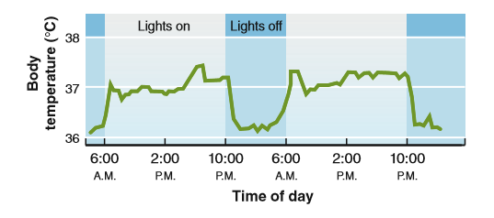

Slide 43
Neural basis of body rhythms:
  In the part of the brain called the hypothalamus, a specific collection of neurons (the suprachiasmatic nucleus) functions as the principal pacemaker, or time clock, for circadian rhythms.
  It keeps time independent of any external environmental cues.
  It appears to involve the rhythmic turning on and off of critical genes in the pacemaker cells.

Slide 44
Pacemaker receives input from the eyes and many other parts of the nervous system
Pacemaker sends out neural signals to other parts of the brain, which then influence the various body systems, activating some and inhibiting others.

Slide 45
One output of the pacemaker goes to the pineal gland, a gland within the brain that secretes the hormone melatonin
These neural signals from the pacemaker cause the pineal gland to secrete melatonin during darkness but not during daylight.
It has been hypothesized, therefore, that melatonin may act as an important mediator to influence other organs either directly or by altering the activity of the parts of the brain that control these organs.

Slide 46
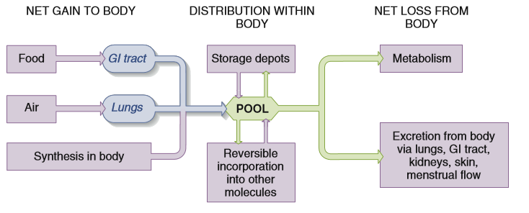
Balance of Chemical Substances in the Body:
Many homeostatic systems regulate the balance between addition and removal of a chemical substance from the body.

Slide 47
Net gain to the body:
  A substance may enter the body through the gastrointestinal (GI) tract or the lungs. Alternatively, a substance may be synthesized within the body from other materials.
Net loss from the body:
  A substance may be lost in the urine, feces, expired air, or menstrual fluid, as well as from the surface of the body as skin, hair, nails, sweat, or tears. The substance may also be chemically altered by enzymes and thus removed by metabolism.

Slide 48
Pool:
  Distributes the substance within the body. The substance may be taken from the pool and accumulated in storage depots—such as the accumulation of fat in adipose tissue. Conversely, it may leave the storage depots to reenter the pool.
  Finally, the substance may be incorporated reversibly into some other molecular structure, such as fatty acids into plasma membranes. Incorporation is reversible because the substance is liberated again whenever the more complex structure is broken down.

Slide 49
Two important generalizations concerning the balance concept:
During any period of time, total-body balance depends upon the relative rates of net gain and net loss to the body; and
The pool concentration depends not only upon the total amount of the substance in the body but also upon exchanges of the substance within the body.

Slide 50
For any substance, three states of total-body balance are possible:
Loss exceeds gain, so that the total amount of the substance in the body is decreasing, and the person is in negative balance;
Gain exceeds loss, so that the total amount of the substance in the body is increasing, and the person is in positive balance; and
Gain equals loss, and the person is in stable balance.

Slide 51
SIGNAL TRANSDUCTION PATHWAYS
The pathway mediating a reflex is known as the reflex arc, and its components are;
  A stimulus is defined as a detectable change in the internal or external environment, such as a change in temperature, plasma potassium concentration, or blood pressure.
  A receptor detects the environmental change.
  A stimulus acts upon a receptor to produce a signal that is relayed to an integrating center.

Slide 52
  The signal travels between the receptor and the integrating center along the afferent pathway (the general term afferent means “to carry to,” in this case, to the integrating center).
  The output of an integrating center is sent to the last component of the system, whose change in activity constitutes the overall response of the system. This component is known as an effector.
  The information going from an integrating center to an effector is like a command directing the effector to alter its activity. This information travels along the efferent pathway (the general term efferent means “to carry away from,” in this case, away from the integrating center).

Slide 53
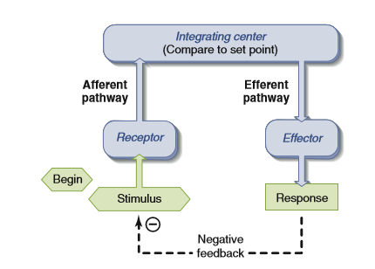

Slide 54
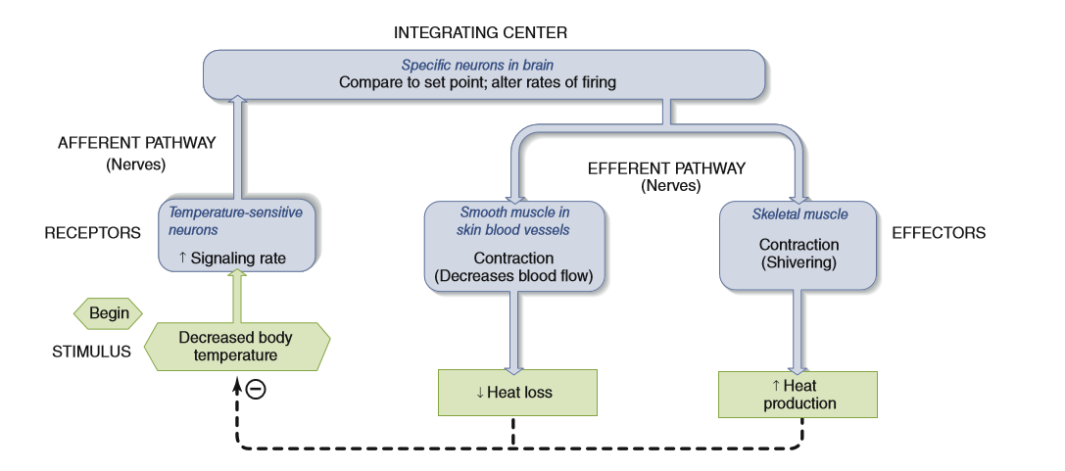

Slide 55
In summary, homeostasis is a complex, dynamic process that regulates the adaptive responses of the body to changes in the external and internal environments. To work properly, homeostatic systems require a sensor to detect the environmental change, and a means to produce a compensatory response.

