Slide 1
The Sensory Systems
(SOMATIC SENSATION)
Prepared by:
Mahreen siddique
Lecturer (rlcp)

Slide 2
Somatic Sensation
Sensation from the skin, skeletal muscles, bones, tendons, and joints—somatic sensation—is initiated by a variety of sensory receptors collectively called somatic receptors.

Slide 3
Activation of somatic receptors gives rise to the sensations of touch, pressure, awareness of the position of the body parts and their movement, temperature, and pain.
The receptors for visceral sensations, which arise in certain organs of the thoracic and abdominal cavities, are the same types as the receptors that give rise to somatic sensations.
Some organs, such as the liver, have no sensory receptors at all.
Each sensation is associated with a specific receptor type.
In other words, distinct receptors exist for heat, cold, touch, pressure, limb position or movement, and pain.

Slide 4
Touch and Pressure
Stimulation of different types of mechanoreceptors in the skin leads to a wide range of touch and pressure experiences—for example.;
      Hair bending
      Deep pressure
      Vibrations
      Superficial touch

Slide 5
These mechanoreceptors are highly specialized neuron endings encapsulated in elaborate cellular structures.
The neuron endings are linked to networks of collagen fibers.
These networks transmit the mechanical tension in the fluid-filled capsule to ion channels in the neuron endings and activate them.
The skin mechanoreceptors adapt at different rates.
    About half of them adapt rapidly, firing only when the stimulus is changing (the sensations of touch, movement, and vibration).
    Other types of mechanoreceptors adapt more slowly (sensation of pressure).

Slide 6
Some receptors have small, well-defined receptive fields and can provide precise information (these receptors are concentrated at the fingertips).
Other receptors have large receptive fields with obscure boundaries, sometimes covering a whole finger or a large part of the palm. These receptors are not involved in detailed spatial discrimination but signal information about skin stretch and joint movement.

Slide 7
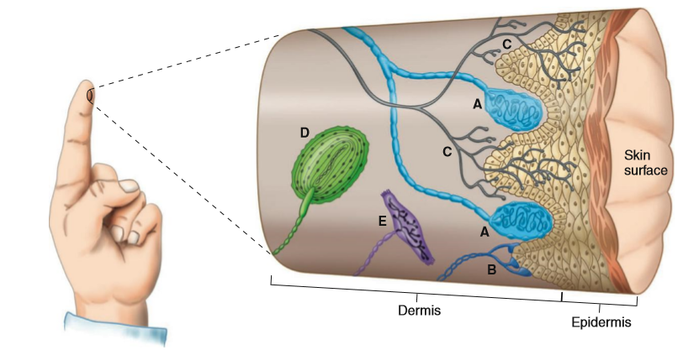
A. Meissner's corpuscle—rapidly adapting mechanoreceptor, touch and pressure
B. Merkel's corpuscle—slowly adapting mechanoreceptor, touch and pressure
C. Free neuron ending—slowly adapting, some are nociceptors, some are thermoreceptors, and some are mechanoreceptors
D. Pacinian corpuscles—rapidly adapting mechanoreceptor, vibration and deep pressure
E. Ruffini corpuscle—slowly adapting mechanoreceptor, skin stretch

Slide 8
Posture and Movement
The major receptors responsible for these senses are the muscle-spindle stretch receptors and Golgi tendon organs.
These mechanoreceptors occur in skeletal muscles and the fibrous tendons that connect them to bone.
Muscle-spindle stretch receptors respond both to the absolute magnitude of muscle stretch and to the rate at which the stretch occurs, and Golgi tendon organs monitor muscle tension.

Slide 9
Vision and the vestibular organs (the sense organs of balance) also support the senses of posture and movement.
Mechanoreceptors in the joints, tendons, ligaments, and skin also have a function.
The term kinesthesia refers to the sense of movement at a joint.

Slide 10
Temperature
Information about temperature is transmitted along small-diameter, afferent neurons, these neurons are called thermoreceptors.
They originate in the tissues as free neuron endings.
The actual temperature sensors are ion channels in the plasma membranes of the axon terminals that belong to a family of proteins called transient receptor potential (TRP) proteins.

Slide 11
Different isoforms of TRP channels have gates that open in different temperature ranges.
When activated, all of these channel types allow flux of a nonspecific cation current that is dominated by a depolarizing inward flux of Na ion.
The resulting receptor potential initiates action potentials in the afferent neuron, which travel along labeled lines to the brain where the temperature stimulus is perceived.

Slide 12
Some of the TRP proteins can be opened by chemical ligands.
    Capsaicin (a chemical found in chili peppers) and ethanol are perceived as being hot when ingested and menthol feels cool when applied to the skin.
Some afferent neurons, especially those stimulated at the extremes of temperature, have proteins in their receptor endings that also respond to painful stimuli.
    These multipurpose neurons are therefore included among the polymodal neurons and are in part responsible for the perception of pain at extreme temperatures.

Slide 13
Pain
Most stimuli that cause, or could potentially cause, tissue damage elicit a sensation of pain.
Receptors for such stimuli are known as nociceptors.
Nociceptors are free axon terminals of small-diameter afferent neurons with little or no myelination.
They respond to intense mechanical deformation, extremes of temperature, and many chemicals.

Slide 14
Neuropeptide transmitters, bradykinin, histamine, cytokines, and prostaglandins, several of which are released by damaged cells.
Some of these chemicals are secreted by cells of the immune system that have moved into the injured area.
These substances act by binding to specific ligand-gated ion channels on the nociceptor plasma membrane.
The primary afferents having nociceptor endings synapse on ascending neurons after entering the central nervous system.
Glutamate and a neuropeptide called substance P are among the neurotransmitters released at these synapses.

Slide 15
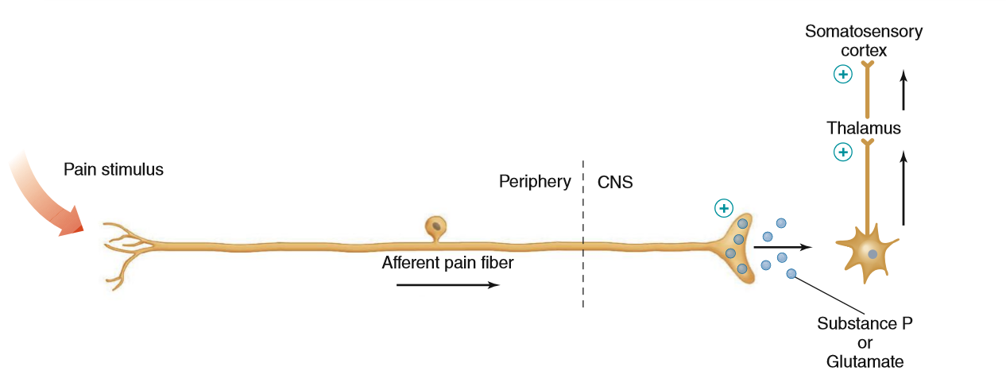
Cellular pathways of pain transmission. Painful stimulation releases substance P or glutamate from afferent fibers in the dorsal horn of the spinal cord. From there, signals are relayed to the somatosensory cortex.

Slide 16
Referred Pain:
  When incoming nociceptive afferents activate interneurons, it may lead to the phenomenon of referred pain, in which the sensation of pain is experienced at a site other than the injured or diseased tissue.
For example,
    During a heart attack, a person often experiences pain in the left arm.
    Referred pain occurs because both visceral and somatic afferents often converge on the same neurons in the spinal cord.

Slide 17
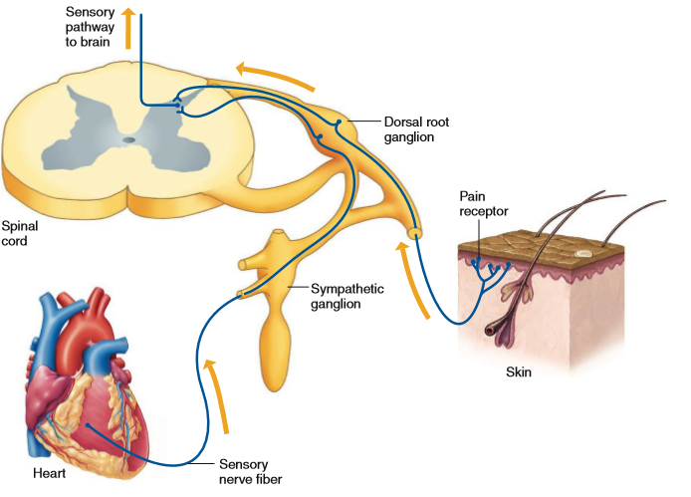
Convergence of visceral and somatic afferent neurons onto ascending pathways produces the phenomenon of referred pain.

Slide 18
Hyperalgesia:
  When these changes result in an increased sensitivity to painful stimuli, known as hyperalgesia, the pain can last for hours after the original stimulus is gone.
A series of changes can occur in components of the pain pathway—including the ion channels in the nociceptors themselves—that alters the way these components respond to subsequent stimuli.
Both increased and decreased sensitivity to painful stimuli can occur.
This type of pain response is common with severe burn injuries.

Slide 19
Inhibition of Pain:
    Analgesia is the selective suppression of pain without effects on consciousness or other sensations.
Electrical stimulation of specific areas of the central nervous system can produce a profound reduction in pain—a phenomenon called stimulation-produced analgesia—by inhibiting pain pathways.
This occurs because descending pathways that originate in these brain areas selectively inhibit the transmission of information originating in nociceptors.

Slide 20
The descending axons end at lower brainstem and spinal levels on interneurons in the pain pathways and inhibit synaptic transmission between the afferent nociceptor neurons and the secondary ascending neurons.
Some of the neurons in these inhibitory pathways release morphinelike endogenous opioids.
These opioids inhibit the propagation of input through the higher levels of the pain system.

Slide 21
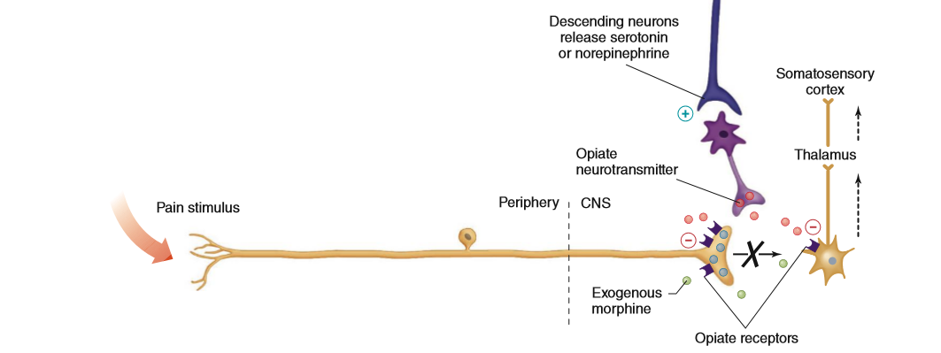
Descending inputs from the brainstem stimulate dorsal horn interneurons to release endogenous opiate neurotransmitters. Presynaptic opiate receptors inhibit neurotransmitter release from afferent pain fibers, and postsynaptic receptors inhibit ascending neurons. Morphine inhibits pain in a similar manner. In some cases, descending neurons may directly synapse onto and inhibit ascending neurons.

Slide 22
Neural Pathways of the Somatosensory System
After entering the central nervous system, the afferent nerve fibers from the somatic receptors synapse on neurons that form the specific ascending pathways projecting primarily to the somatosensory cortex via the brainstem and thalamus.
They also synapse on interneurons that give rise to the nonspecific ascending pathways.

Slide 23
There are two major types of somatosensory pathways from the body;
    Anterolateral pathway (spinothalamic pathway)
    Dorsal column pathway

Slide 24
1-Anterolateral pathway (spinothalamic pathway):
Makes its first synapse between the sensory receptor neuron and a second neuron located in the gray matter of the spinal cord.
This second neuron immediately crosses to the opposite side of the spinal cord and then ascends through the anterolateral column of the cord to the thalamus, where it synapses on cortically projecting neurons.
The anterolateral pathway processes pain and temperature information.

Slide 25
2-Dorsal column pathway:
In the dorsal column pathway, sensory neurons do not cross over or synapse immediately upon entering the spinal cord.
Rather, they ascend on the same side of the cord and make the first synapse in the brainstem.
The secondary neuron then crosses in the brainstem as it ascends.
As in the anterolateral pathway, the second synapse is in the thalamus, from which projections are sent to the somatosensory cortex.

Slide 26
Both pathways cross from the side where the afferent neurons enter the central nervous system to the opposite side either in the spinal cord (anterolateral system) or in the brainstem (dorsal column system).
Somatosensory information from the head and face does not travel to the brain within these two spinal cord pathways; it enters the brainstem directly via cranial nerves.
In the somatosensory cortex, the endings of the axons of the specific somatic pathways are grouped according to the peripheral location of the receptors that give input to the pathways.

Slide 27
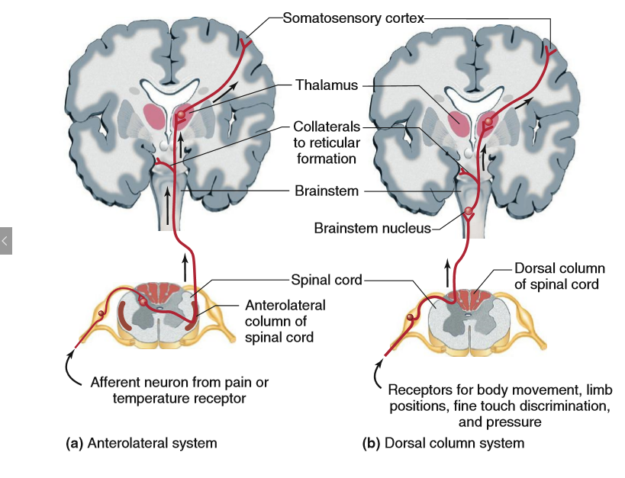

Slide 28
