Slide 1
The Sensory Systems
Prepared by:
Mahreen siddique
Lecturer (rlcp)

Slide 2
Audition
The sense of audition (hearing) is based on the physics of sound and the physiology of the external, middle, and inner ear. In addition, there is complex neural processing along pathways to the brain and within brain regions involved in sensing and perceiving acoustic information.

Slide 3
Sound
Sound energy is transmitted through a gaseous, liquid, or solid medium by setting up a vibration of the medium’s molecules, air being the most common medium in which we hear sound energy.
The sounds heard most keenly by human ears are those from sources vibrating at frequencies between 1000 and 4000 Hz, but the entire range of frequencies audible to human beings extends from 20 to 20,000 Hz.

Slide 4
Sound Transmission in the Ear
External Ear:
  The first step in hearing is the entrance of sound waves into the external auditory canal.
  The shapes of the outer ear (the pinna, or auricle) and the external auditory canal help to amplify and direct the sound.
  The sound waves reverberate from the sides and end of the external auditory canal, filling it with the continuous vibrations of pressure waves.

Slide 5
    The Tympanic membrane (eardrum) is stretched across the end of the external auditory canal, and as air molecules push against the membrane, they cause it to vibrate at the same frequency as the sound wave.
        Under higher pressure during a zone of compression, the tympanic membrane bows inward.
        During the subsequent zone of rarefaction, the membrane bows outward.
        When the sound ceases, it returns toward a midpoint.

Slide 6
The Middle and Inner Ear:
  The tympanic membrane separates the external auditory canal from the middle ear, an air-filled cavity in the temporal bone of the skull.
  The pressures in the external auditory canal and middle ear cavity are normally equal to atmospheric pressure.
  The middle ear cavity is exposed to atmospheric pressure through the eustachian tube, which connects the middle ear to the pharynx.
  The slit-like ending of this tube in the pharynx is normally closed, but muscle movements open the tube during yawning, swallowing, or sneezing.

Slide 7
  The second step in hearing is the transmission of sound energy from the tympanic membrane through the middle ear cavity to the inner ear.
  The inner ear consists of the cochlea–a spiral-shaped, fluid-filled space in the temporal bone–and the semicircular canals, which contain the sensory organs for balance and movement.
  These fluid-filled passages are connected to the cochlea.
  Because liquid is more difficult to move than air, the sound pressure transmitted to the inner ear must be amplified.
  This is achieved by a movable chain of three small middle ear bones, the malleus, incus, and stapes.

Slide 8
  These bones act as a piston and couple the vibrations of the tympanic membrane to the oval window, a membrane-covered opening separating the middle and inner ears.
  The total force of a sound wave applied to the tympanic membrane is transfer to the oval window.
  However, because the oval window is much smaller than the tympanic membrane, the force per unit area (i.e., the pressure) is increased 15 to 20 times.

Slide 9
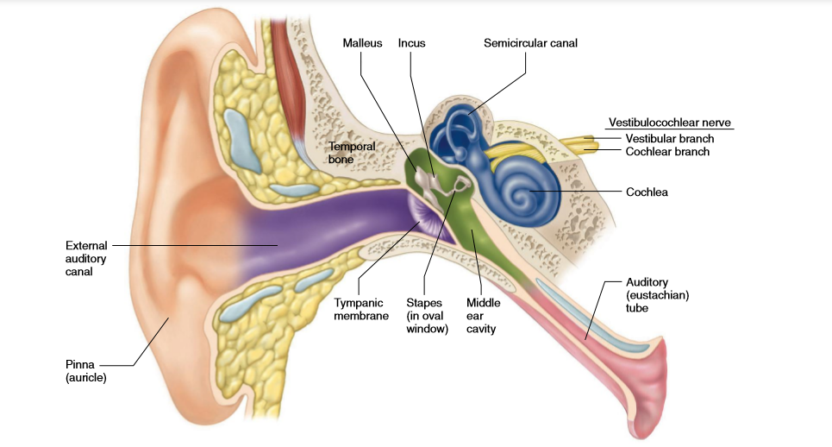

Slide 10
  The cochlea is almost completely divided lengthwise by a membranous tube called the cochlear duct, which contains the sensory receptors of the auditory system.
  The cochlear duct is filled with a fluid known as endolymph.
  On either side of the cochlear duct are compartments filled with a fluid called perilymph.
  The scala vestibuli is above the cochlear duct and begins at the oval window; the scala tympani is below the cochlear duct and connects to the middle ear at a second membrane-covered opening, the round window.
  The scala vestibuli and scala tympani are continuous at the far end of the cochlear duct at the helicotrema.

Slide 11
  Movements of the oval window membrane set up pressure waves in the fluid-filled scala vestibuli, which cause vibrations in the cochlear duct wall, setting up pressure waves in the fluid there.
  These pressure waves cause vibrations in the basilar membrane, as this membrane vibrates, the hair cells of the organ of Corti move.
  Movement of the hair cells’ stimulates the hair cells to release glutamate, which activates receptors on the peripheral ends of the afferent nerve fibers.

Slide 12
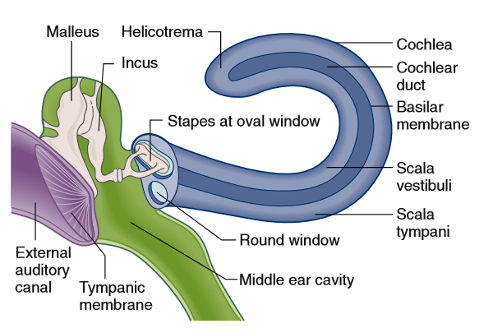

Slide 13
  The receptor cells of the organ of Corti are called hair cells. These cells are mechanoreceptors that have hairlike stereocilia protruding from one end.
  As sound waves vibrate the basilar membrane, the stereocilia are bent back and forth, the membrane potential of the hair cells rapidly oscillates, and bursts of neurotransmitter are released onto afferent neurons.
  The neurotransmitter released from each hair cell is glutamate (just like in photoreceptor cells), which binds to and activates protein-binding sites on the terminals of afferent neurons.
  This causes the generation of action potentials in the neurons, the axons of which join to form the cochlear branch of the vestibulocochlear nerve (cranial nerve VIII). The greater the energy (loudness) of the sound wave, the greater the frequency of action potentials generated in the afferent nerve fibers.

Slide 14
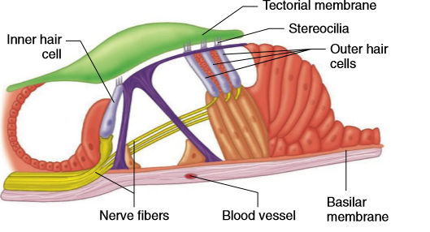

Slide 15
Neural Pathways in Hearing
Cochlear nerve fibers enter the brainstem and synapse with interneurons there. Fibers from both ears often converge on the same neuron.
From the brainstem, the information is transmitted via a polysynaptic pathway to the thalamus and on to the auditory cortex in the temporal lobe.

Slide 16
Vestibular System
A vestibular apparatus lies in the temporal bone on each side of the head and consists of three semicircular canals, a utricle, and a saccule.
Receptor cells of the semicircular canals, contain stereocilia, the movement causes bending of the stereocilia and alteration in the rate of release of neurotransmitter from the hair cells.

Slide 17
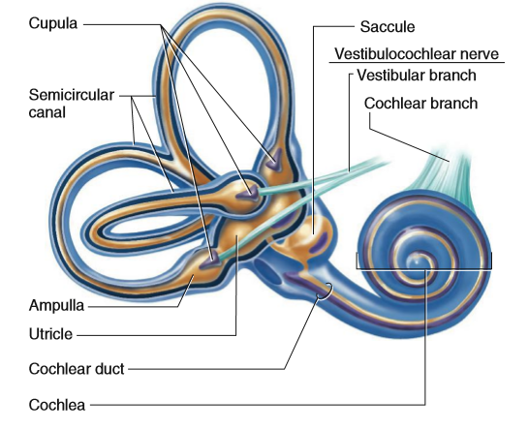

Slide 18
Vestibular Information and Pathways
Vestibular information is used in three ways.
One is to control the eye muscles so that, in spite of changes in head position, the eyes can remain fixed on the same point.
The second use of vestibular information is in reflex mechanisms for maintaining upright posture and balance. The vestibular apparatus functions in the support of the head during movement, orientation of the head in space, and reflexes accompanying locomotion.

Slide 19
The third use of vestibular information is in providing conscious awareness of the position and acceleration of the body, perception of the space surrounding the body, and memory of spatial information.
Information about hair cell stimulation is relayed from the vestibular apparatus to nuclei within the brainstem via the vestibular branch of the vestibulocochlear nerve.
It is transmitted via a polysynaptic pathway through the thalamus to a system of vestibular centers in the parietal lobe of the cerebral cortex.

