Slide 1
The Sensory Systems
Prepared by:
Mahreen siddique
Lecturer (rlcp)

Slide 2
Vision
Vision is perhaps the most important sense for the day-to-day activities of humans. Perceiving a visual signal requires an organ—the eye—capable of focusing and responding to light and the appropriate neural pathways and structures to interpret the signal.

Slide 3
Light
The receptors of the eye are sensitive only to that tiny portion of the vast spectrum of electromagnetic radiation that we call visible light.
The visible spectrum— are between about 400 and 750 nm.
Different wavelengths of light within this band are perceived as different colors

Slide 4
Eye Anatomy
The eye is a three-layered, fluid-filled ball divided into two chambers.
  1-The sclera: The outer layer, forms a white, connective-tissue capsule around the eye, except at its anterior surface where it is specialized into the clear, dense cornea.
  The tough, fibrous sclera serves as the insertion point for external muscles that move the eyeballs within their sockets.

Slide 5
  2-The choroid: The layer beneath the sclera. Part of the choroid layer is darkly pigmented to absorb light rays at the back of the eyeball.
  In the front, the choroid layer is specialized into the iris (the structure that gives your eyes their color), the ciliary muscle, and the zonular fibers.
  Circular and radial smooth muscle fibers of the iris determine the diameter of the pupil, the anterior opening that allows light into the eye.
  Activity of the ciliary muscle and the resulting tension on the zonular fibers determine the shape and consequently the focusing power of the crystalline lens just behind the iris.

Slide 6
  3-The retina: The third major layer of the eye. It forms the inner, posterior surface of the eye, containing numerous types of neurons including the sensory cells of the eyes, called photoreceptors.
    The macula lutea: a small region near the center of the retina that is relatively free of blood vessels;
    The fovea centralis: a central, shallow pit within the macula containing a high density of cones but relatively few light obstructing retinal neurons—this region is specialized to deliver the highest visual acuity;
    The optic disc: a distinct, circular region toward the nasal side of the retina where neurons carrying information from the photoreceptors exit the eye as the optic nerve;
    The blood vessels: that enter the eye at the optic disc and branch extensively over the inner surface of the retina.

Slide 7
The eye is divided into two fluid-filled spaces that provide support.
  The anterior chamber of the eye, between the iris and the cornea, is filled with a clear fluid called aqueous humor.
  The posterior chamber of the eye, between the lens and the retina, is filled with a viscous, jellylike substance known as vitreous humor.

Slide 8
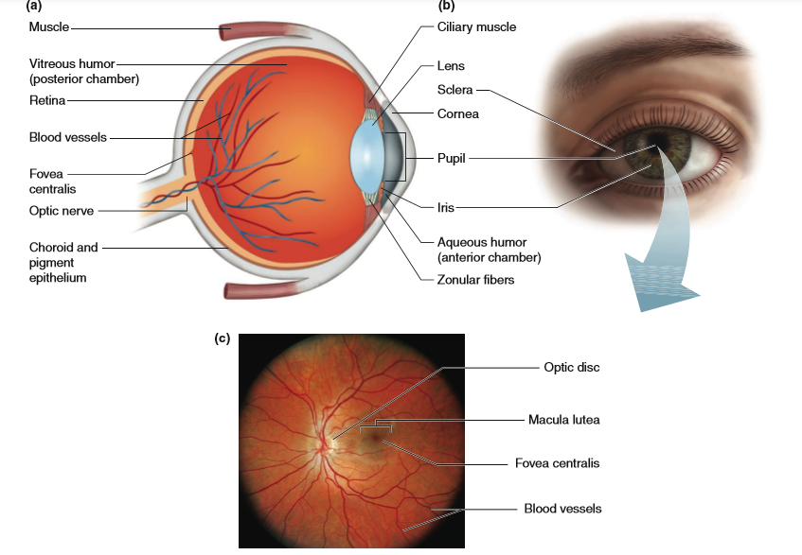

Slide 9
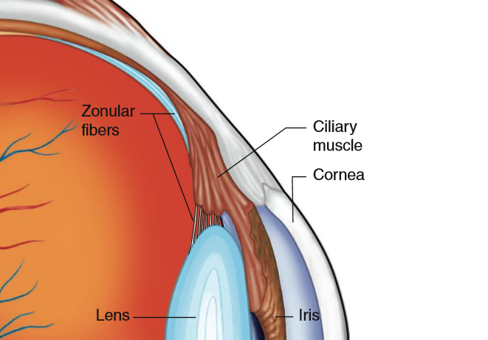

Slide 10
The Optics of Vision
When light waves diverging from a point on an object pass from air into the curved surfaces of the cornea and lens of the eye, they are refracted inward, converging back into a point on the retina.
Objects in the center of the field of view are focused onto the fovea centralis, with the image formed upside down and reversed right to left relative to the original source. One of the fascinating features of the brain, however, is that it restores our perception of the image to its proper orientation.

Slide 11
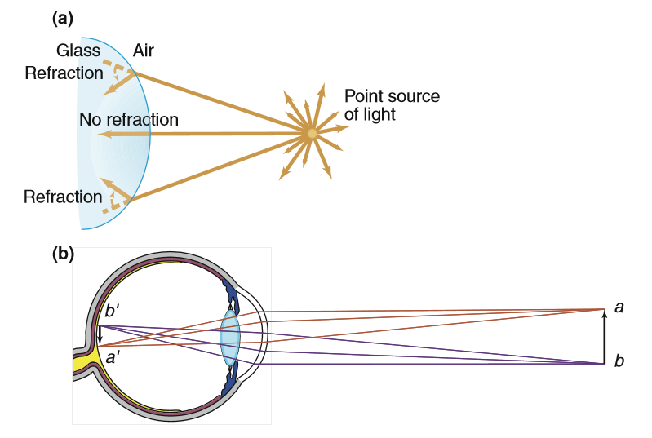

Slide 12
The cornea performs the greater part quantitatively of focusing the visual image on the retina, all adjustments for distance are made by changes in lens shape. Such changes are part of the process known as accommodation.
    The shape of the lens is controlled by the ciliary muscle and the tension it applies to the zonular fibers, which attach the ciliary muscle to the lens.
    To focus on distant objects, the ciliary muscle relaxes and the zonular fibers pull the lens into a flattened, oval shape.
    Contraction of the ciliary muscles focuses the eye on near objects by releasing the tension on the zonular fibers, which allows the natural elasticity of the lens to return it to a more spherical shape.
Cornea and lens shape and eyeball length determine the point where light rays converge.

Slide 13
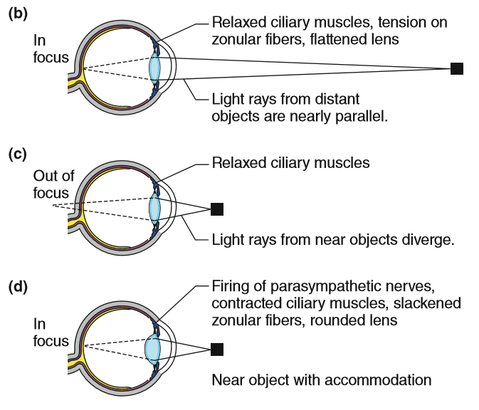

Slide 14
Photoreceptor Cells and Phototransduction
The retina, an extension of the central nervous system, contains photoreceptors and several other cell types that function in the transduction of light waves into visual information.

Slide 15
Photoreceptors:
  Photoreceptors function in the transduction of light waves into visual information.
  The two types of photoreceptors are called rods and cones.
    The rods are extremely sensitive and respond to very low levels of illumination.
    The cones are considerably less sensitive and respond only when the light is bright.

Slide 16
Absorption of Light by Photoreceptors:
    The photoreceptors contain molecules called photopigments, which absorb light.
    The photopigments of the rods and cones are made up of a protein component (opsin) and a chromophore (retinal, a derivative of vitamin A)
    Each photoreceptor may contain over a billion molecules of photopigment, providing an extremely effective trap for light

Slide 17
Sensory Transduction in Photoreceptors:
    The photoreceptor is unique because it is the only type of sensory cell that is relatively depolarized (about 235 mV) when it is at rest (i.e., in the dark)
    Hyperpolarized (to about 270 mV) in response to its adequate stimulus.

Slide 18
In Darkness
    Enzyme guanylyl cyclase converts GTP into cyclic GMP (cGMP). The cGMP opens ligand-gated cation channels leading to a persistent influx of Na and Ca
    Thus, in the dark, cGMP concentrations are high and the photoreceptor cell is maintained in a relatively depolarized state.

Slide 19
In Light
    In light, a cascade of events leads to hyperpolarization of the photoreceptor cell membrane.
    Energy from photons alters the shape of the opsin protein and promotes an interaction between the opsin and a protein called transducin.
    Transducin activates the enzyme cGMP-phosphodiesterase, which rapidly degrades cGMP.
    The decrease in cytoplasmic cGMP concentration allows the cation channels to close, and allows the membrane potential to hyperpolarize.

Slide 20
Neural Pathways of Vision
Light signals are converted into action potentials through the interaction of photoreceptors with bipolar cells and ganglion cells
Photoreceptors interact with bipolar and ganglion cells in two distinct ways, “ON-pathways” and “OFF-pathways.”

Slide 21
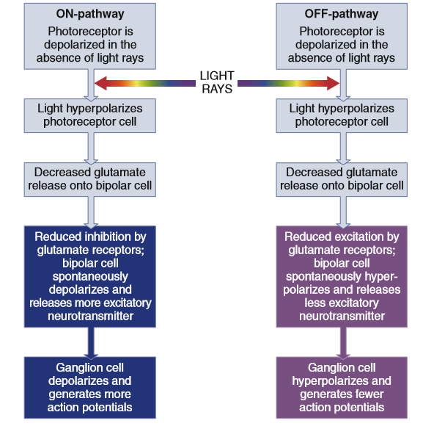

Slide 22
Output from Ganglion Cells
  The axons of the ganglion cells form the output from the retina—the optic nerve, which is cranial nerve II.
  The two optic nerves meet at the base of the brain to form the optic chiasm, where some of the axons cross and travel within the optic tracts to the opposite side of the brain, providing both cerebral hemispheres with input from each eye.

Slide 23
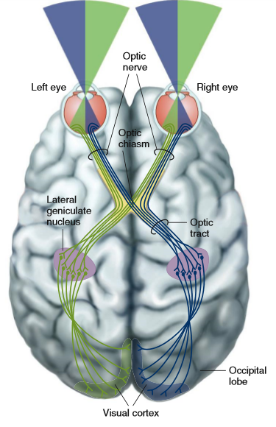

Slide 24
Color Vision
The colors we perceive are related to the wavelengths of light that the pigments reflect, absorb, or transmit
Color vision begins with activation of the photopigments in the cone photoreceptor
Retinas have three kinds of cones:
    Red cones : responding optimally at long wavelengths
    Green cones: medium wavelengths
    Blue cones: stimulated best at short wavelengths

Slide 25
Color Blindness
Color blindness results from a recessive mutation in one or more genes encoding the cone pigments
Men with red–green color blindness lack either the red or the green cone pigments entirely or have them in an abnormal form.
the discrimination between shades of these colors is poor.
Genes encoding the red and green cone pigments are located very close to each other on the X chromosome, whereas the gene encoding the blue chromophore is located on chromosome 7.

Slide 26
Common Diseases of the Eye
Cataract
  An opacity (clouding) of the lens due to the accumulation of proteins in the lens tissue.
  As the opacity of the lens progresses, significant blurring, loss of night vision, and difficulty focusing on nearby objects occur.

Slide 27
Glaucoma
  Retinal cells are damaged as a result of increased pressure within the eye.
  The aqueous humor forms faster than it is removed, which results in increased pressure within the eye.

